Slide 1
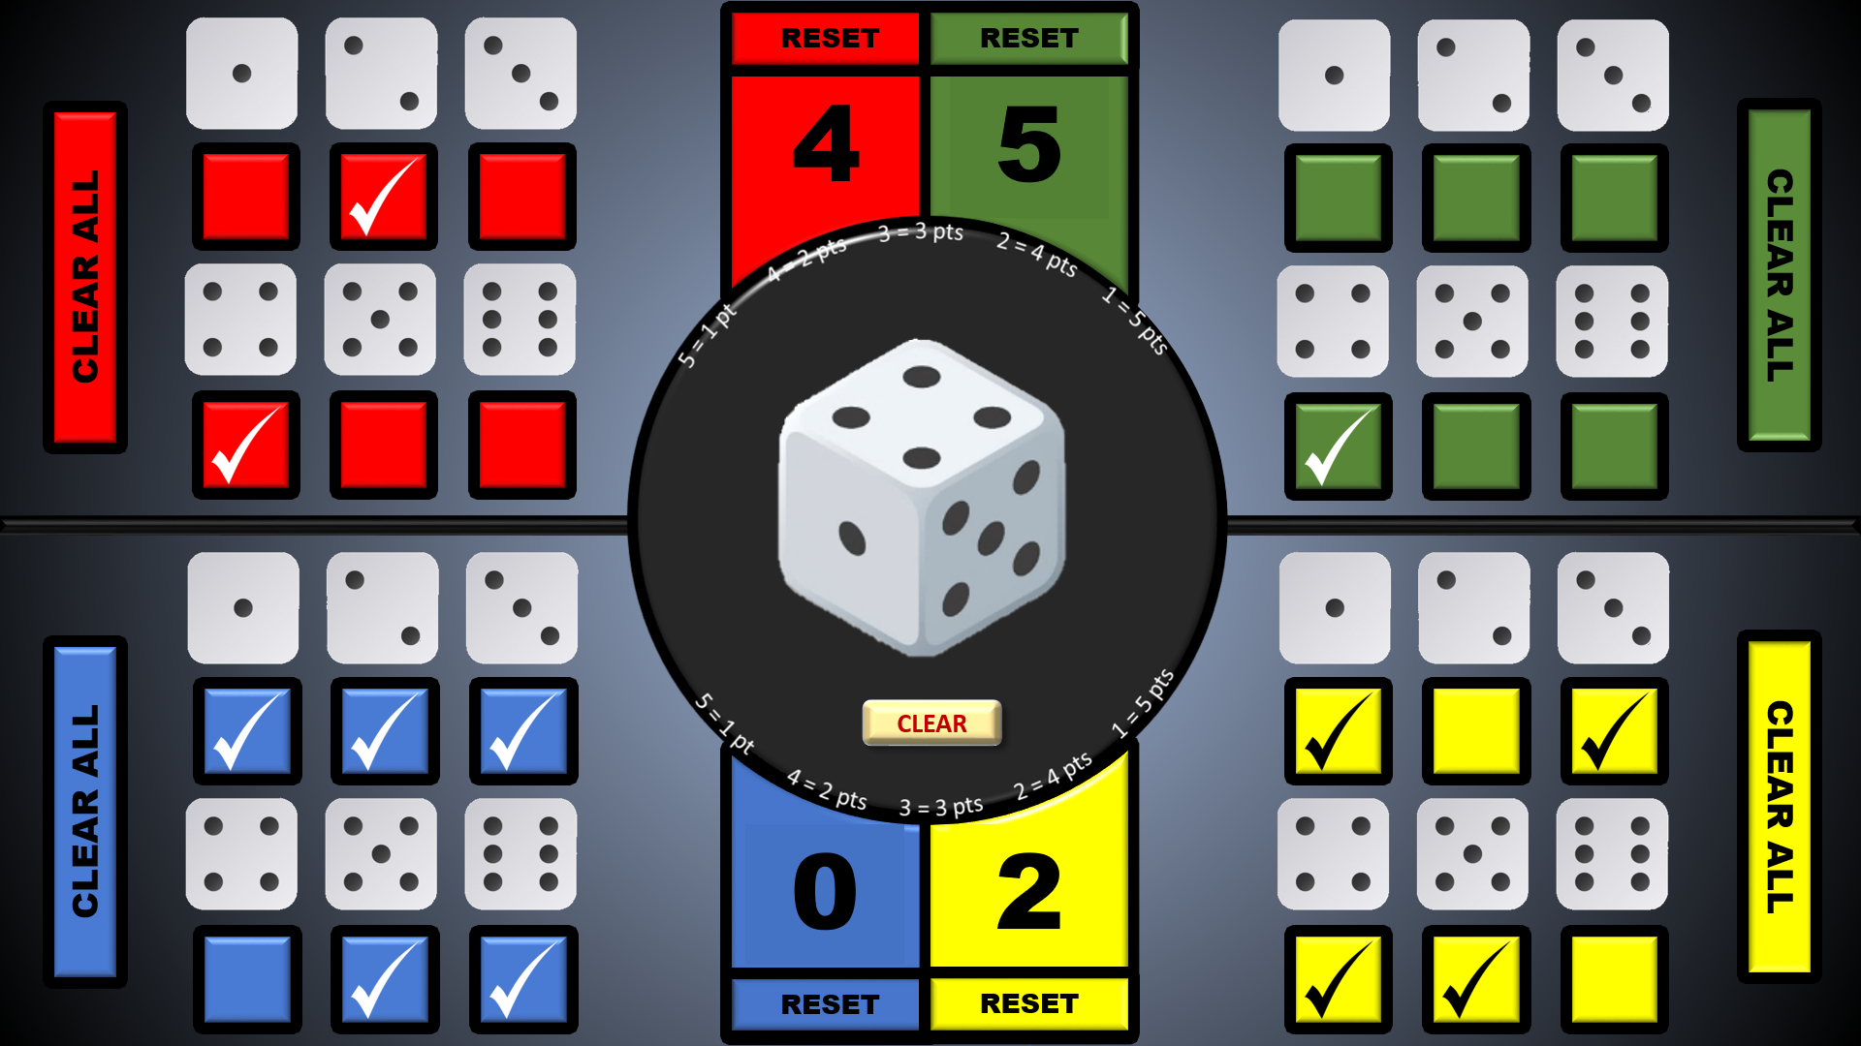
GAMEPLAY
Each player clicks on their boxes
One player clicks on the dice to make the throw
When the dice number is revealed, players click on their scoring boxes depending on the number of points scored
e.g. 4 points = 4 clicks to advance the score
Click on the ‘CLEAR’ button below the dice to re-set it for the next throw
Click on the ‘CLEAR ALL’ buttons to remove the check marks, ready for the next round (Clicking an individual check mark will also remove it)
When a player has won the game, click on the ‘RESET’ buttons to re-set the scores and either play another game or press the ‘Esc’ key to exit
Click on the coloured boxes to show a check mark beneath the dice numbers that you hope the dice throw will show.
You can click up to 5 boxes.
A dice game with echoes of roulette for 2 - 4 players with each player taking one of the four colours in each quadrant (or you can play against yourself)
If you click on just 1 box, and the dice number above it is thrown, you get 5 points.
Click on 2 boxes and if one of your selected numbers is thrown, you get 4 points and so on as per the table below:
1 checked 1 correct = 5 points
2 checked 1 correct = 4 points
3 checked 1 correct = 3 points
4 checked 1 correct = 2 points
5 checked 1 correct = 1 point
No checked numbers correct = 0 points
(See picture for examples)
The winner is the first player to reach 20 points

Slide 2
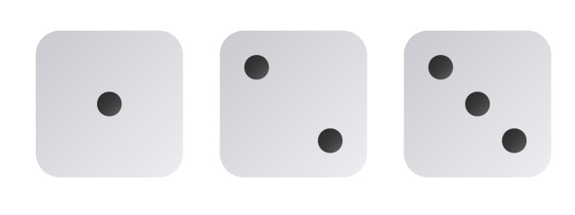
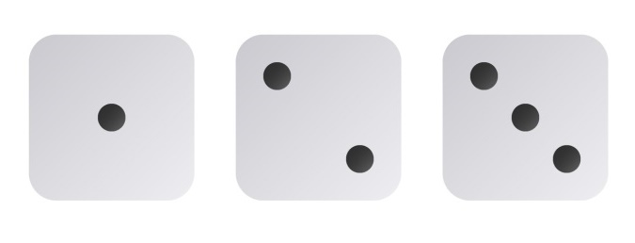
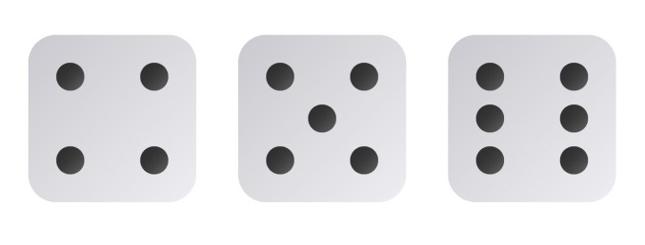
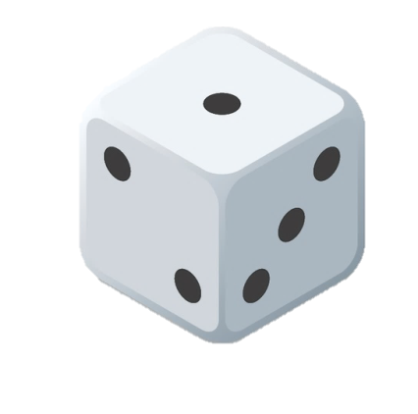
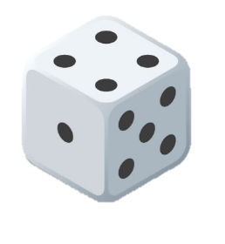
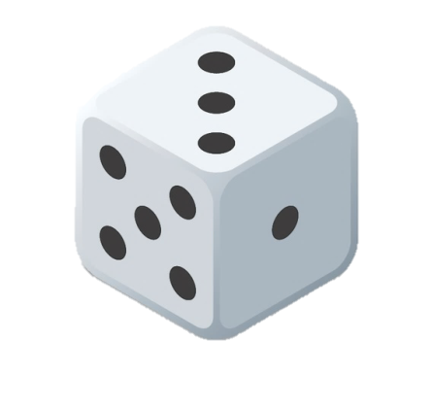
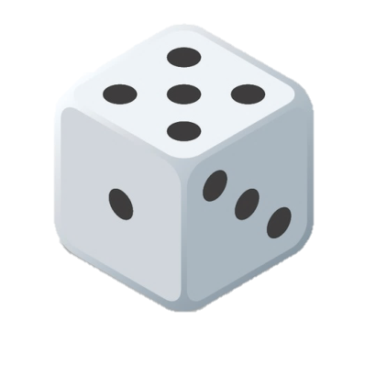
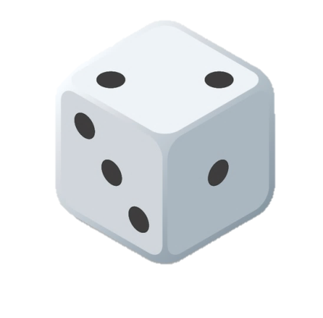
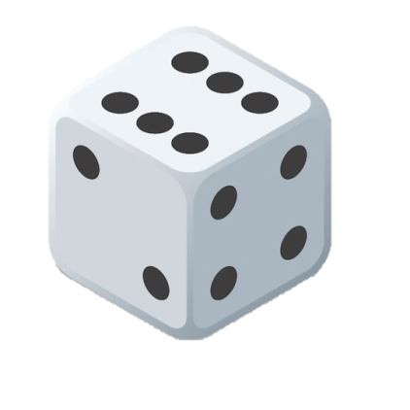
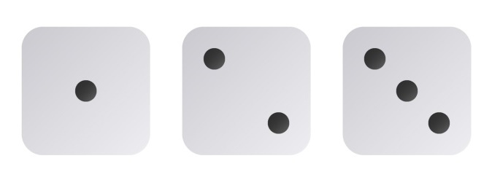
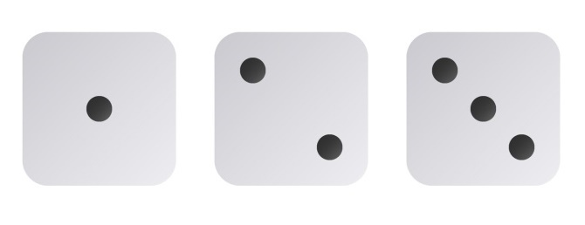
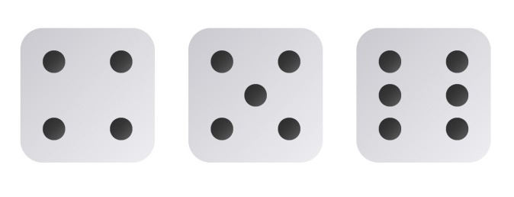
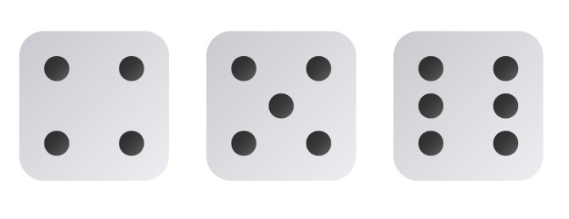
RESET
RESET
20
19
18
17
16
15
14
13
12
11
10
9
8
7
6
5
4
3
2
1
0
20
19
18
17
16
15
14
13
12
11
10
9
8
7
6
5
4
3
2
1
0
CLEAR ALL
CLEAR ALL
CLEAR ALL
CLEAR ALL
CLEAR
20
19
18
17
16
15
14
13
12
11
10
9
8
7
6
5
4
3
2
1
0
20
19
18
17
16
15
14
13
12
11
10
9
8
7
6
5
4
3
2
1
0
RESET
RESET

