Slide 1
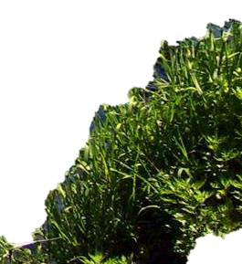
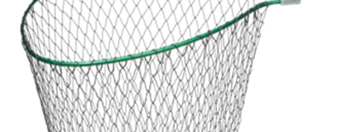

Slide 2
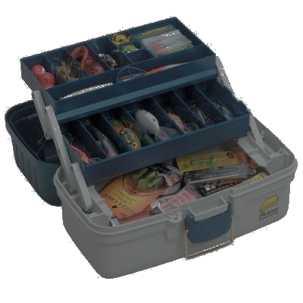

Slide 3
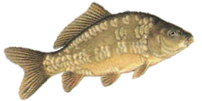
Strike!
Try somewhere else
Strike!

Slide 4
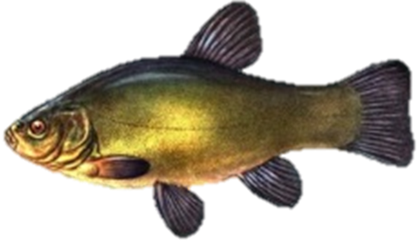
Strike!
Try somewhere else
Strike!

Slide 5
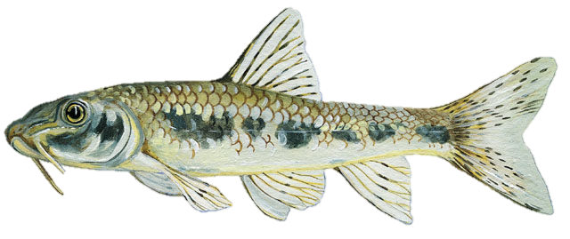
Strike!
Try somewhere else
Strike!
Try somewhere else

Slide 6
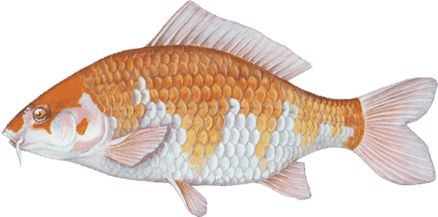
Strike!
Try somewhere else
Strike!
Try somewhere else

Slide 7
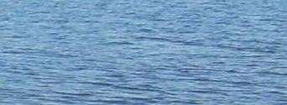
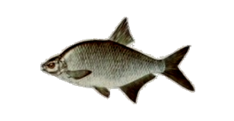
Strike!
Strike!
Try somewhere else

Slide 8
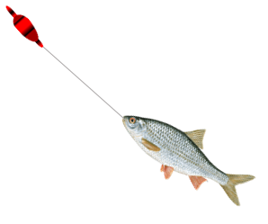
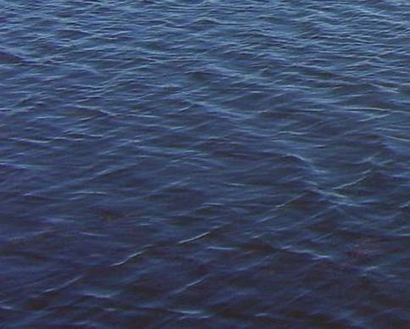
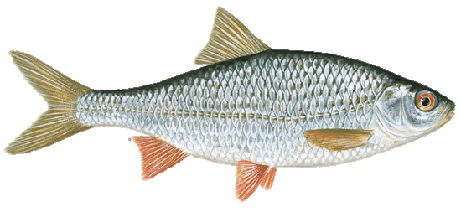
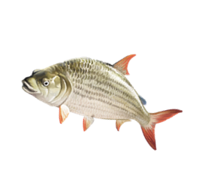
Strike!
Try somewhere else
Strike!

Slide 9
Strike!
Try somewhere else

Slide 10
Strike!
Try somewhere else

Slide 11
Strike!
Try somewhere else

Slide 12
Strike!
Try somewhere else
Try somewhere else

Slide 13
Strike!
Try somewhere else
Try somewhere else

Slide 14
Strike!
Try somewhere else
Try somewhere else

Slide 15
Strike!
Try somewhere else
Try somewhere else

Slide 16
Strike!
Try somewhere else
Try somewhere else

Slide 17
Strike!
Try somewhere else
Try somewhere else

Slide 18
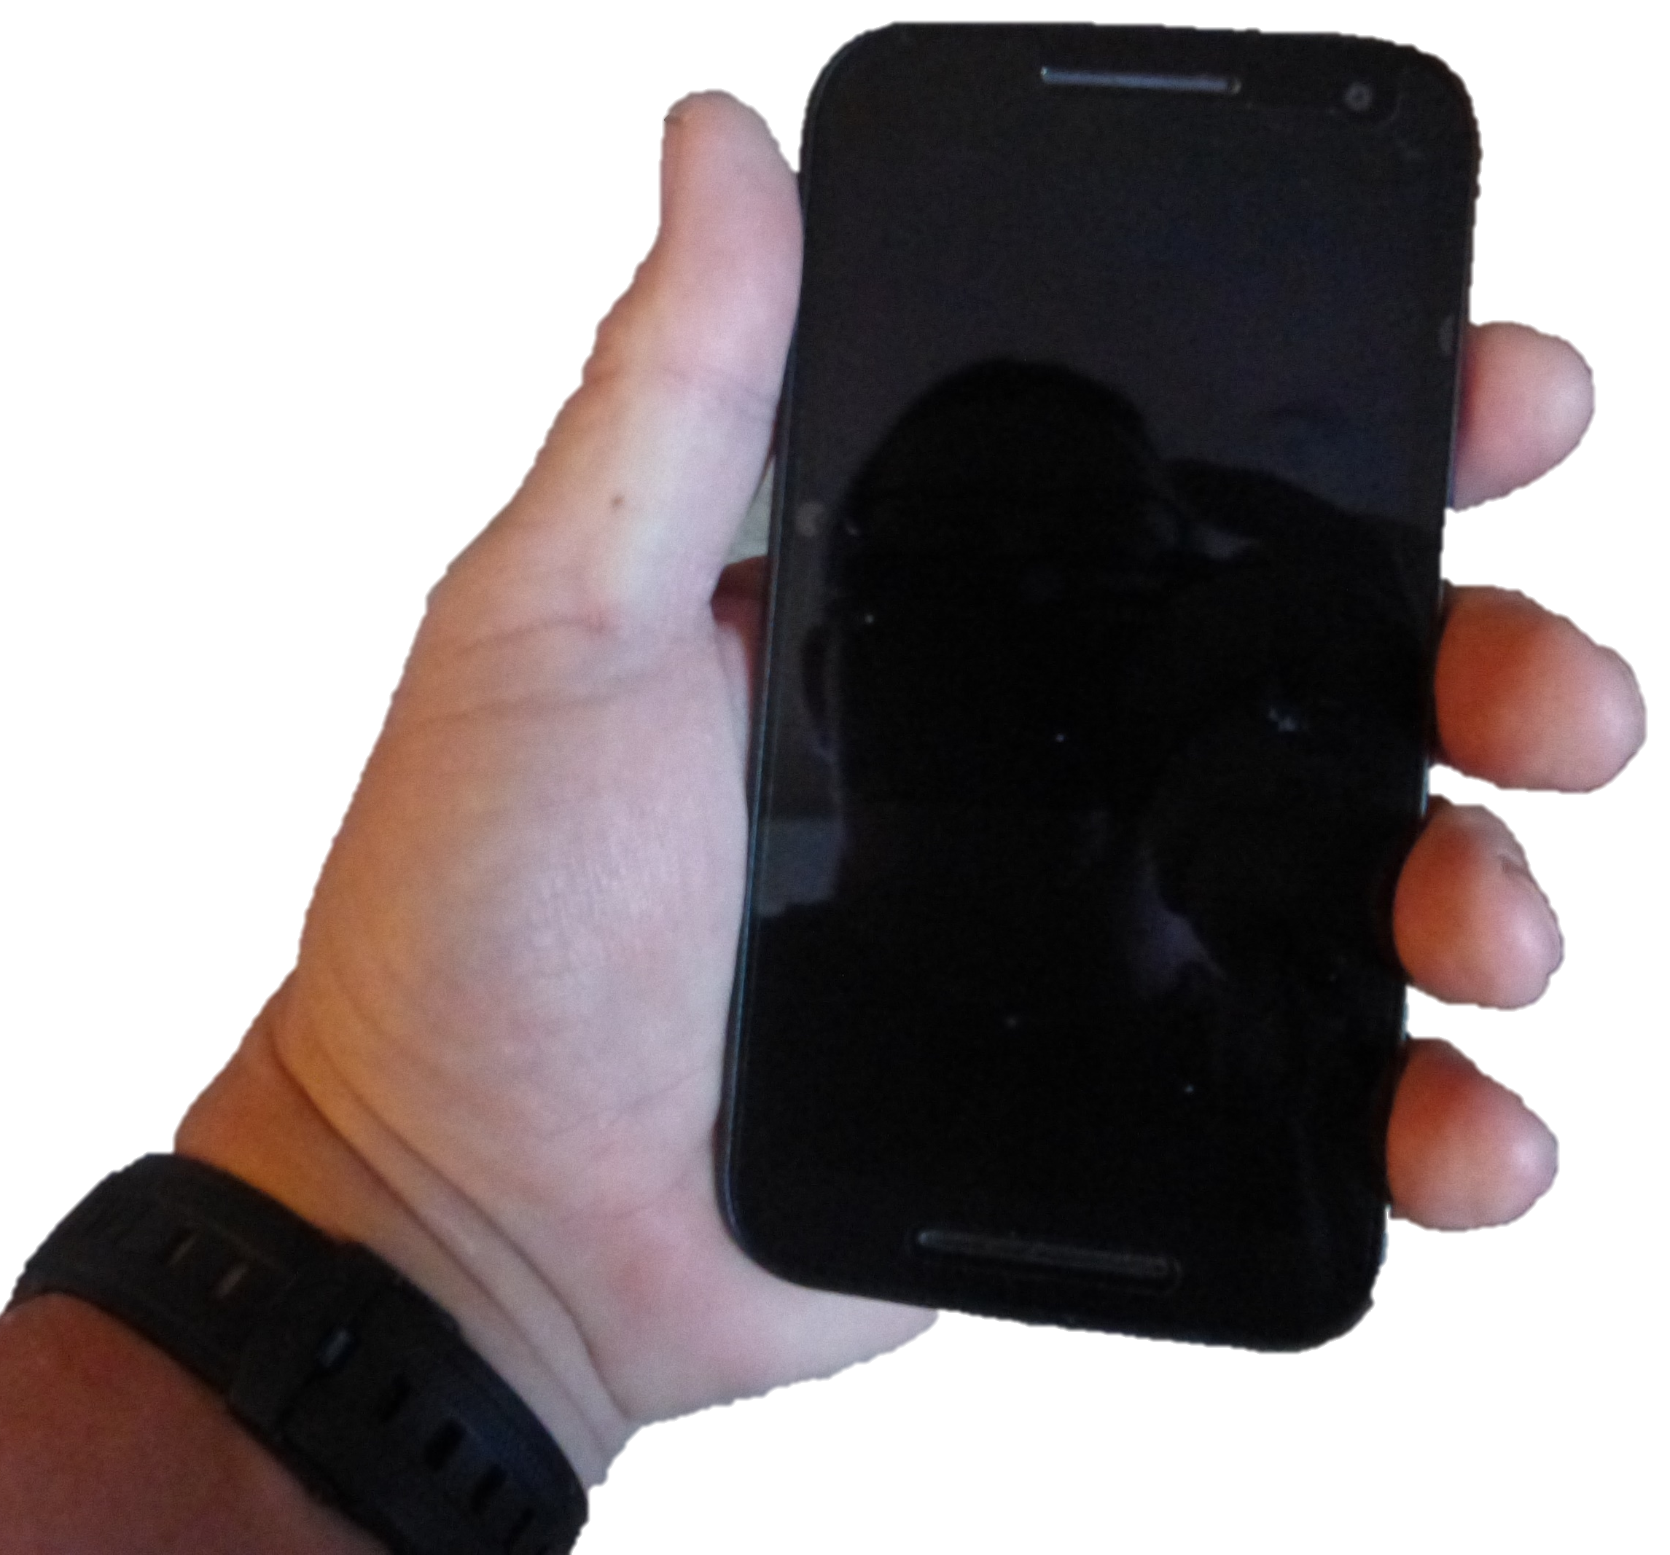
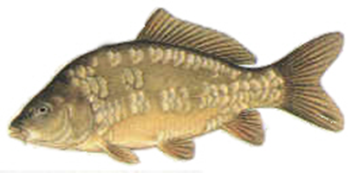
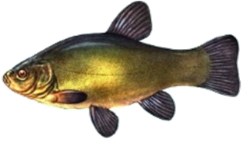
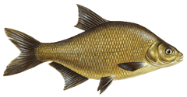
Mirror Carp
Tench
Gudgeon
Koi Carp
Bream
Roach
Fish some more

