Slide 1
happy
SHOW

Slide 2
sick
SHOW

Slide 3
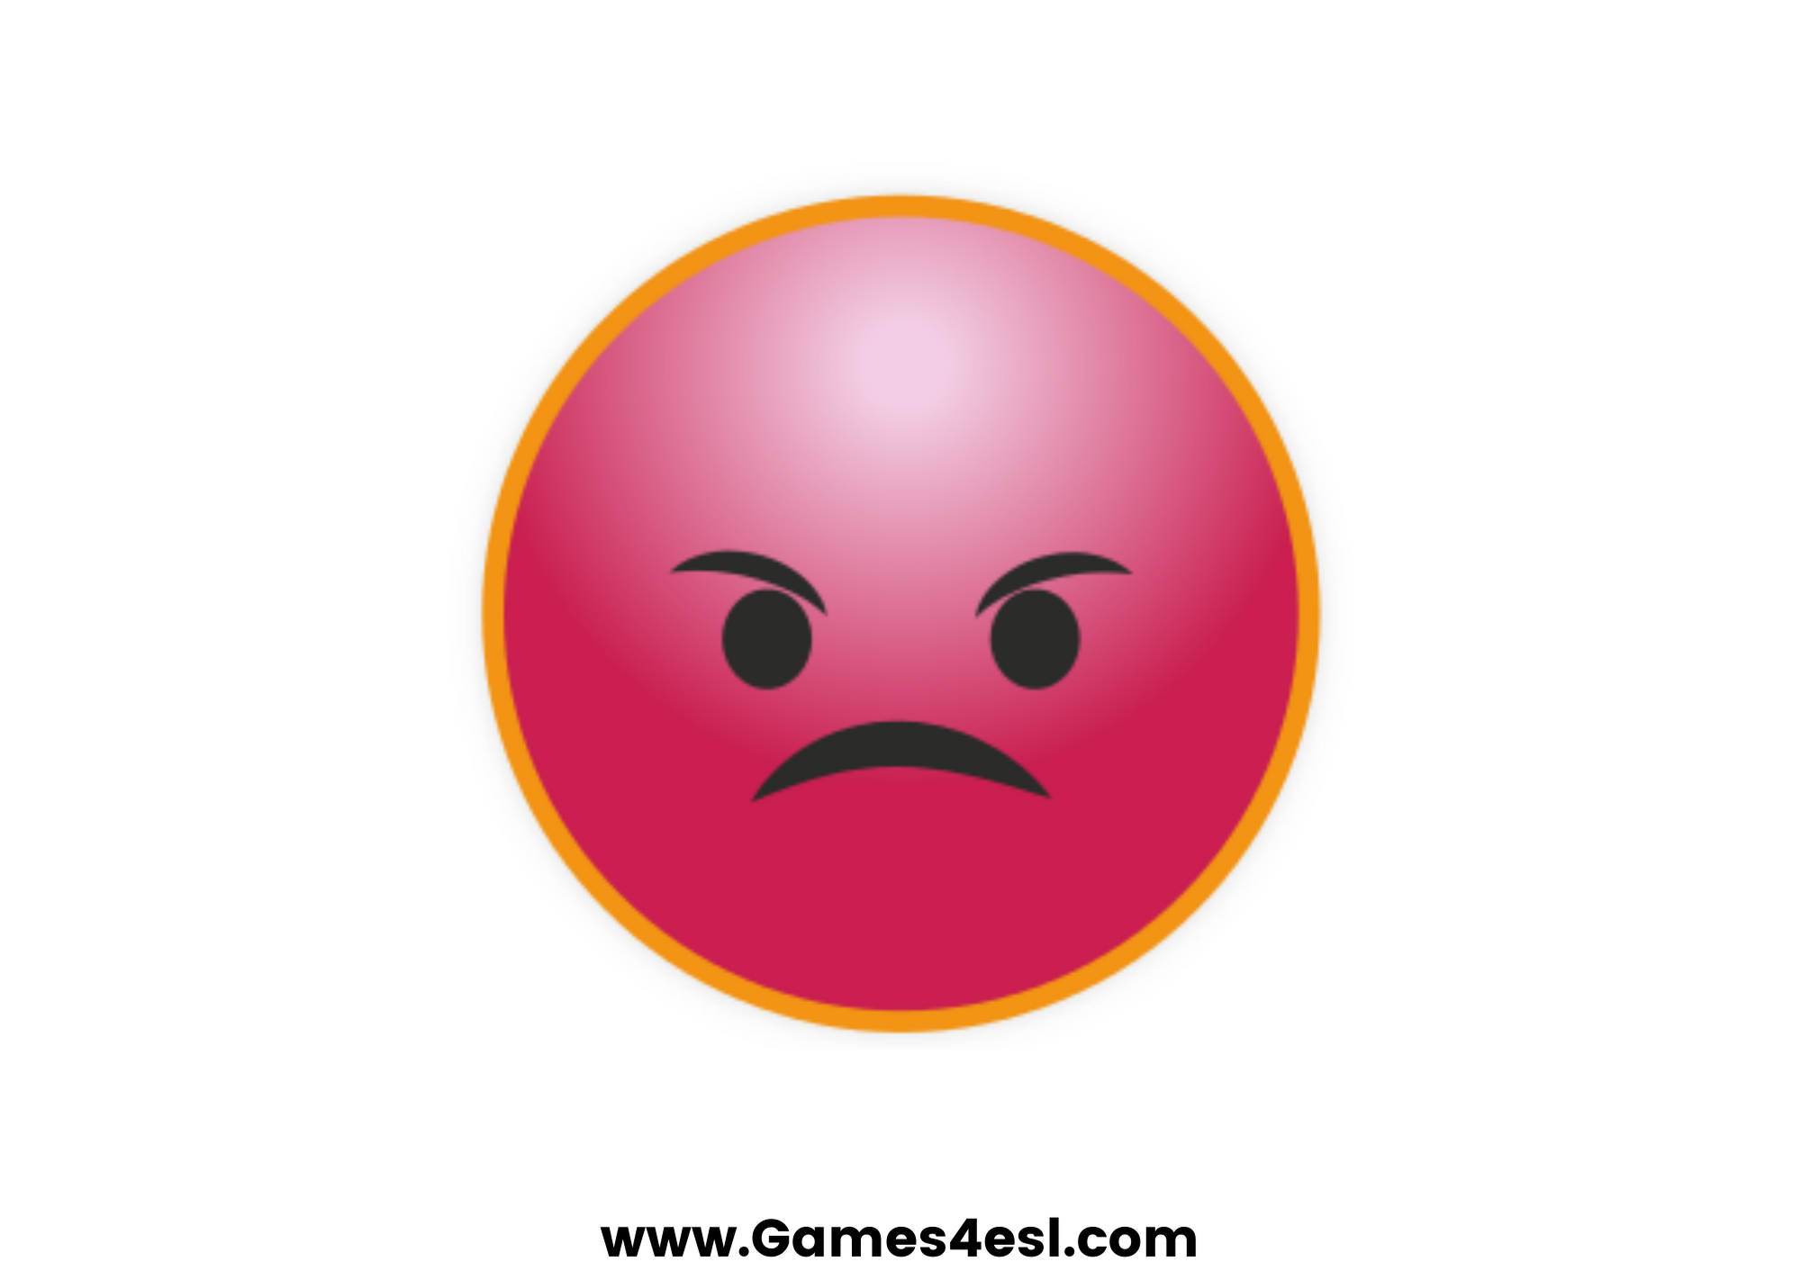
angry
SHOW

Slide 4
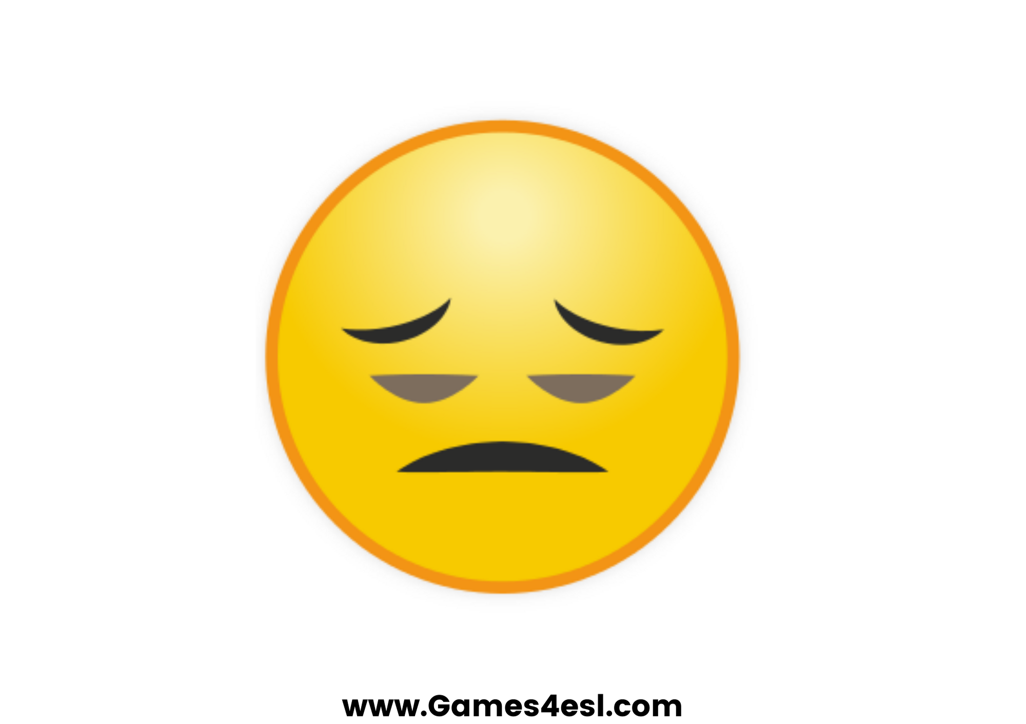
tired
SHOW

Slide 5
hungry
SHOW

Slide 6
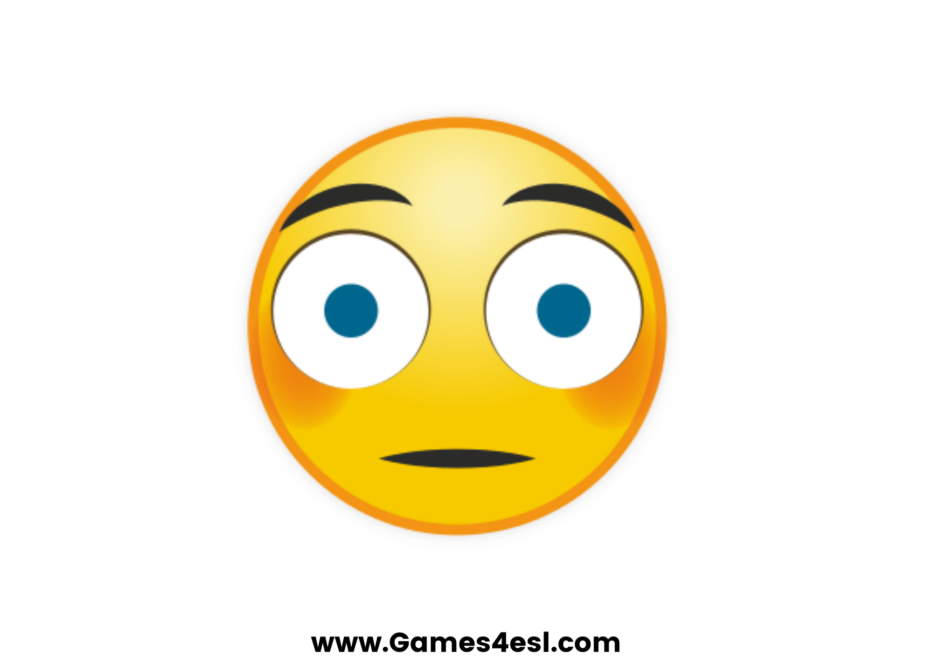
scared
SHOW

Slide 7
bored
SHOW

Slide 8
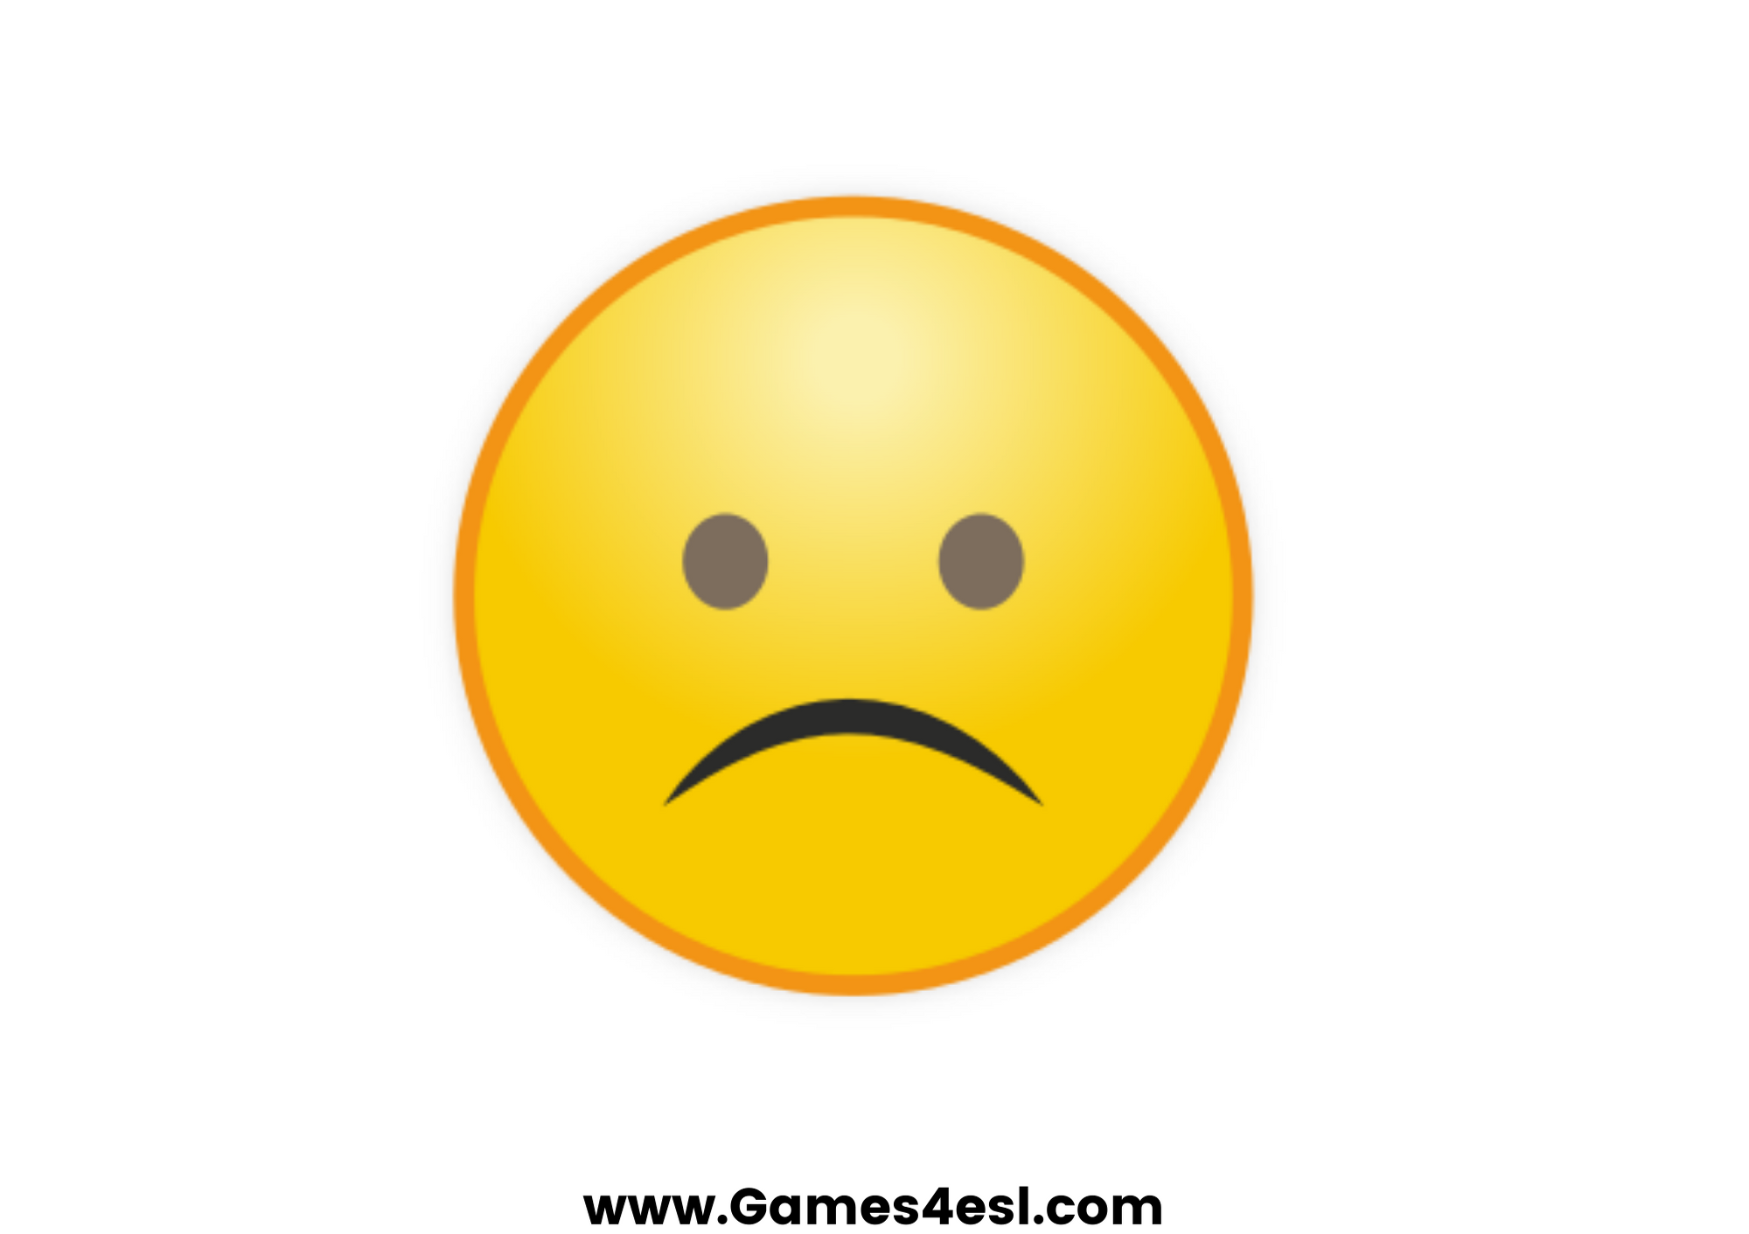
sad
SHOW

