Slide 1
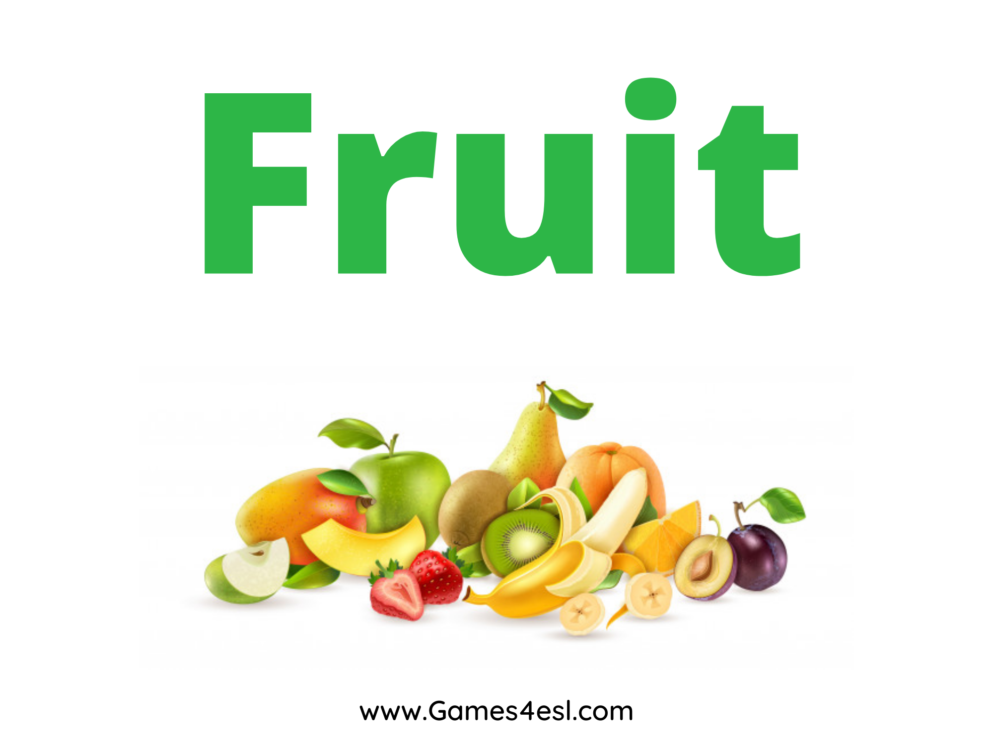

Slide 2
lemon
SHOW

Slide 3
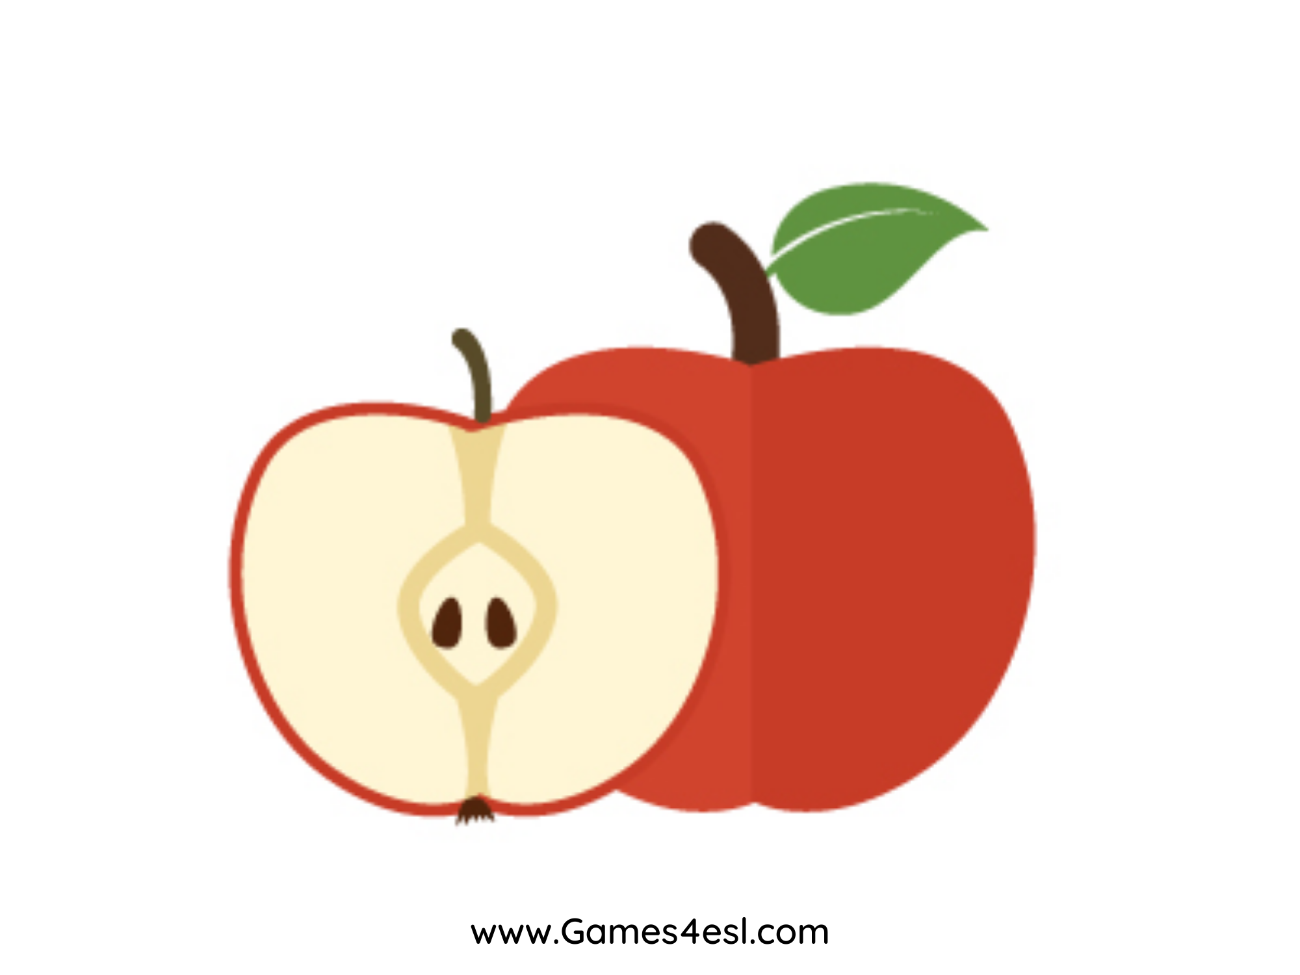
apple
SHOW

Slide 4
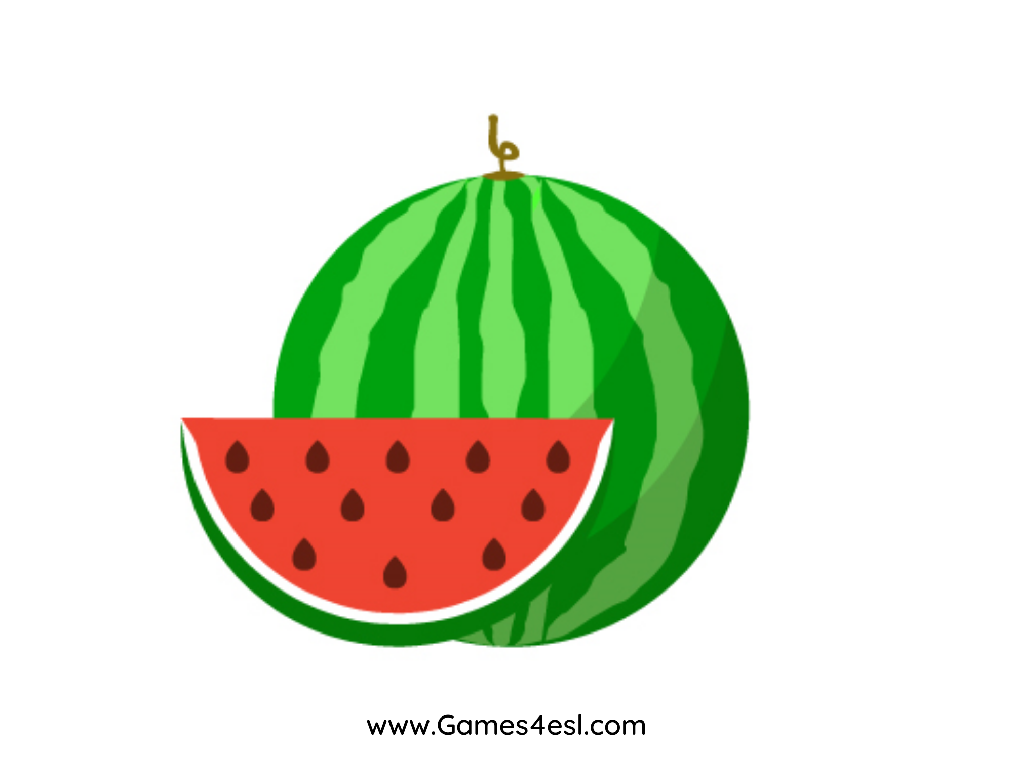
watermelon
SHOW

Slide 5
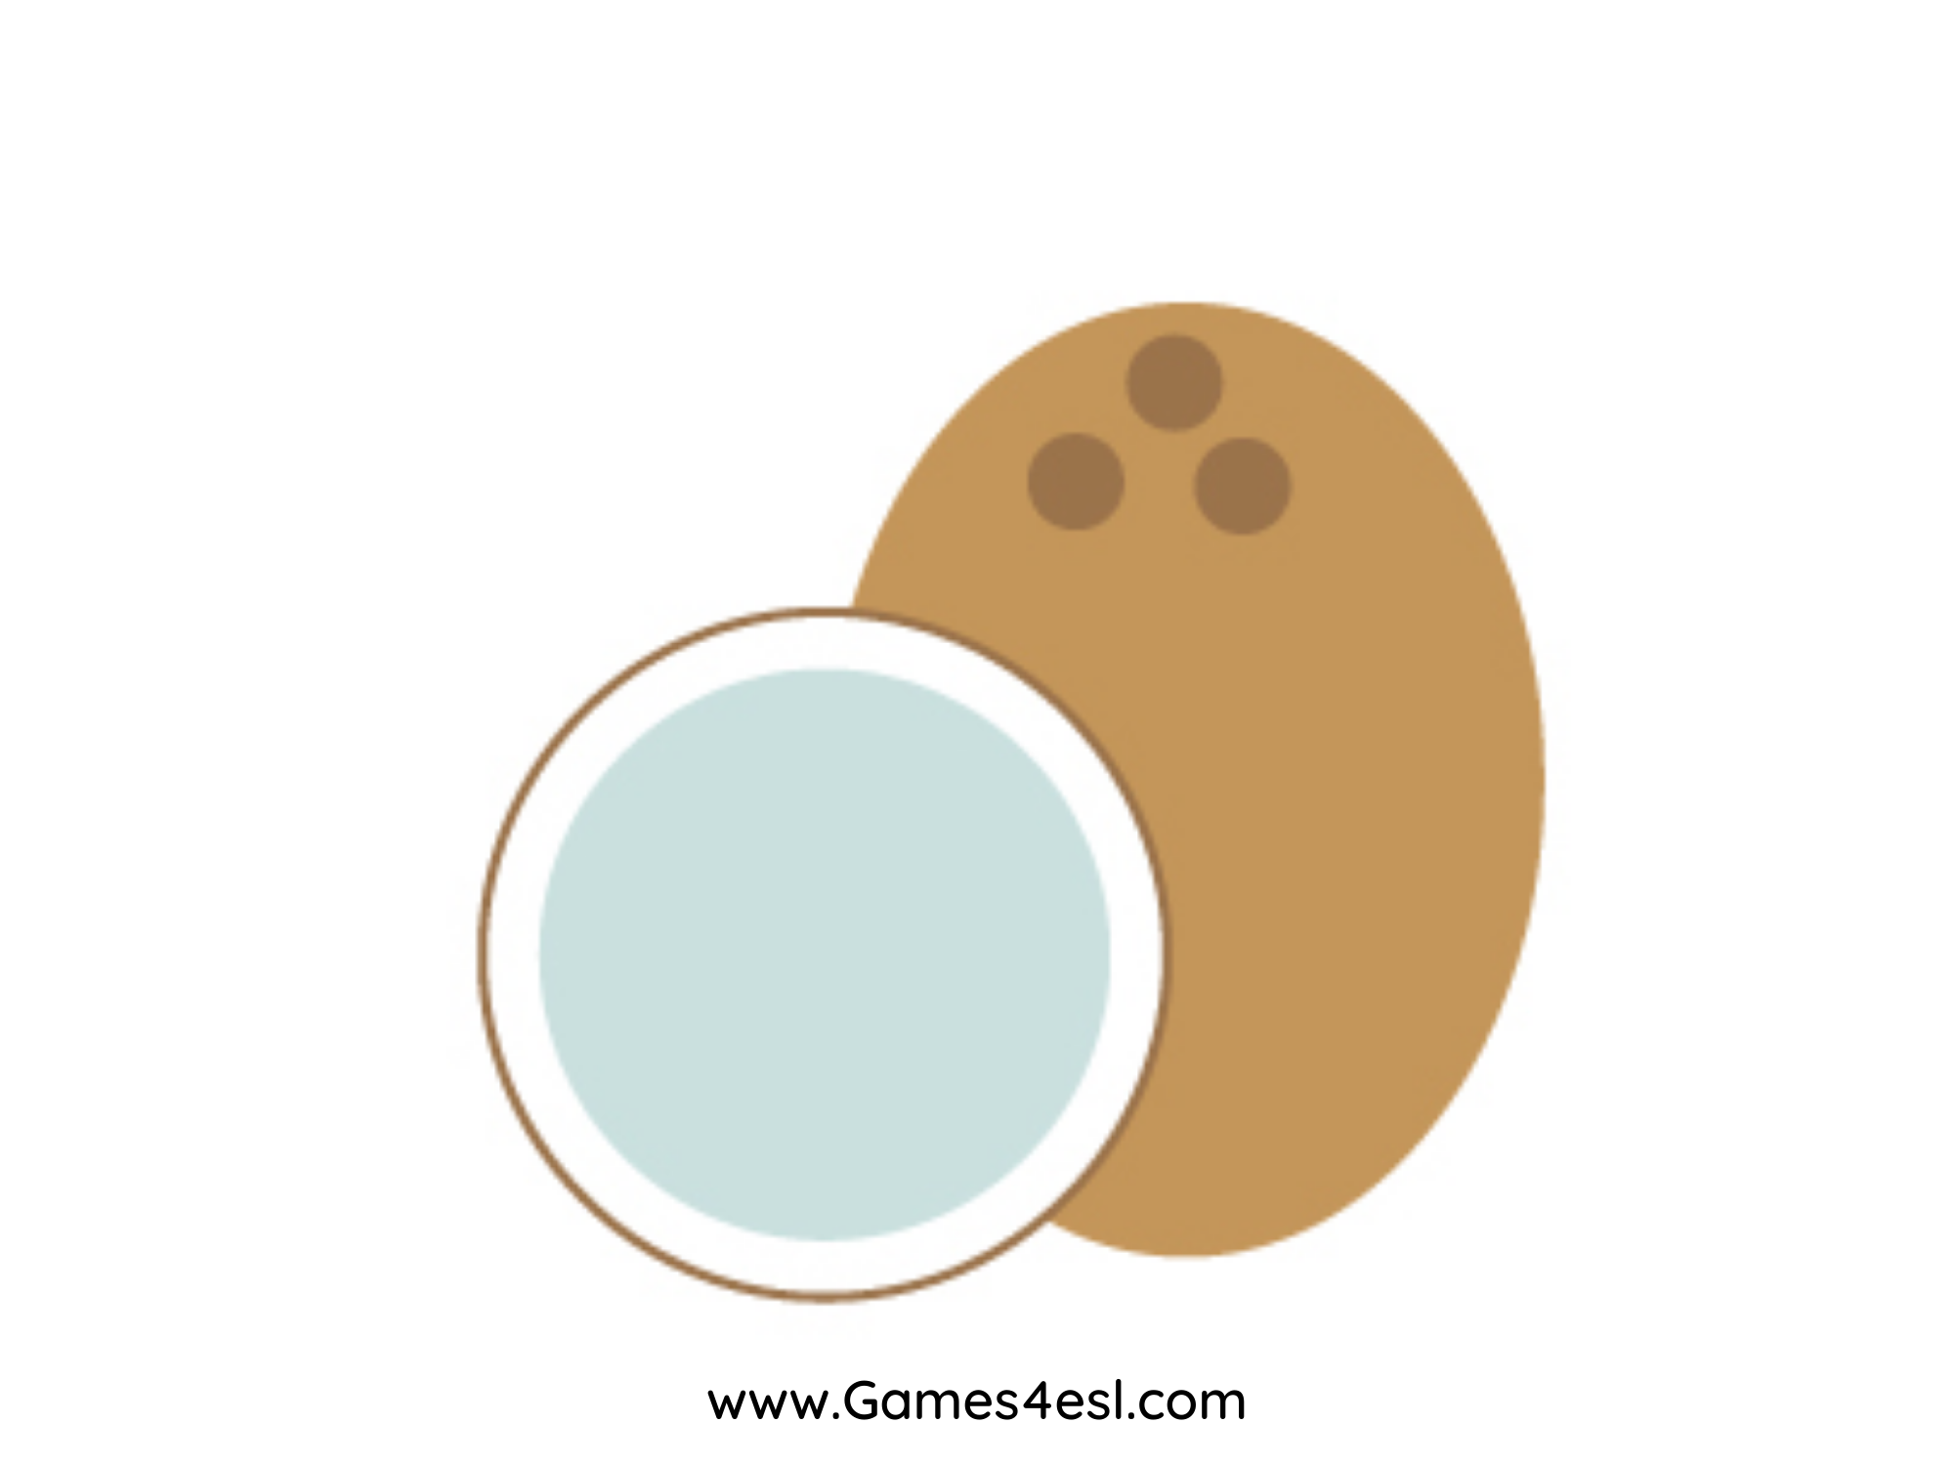
coconut
SHOW

Slide 6
strawberry
SHOW

Slide 7
pear
SHOW

Slide 8
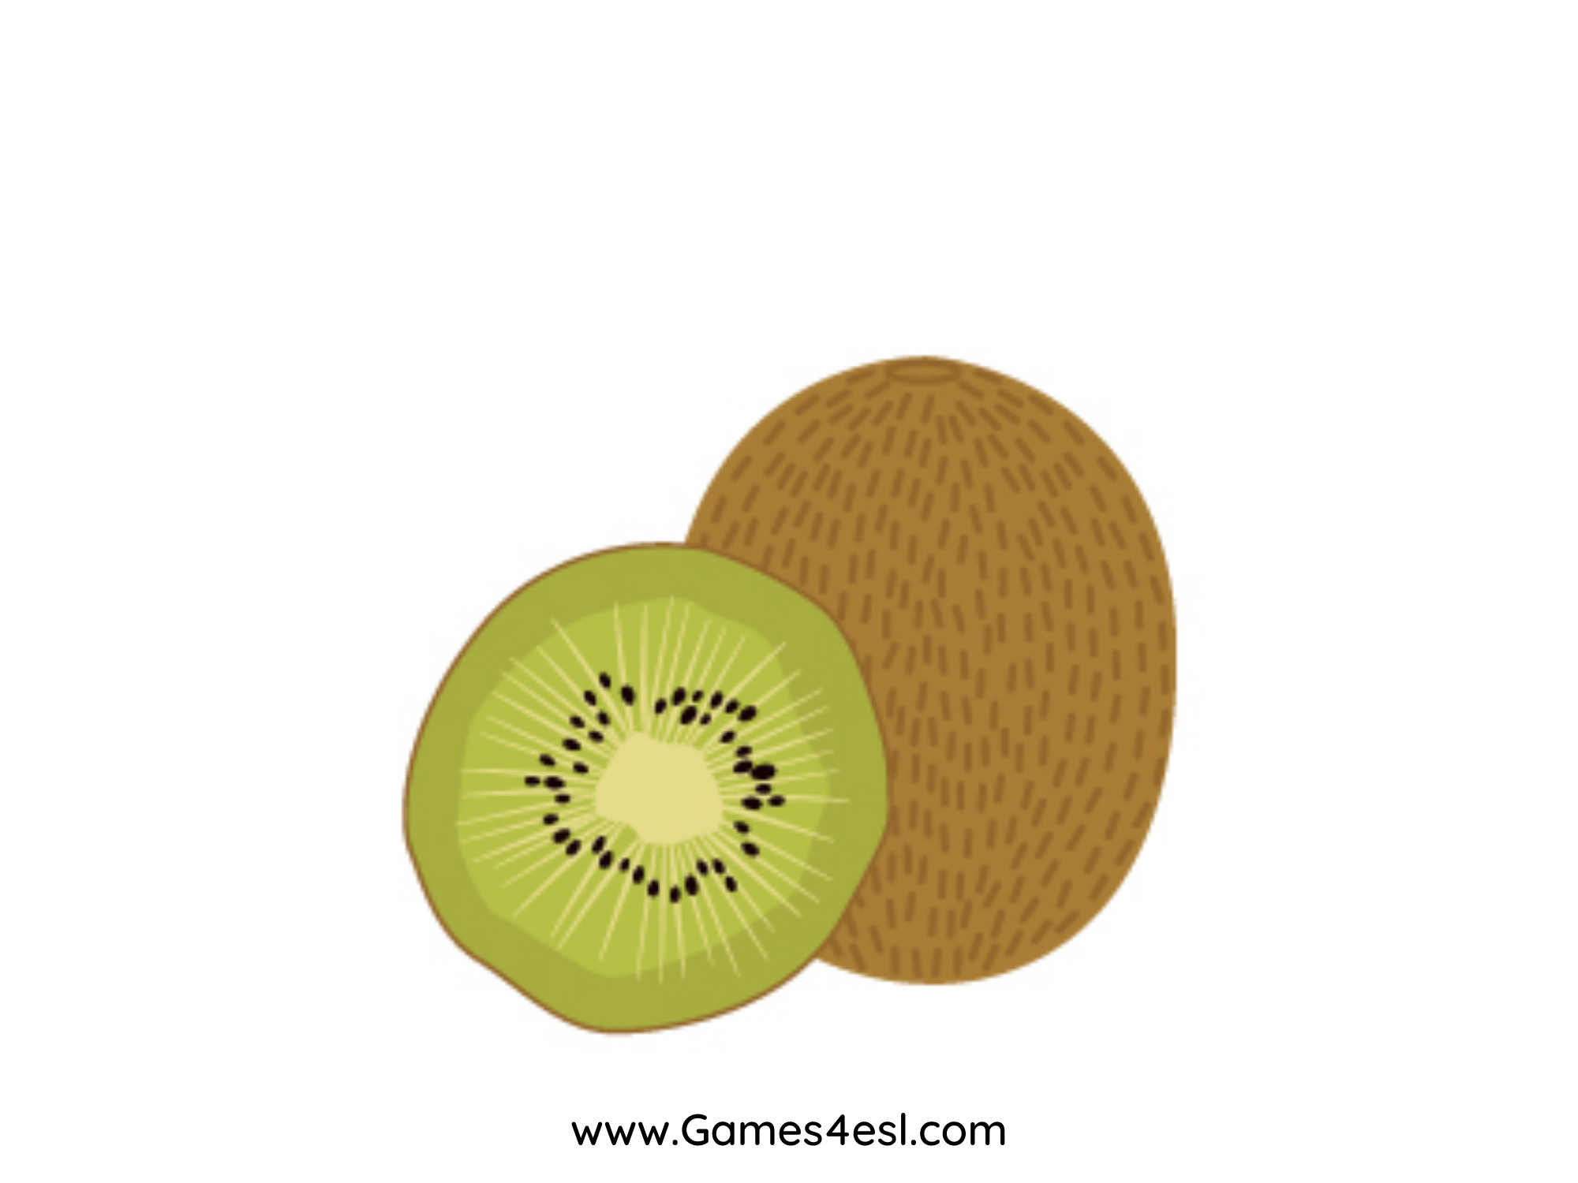
kiwi
SHOW

Slide 9
orange
SHOW

