Slide 1
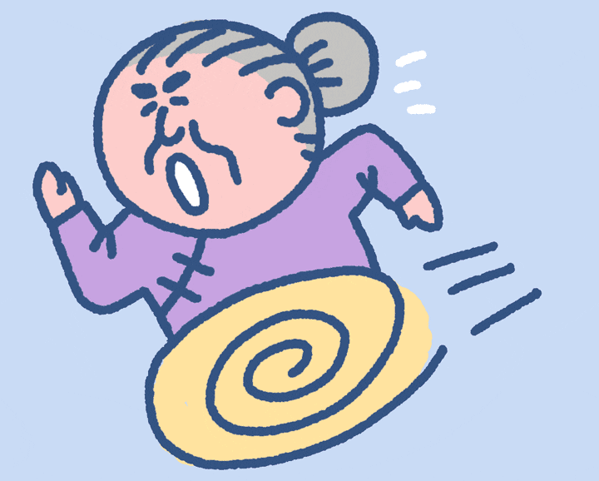
Get grandma home! Start

Slide 2
You got grandma home safely! Now she is happy!

Slide 3
You got grandma home safely! Now she is happy!

Slide 4
You got grandma home safely! Now she is happy!

Slide 5
You got grandma home safely! Now she is happy!

Slide 6
You got grandma home safely! Now she is happy!

Slide 7
You got grandma home safely! Now she is happy!

Slide 8
You got grandma home safely! Now she is happy!

Slide 9
You got grandma home safely! Now she is happy!

Slide 10
You got grandma home safely! Now she is happy!

Slide 11
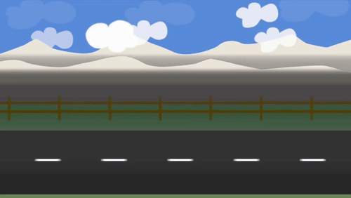
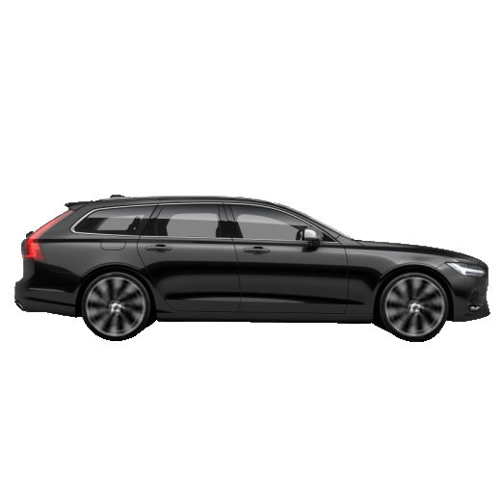
How __________do you want? - Six, please.
many
much
any

Slide 12
Maja has __________rice.
many
so much
very

Slide 13
__________ apples have you got?
any
how much
how many

Slide 14
_________ milk is there in the fridge?
how much
how many
is there a

Slide 15
I haven't got ____ oranges.
some
any
was

Slide 16
How ______ sugar have you got?
must
much
many

Slide 17
John has got ______ peaches.
a
some
any

Slide 18
John hasn't got ______ peaches.
an
a
any

Slide 19
________ dogs are there in your house?
a
how many
how much

Slide 20
Are there _____ onions?
any
a
an

Slide 21
There are _____ oranges.
any
some
a

Slide 22
Have we got _____ salt?
a
any
an

Slide 23
We haven't got _____ bananas.
all
any
no

Slide 24
There is _____ apple on the table.
is
a
an

Slide 25
How ....... keyboards are there?
must
many
much

Slide 26
I have ... time. Hurry up!
much
few
little

Slide 27
Will you give me ... water? I am thirsty
a little
a few
none

Slide 28
He has ... friends. He is very lonely
none
no
any

Slide 29
I know ... Italian words. I can help you!
some
any
much

Slide 30
It was freezing. Brrr! Only ... people were walking.
an
much
a few

Slide 31
There is ... food in the fridge. It is almost empty
little
lots of
many

Slide 32
I know ... cities and countries. I had 5 geography lessons!
no
many
much

Slide 33
I know ______ bit of Vietnamese
much
a little
not

Slide 34
There are ____ apples in the firdge
a
any
some

Slide 35
There aren't____ car parks in the centre of Oxford
none
any
much

Slide 36
Liverpool has ______ great nightclubs.
some of
many of
a lot of

Slide 37
'Much' is used with
countable
uncountable
both

Slide 38
'many' is used with
countable
uncountable
both

Slide 39
You lost. Now grandma is crying.

