Slide 1
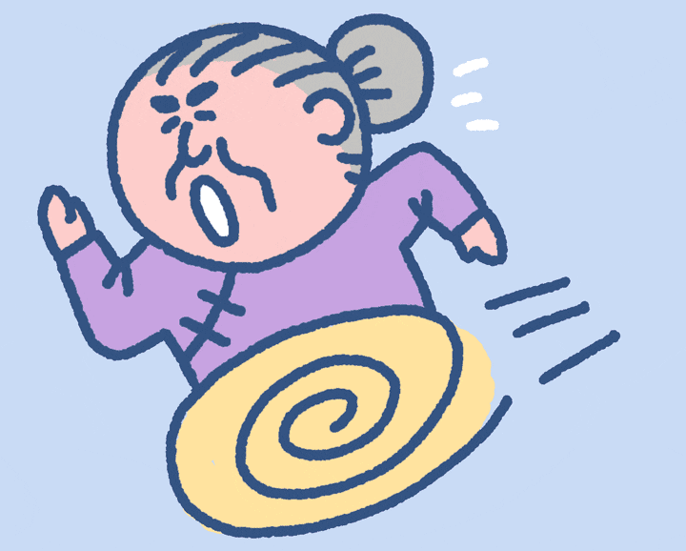
Get grandma home! Start

Slide 2
You got grandma home safely! Now she is happy!

Slide 3
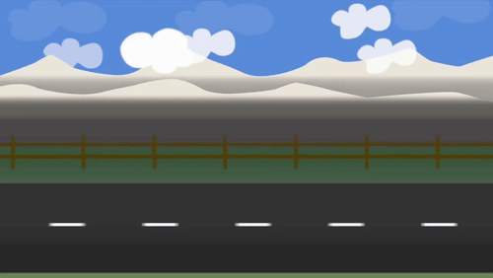
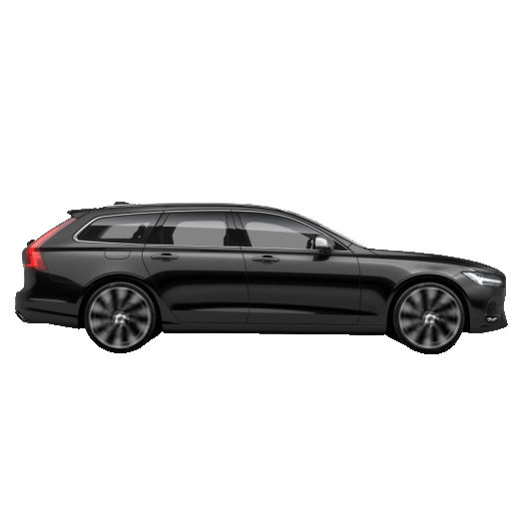
I ____ got a big nose!
have
has
had

Slide 4
He ____ got a packet of crisps.
have
has
had

Slide 5
She ____ got some candy.
had
have
has

Slide 6
They ____ got some sweets.
have
had
has

Slide 7
I ____ got a new book.
has
have
had

Slide 8
You ____ got something on your face.
has
have
had

Slide 9
We ____ got to get to class now!
has
have
had

Slide 10
John and Sarah ___ both got new bags.
had
has
have

Slide 11
John ___ got a a ball.
have
has
had

Slide 12
____ you got any milk?
have
had
has

Slide 13
____ he seen the movie?
have
has
had

Slide 14
____ I got enough money left?
has
have
had

Slide 15
____ Steve gone to work yet?
have
has
had

Slide 16
____ we got any milk in the fridge?
had
has
have

Slide 17
I ____ got any money!
has
haven't
hasn't

Slide 18
You _____ seen a ball around here, have you?
hasn't
has
haven't

Slide 19
We ____got enough people to play football.
haven't
hasn't
has

Slide 20
He _____ been to school in three days!
haven't
hasn't
have

Slide 21
She _____ seen the movie yet?
hasn't
has
have

Slide 22
John _____ arrived to class yet.
haven't
has to
hasn't

Slide 23
I ____ got a pencil case.
have
hasn't
has

Slide 24
He ____ got a book.
have
has
haven't

Slide 25
She ___ gone to work early.
haven't
has
have

Slide 26
They ____ got any balloons for the party.
hasn't
has
haven't

Slide 27
We _____ seen anybody yet.
hasn't
haven't
has

Slide 28
I _____ to go home now.
hasn't
has
have

Slide 29
John ____ a pet cat.
hasn't
has
haven't

Slide 30
John and Dave _____ got any food at home.
haven't
has
hasn't

Slide 31
You lost. Now grandma is crying.

