Slide 1
Start
Click for music --->

Slide 2
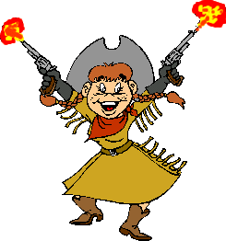
A dog is ______ than a cat
big
bigger
biggest
A cat is _____ than a dog
smaller
small
smallest
Ice is _____ water
colder than
colder
cold
A cheetah is faster _____ a horse.
than
that
with

Slide 3
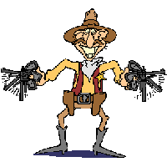
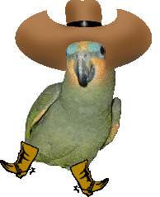
Mt Everest is the ________ mountain in the world
taller than
tallest
taller
The cheetah is __ _______ land mammal
faster
the fastest
fastest
The nile is ____ longest river in the world
than
a
the
This question is ____ ________ one.
hard
the hardest
the hard

Slide 4
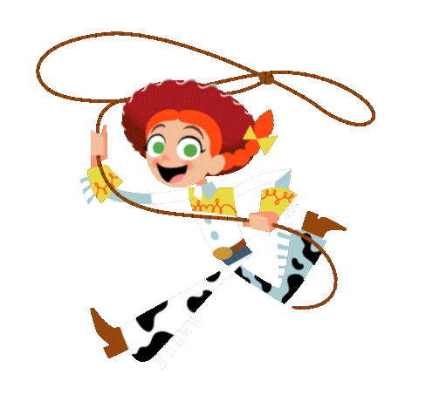
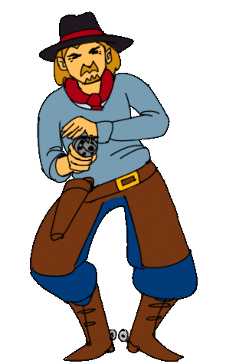
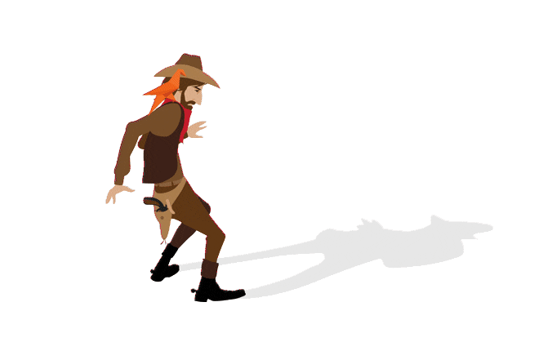
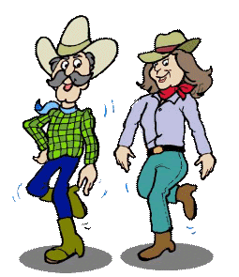
This is is bad, but that is so much _______!
worse
badder
awful
This is good, but that is so much _____!
better
gooder
great
This is the ______ meal I've ever eaten!
most good
goodest
best
It hurt so much! It was the _____ pain I'd ever felt!
most bad
baddest
worst

Slide 5
Football is ___ _____ than maths!
funly
more fun
funner
Maths is ____ _____ than football.
less fun
not fun
funless
A cat is _____ _____ than an elephant.
less big
less bigger
not big
They are the same height. They are both ___ _____ ____ eachother!
as tall as
taller than
taller as

Slide 6
A butterfly is ____ ______ than a slug!
pretty
more beautiful
beautifuller
A swan is _____ than a rat!
prettier
pretty
prettyer
A parrot is ___ ________ than a pigeon!
more colourful
more colour
colourfuler
A donkey is ____ ____ a horse
slower than
slowest
slower as

Slide 7
A dog is ______ than a cat
big
bigger
biggest
A cat is _____ than a dog
smaller
small
smallest
Ice is _____ water
colder than
colder
cold
A cheetah is faster _____ a horse.
than
that
with

Slide 8
Mt Everest is the ________ mountain in the world
taller than
tallest
taller
The cheetah is __ _______ land mammal
faster
the fastest
fastest
The nile is ____ longest river in the world
than
a
the
This question is ____ ________ one.
hard
the hardest
the hard

Slide 9
This is is bad, but that is so much _______!
worse
badder
awful
This is good, but that is so much _____!
better
gooder
great
This is the ______ meal I've ever eaten!
most good
goodest
best
It hurt so much! It was the _____ pain I'd ever felt!
most bad
baddest
worst

Slide 10
Football is ___ _____ than maths!
funly
more fun
funner
Maths is ____ _____ than football.
less fun
not fun
funless
A cat is _____ _____ than an elephant.
less big
less bigger
not big
They are the same height. They are both ___ _____ ____ eachother!
as tall as
taller than
taller as

Slide 11
A butterfly is ____ ______ than a slug!
pretty
more beautiful
beautifuller
A swan is _____ than a rat!
prettier
pretty
prettyer
A parrot is ___ ________ than a pigeon!
more colourful
more colour
colourfuler
A donkey is ____ ____ a horse
slower than
slowest
slower as

Slide 12
You win.

Slide 13
You got shot!

