Slide 1
Time
Start

Slide 2
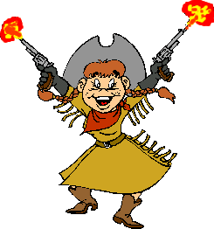
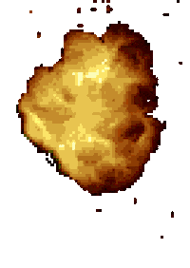
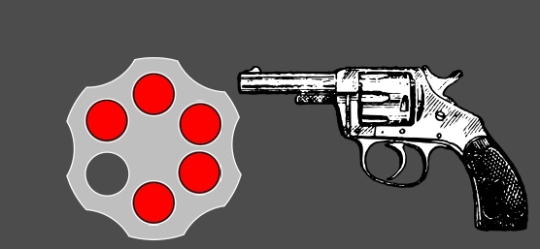
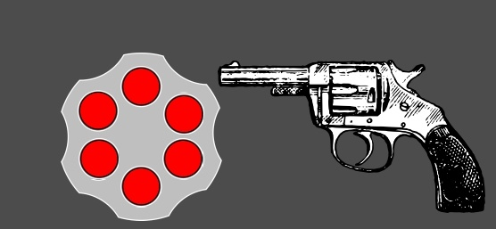
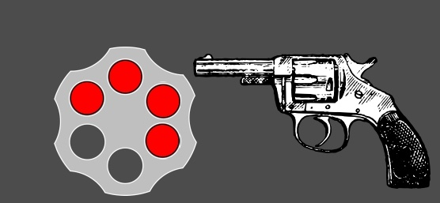
10:00
Nine o'clock
Ten o'clock
Eight o'clock
11:30
Half past eleven
one o'clock
half past six
9:45
Quarter to ten
half past nine
quarter past three
8:15
Quarter past eight
Half past eight
Seven o'clock

Slide 3
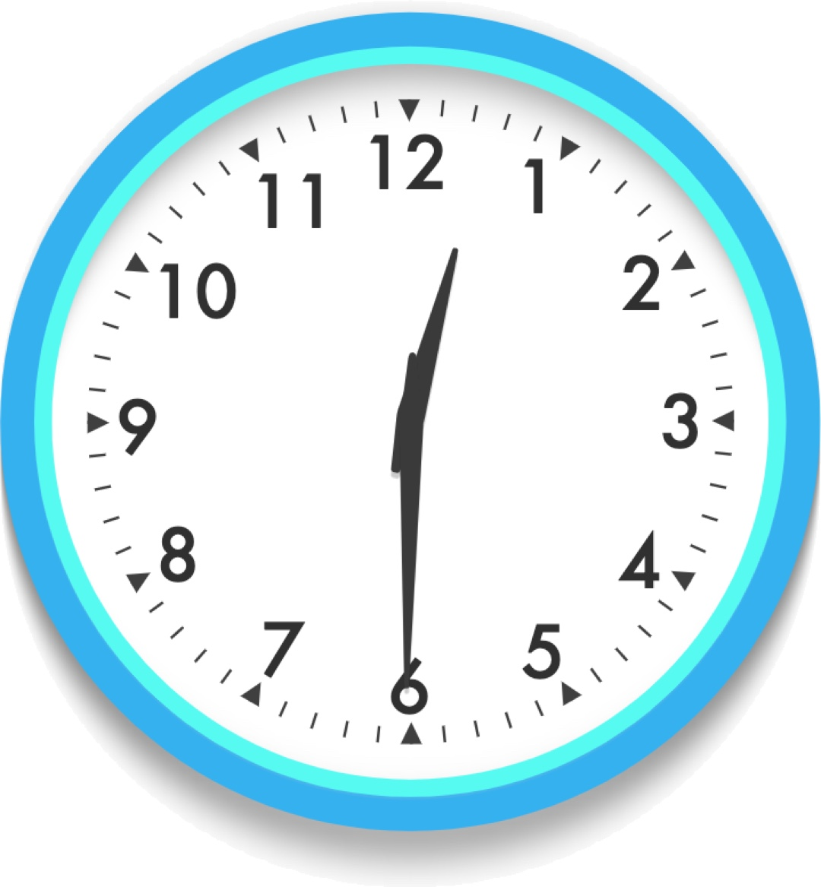
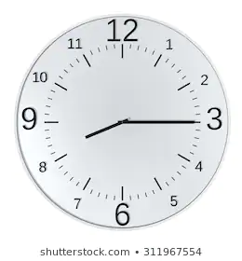
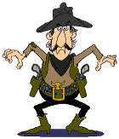
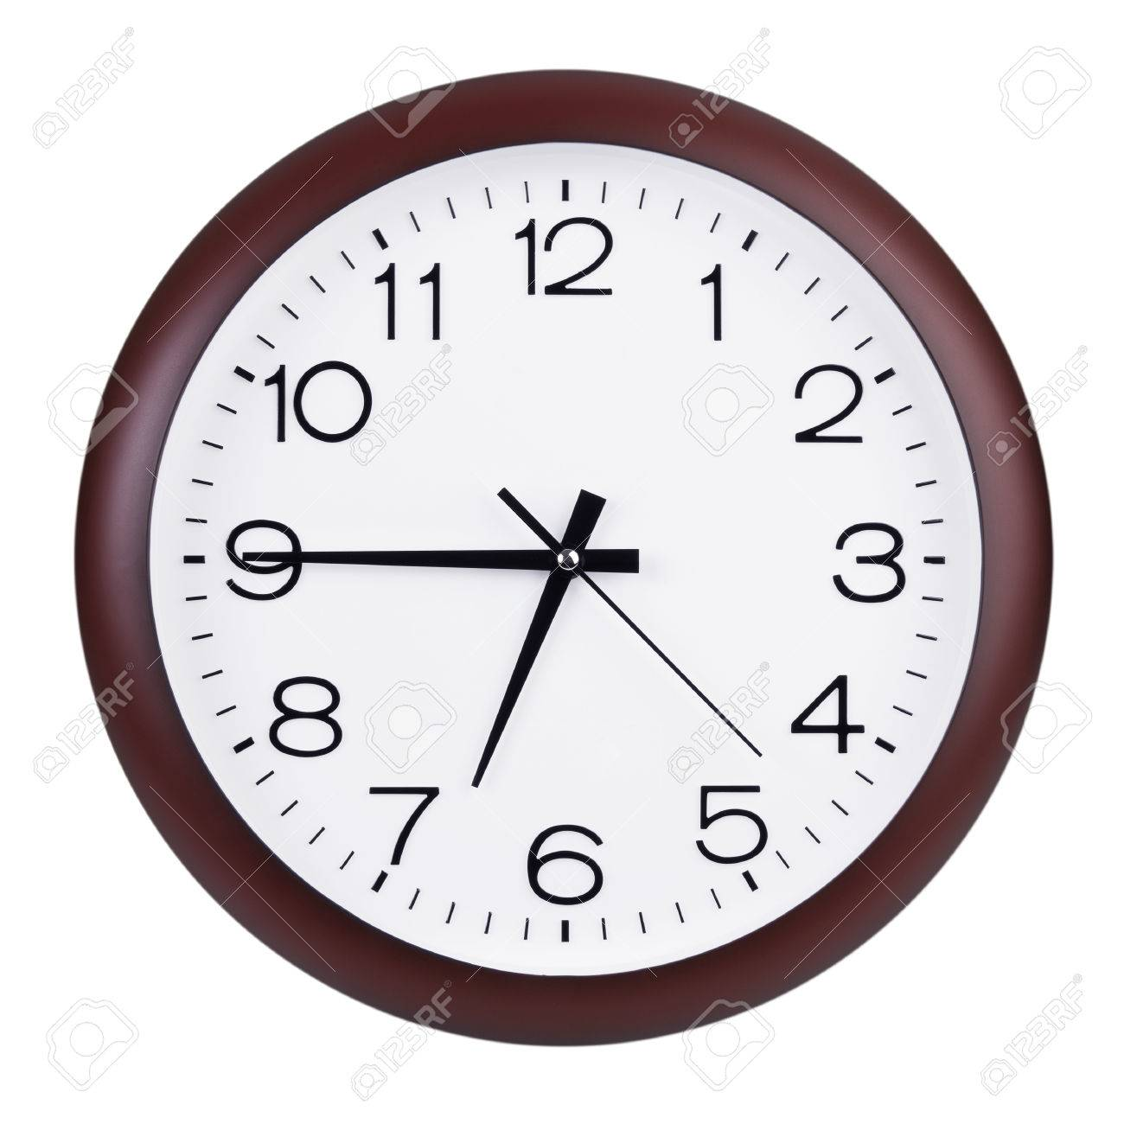
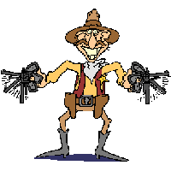
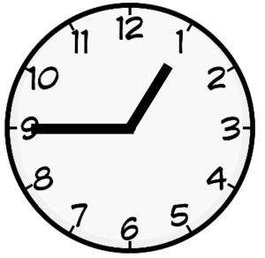
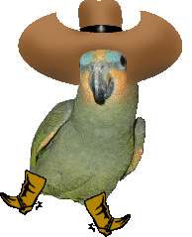
What time is it?
quarter to one
half past twelve
one o'clock
What time is it?
eight o'clock
Quarter past eight
half past eight
What time is it?
quarter to eight
quarter past six
quarter to seven
Sudden death round!
quarter past one
quarter to one
half past one

Slide 4
10:00
Nine o'clock
Ten o'clock
Eight o'clock
11:30
Half past eleven
one o'clock
half past six
9:45
Quarter to ten
half past nine
quarter past three
8:15
Quarter past eight
Half past eight
Seven o'clock

Slide 5
What time is it?
quarter to one
half past twelve
one o'clock
What time is it?
eight o'clock
Quarter past eight
half past eight
What time is it?
quarter to eight
quarter past six
quarter to seven
Sudden death round!
quarter past one
quarter to one
half past one

Slide 6
You win.

Slide 7
You got shot!

