Slide 1
Start

Slide 2
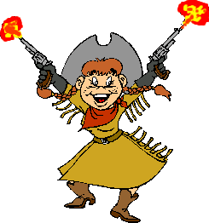
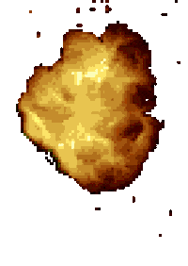
I ____ strong
is
am
are
He ____ tall
is
are
am
We ____ funny.
are
is
am
They ____ going home now.
are
is
am

Slide 3
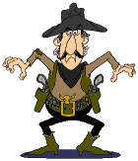
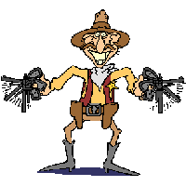
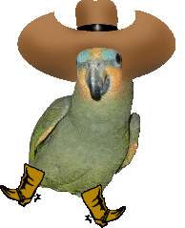
She ___ great!
are
is
am
You ____ loved
is
are
am
I ____ running.
are
is
am
We ____ in the class room.
am
are
is

Slide 4
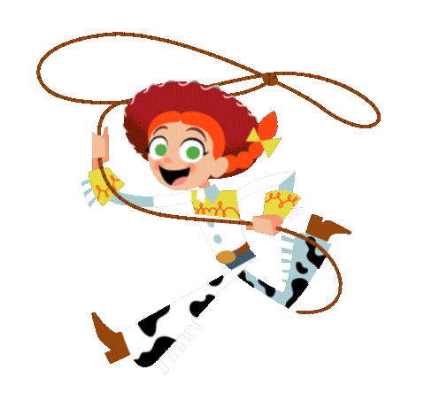
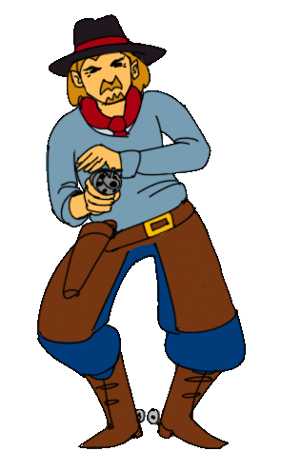
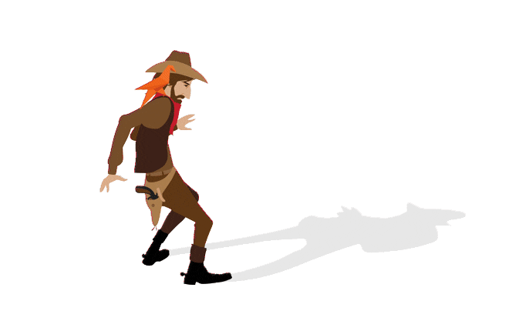
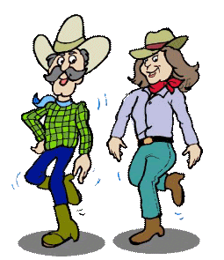
I ____ feeling well today.
am not
aren't
isn't
She ____ hungry.
isn't
aren't
am not
They _____ coming anymore.
am not
isn't
aren't
I ______ ready to go yet.
aren't
isn't
am not

Slide 5
___ you cooking? It smells good!
are
is
am
____ that the person who stole your wallet?
isn't
aren't
am not
____ they the people we're supposed to meet?
am not
isn't
aren't
___ I going to the dentist today?
aren't
is
am

Slide 6
You win.

Slide 7
You got shot!

