Slide 1
Halloween games!

Slide 2
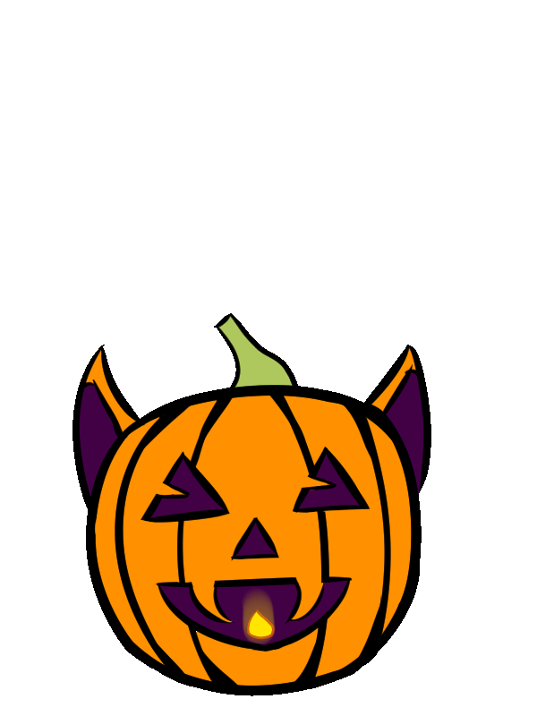

Slide 4
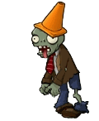
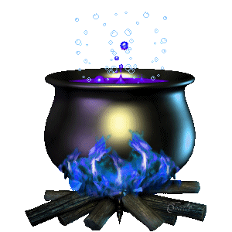
ghost
ZOMBIE
frankenstein

Slide 5
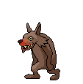
Black cat
bat
werewolf

Slide 6
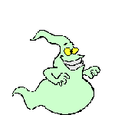
ghost
ZOMBIE
vampire

Slide 7
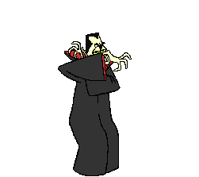
mummy
vampire
devil

Slide 8
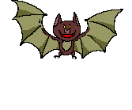
Black cat
werewolf
bat

Slide 9
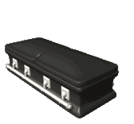
bat
vampire
coffin

Slide 10
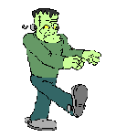
ZOMBIE
vampire
frankenstein

Slide 11
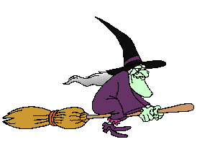
skeleton
witch
devil

Slide 12
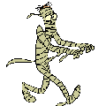
mummy
witch
skeleton

Slide 13
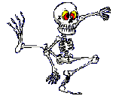
skull
witch
skeleton

Slide 14
Halloween riddles!
Print off the worksheet:
https://drive.google.com/file/d/1bNPpKTe8RYqoNOV39JfhLo1uwoHnoM3g/view?usp=sharing
Play each riddle and let students write the answers to the questions (video on next slide)
Discuss possible answers
Play the answers and see who was right!

Slide 16
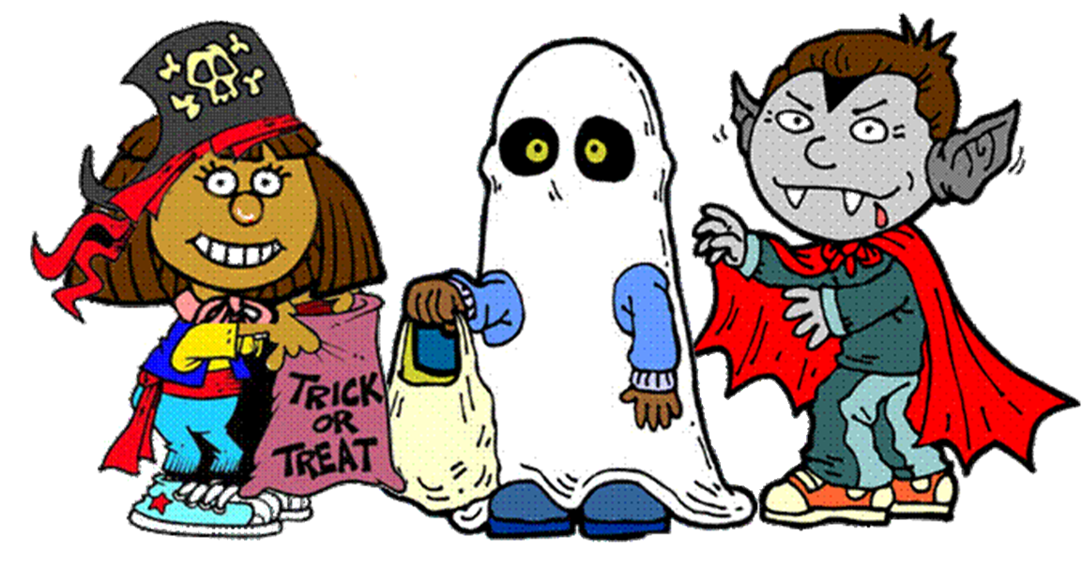
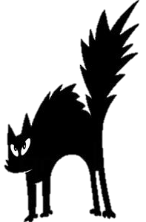

Slide 17
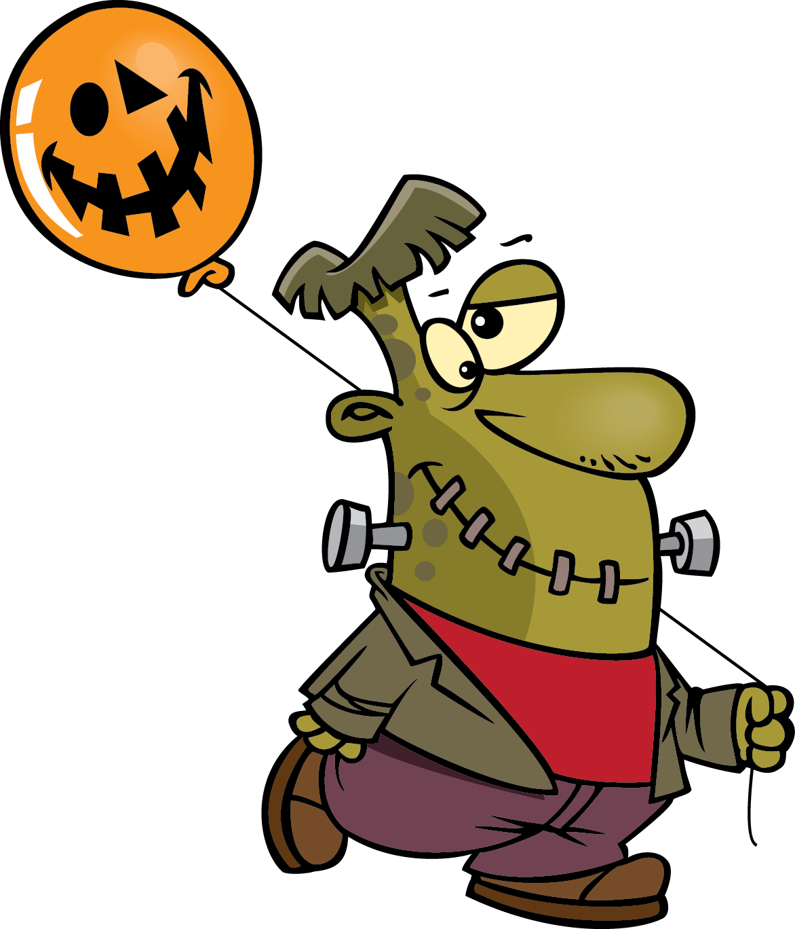
Collect the candy by clicking the word corresponding to the picture.

Slide 18
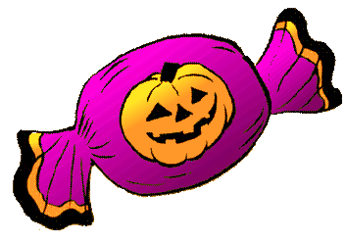
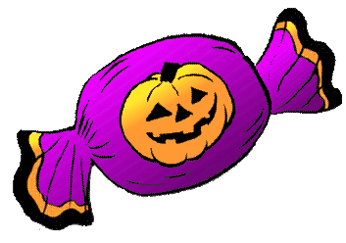
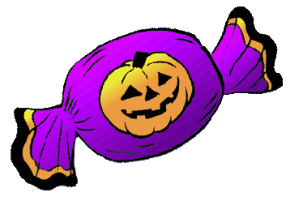
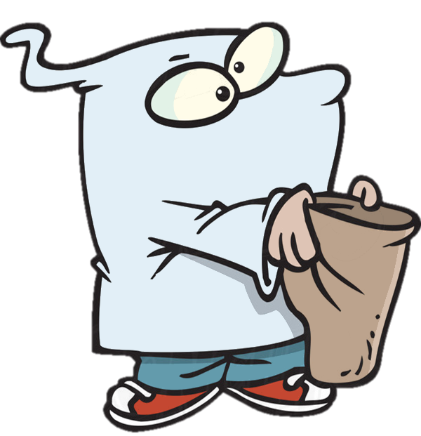
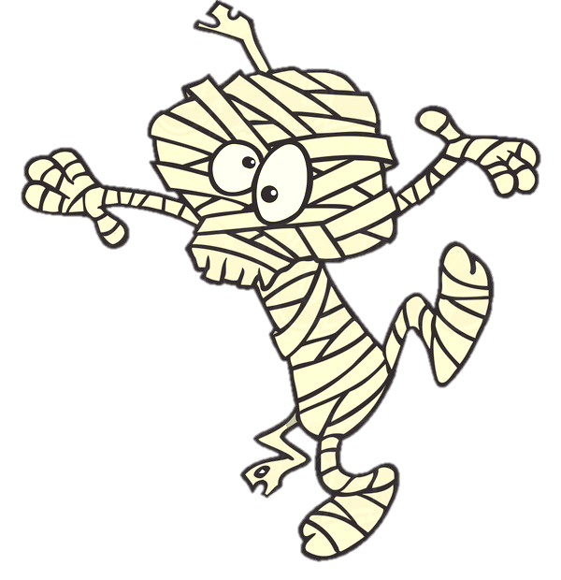
This is a …
ghost
zombie
mummy
Yes, it’s a mummy!
NEXT

Slide 19
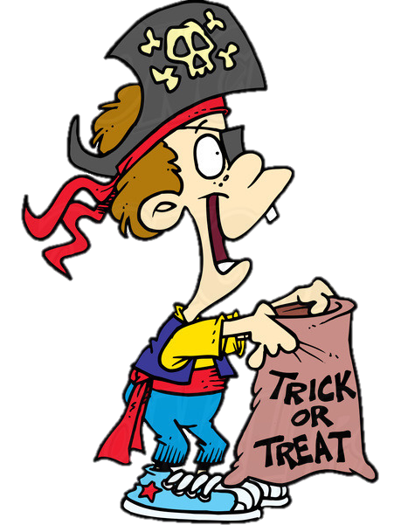
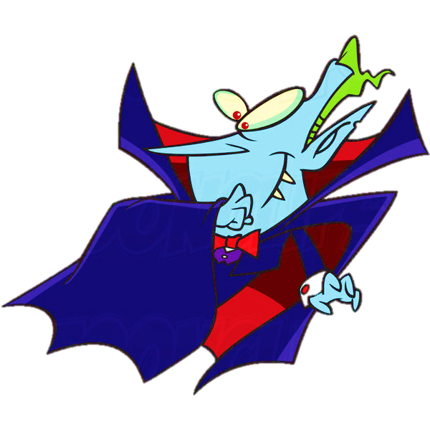
This is a …
vampire
zombie
ghost
Yes, it’s a vampire!
NEXT

Slide 20
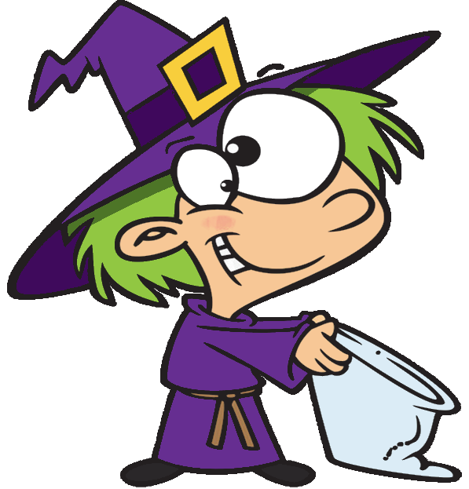
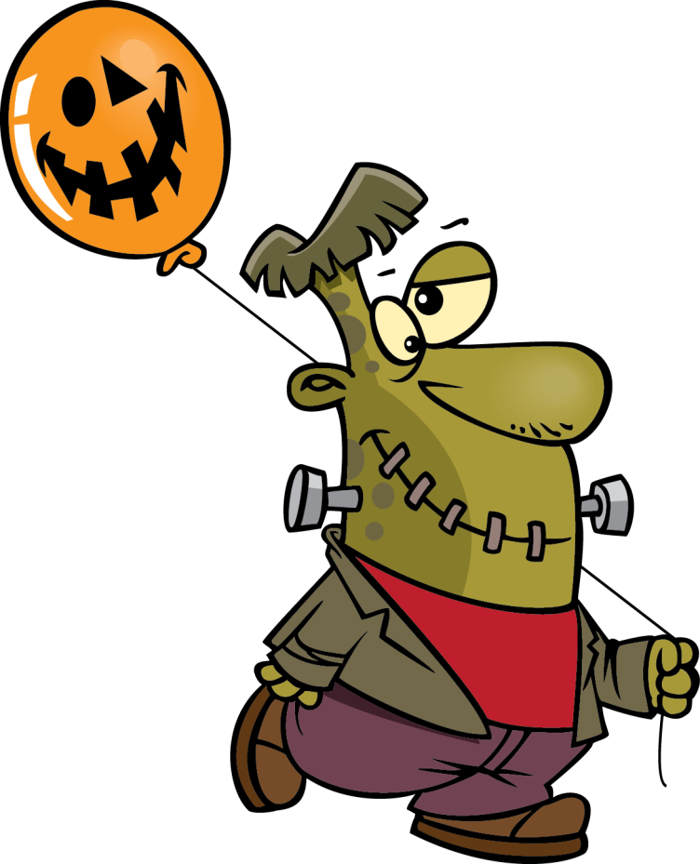
This is a …
ghost
monster
zombie
Yes, it’s a monster!
NEXT

Slide 21
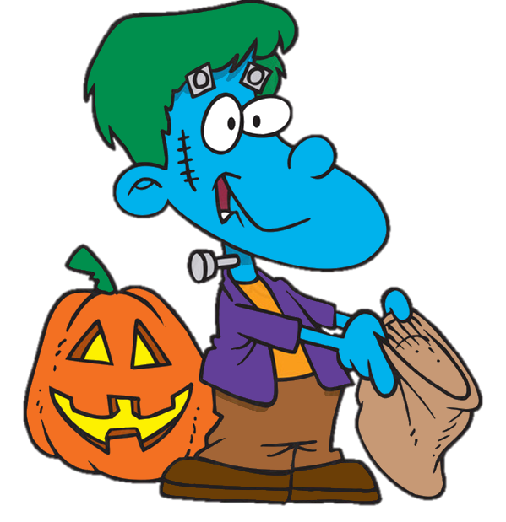
This is a …
witch
zombie
ghost
Yes, it’s a ghost!
NEXT

Slide 22
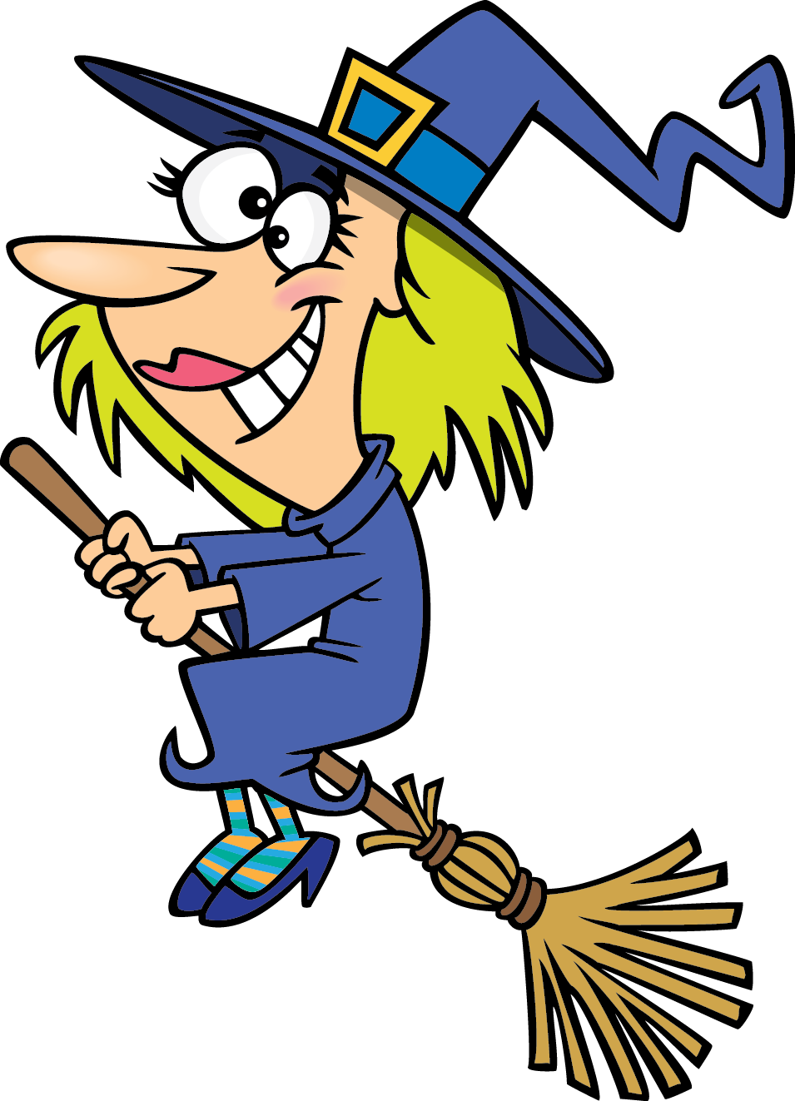
This is a …
skeleton
zombie
witch
Yes, it’s a witch!
NEXT

Slide 23
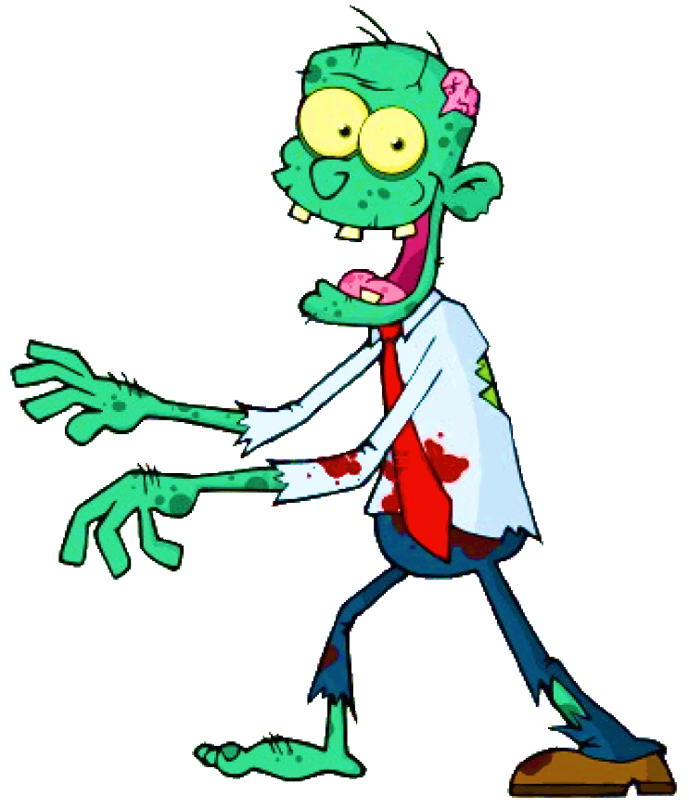
This is a …
skeleton
zombie
werewolf
Yes, it’s a zombie!
NEXT

Slide 24
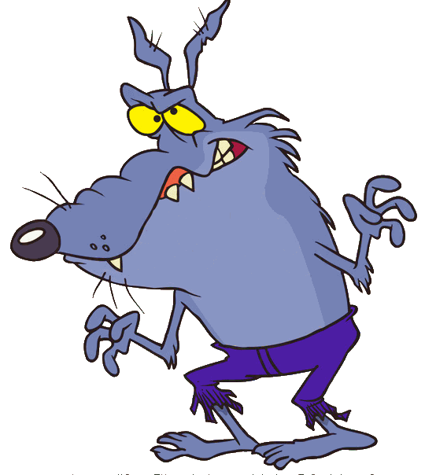
This is a …
skeleton
werewolf
Jack-o-lantern
Yes, it’s a werewolf!
NEXT

Slide 25
This is a …
skeleton
bat
Jack-o-lantern
Yes, it’s a
jack-o-lantern!
NEXT

Slide 26
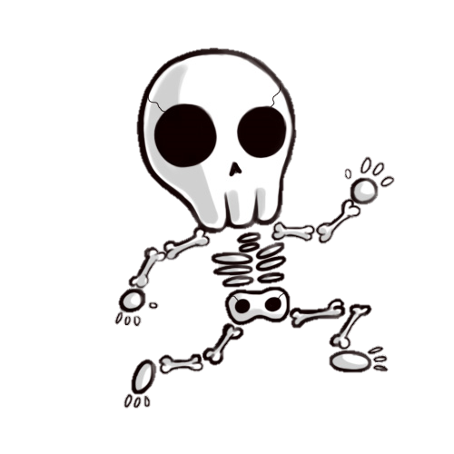
This is a …
bat
devil
skeleton
Yes, it’s a skeleton!
NEXT

Slide 27
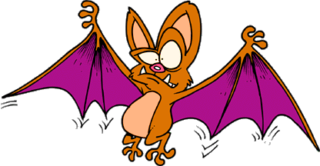
This is a …
skeleton
devil
bat
Yes, it’s a bat!
NEXT

Slide 28
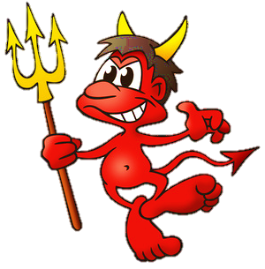
This is a …
monster
devil
vampire
Yes, it’s a devil
NEXT

Slide 29
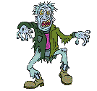
GOOD JOB!
THANK YOU!
EXIT

Slide 32
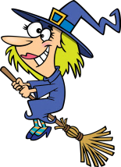
What’s this? How do you spell it?
1/10
t
i
h
c
w
It’s a ...
NEXT
CHECK

Slide 33
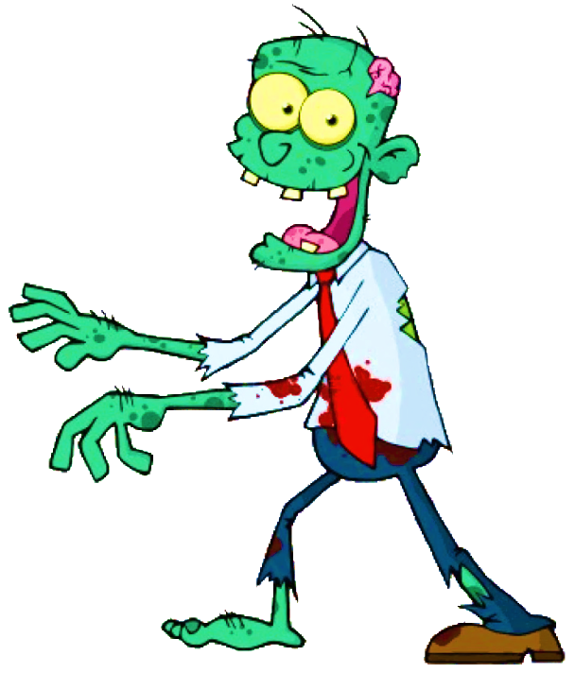
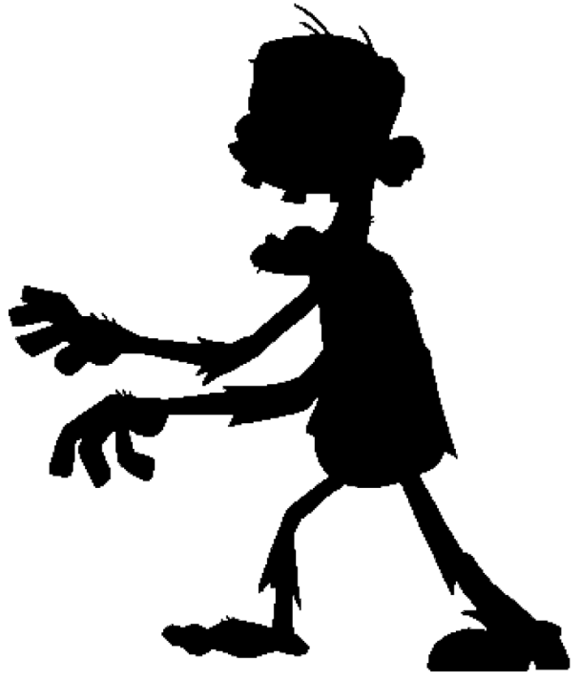
What’s this? How do you spell it?
2/10
m
o
i
b
z
e
It’s a ...
NEXT
CHECK

Slide 34
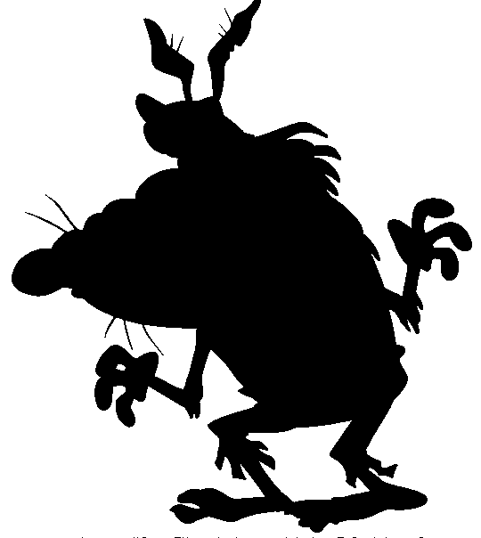
What’s this? How do you spell it?
3/10
r
e
w
e
w
o
f
l
It’s a ...
NEXT
CHECK

Slide 35
What’s this? How do you spell it?
4/10
m
a
i
p
v
r
e
It’s a ...
NEXT
CHECK

Slide 36
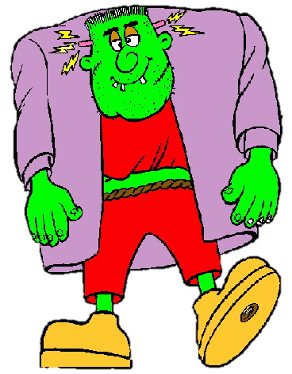
What’s this? How do you spell it?
5/10
n
o
t
s
m
e
r
It’s a ...
NEXT
CHECK

Slide 37
What’s this? How do you spell it?
6/10
e
k
e
l
s
t
n
o
It’s a ...
NEXT
CHECK

Slide 38
What’s this? How do you spell it?
7/10
m
u
y
m
m
It’s a ...
NEXT
CHECK

Slide 39
What’s this? How do you spell it?
8/10
o
h
t
s
g
It’s a ...
NEXT
CHECK

Slide 40
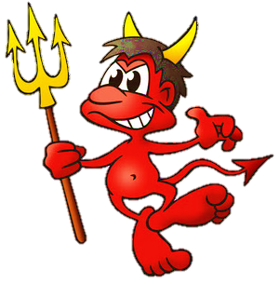
What’s this? How do you spell it?
9/10
v
e
l
i
d
It’s a ...
NEXT
CHECK

Slide 41
What’s this? How do you spell it?
10/10
a
t
b
It’s a ...
CHECK
EXIT

Slide 43
cauldron
pot
pan
A large round metal container used for cooking over fire.

Slide 44
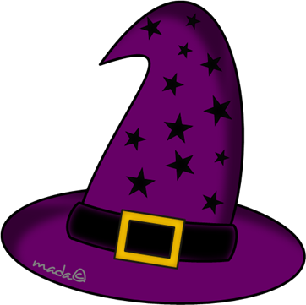
witch cap
witch beret
witch hat
A pointed covering for
the head that witches wear.

Slide 45
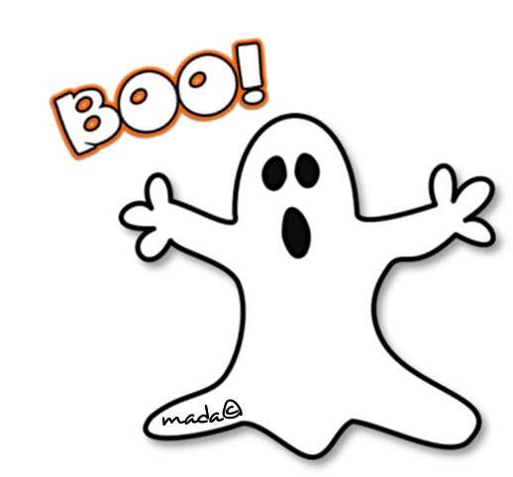
skeleton
ghost
mummy
A spirit of a dead person
represented as a pale,
transparent image.

Slide 46
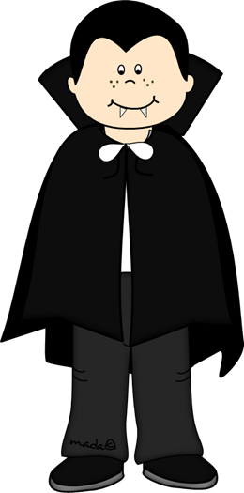
witch cap
witch beret
witch hat
A typical Halloween
character that is a
vampire.

Slide 47
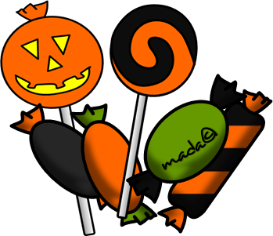
biscuits
candies
cake
Sweet food made of sugar.

Slide 48
tomb
coffin
sarcophagus
A large grave, built of stone.

Slide 49
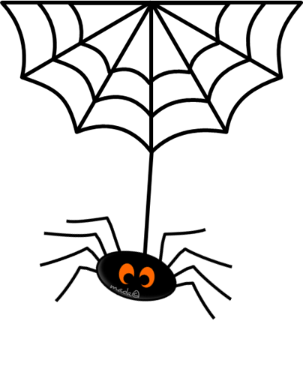
rat
frog
spider
A small creature that catches insects in a web.

Slide 50
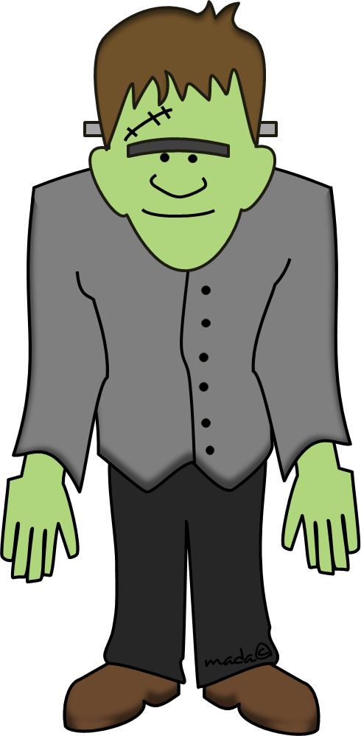
Frankenstein
Harry Potter
Spiderman
A monster that goes out of control and is
dangerous.

Slide 51
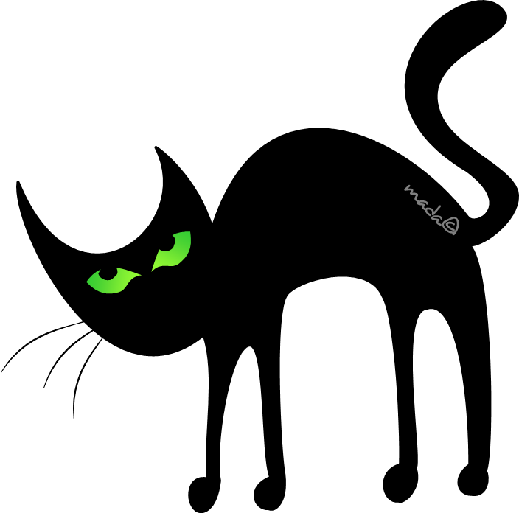
owl
black cat
bat
An animal that symbolizes evil and bad luck and is witch’s pet.

Slide 52
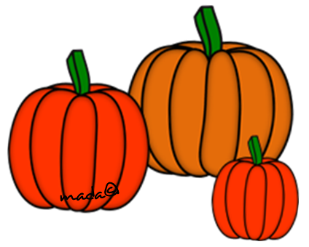
courgettes
eggplants
pumpkins
Large round
vegetables with hard orange skin.

Slide 53
mop
wire brush
broom
A brush on the end of a long handle that witches use to fly.

Slide 54
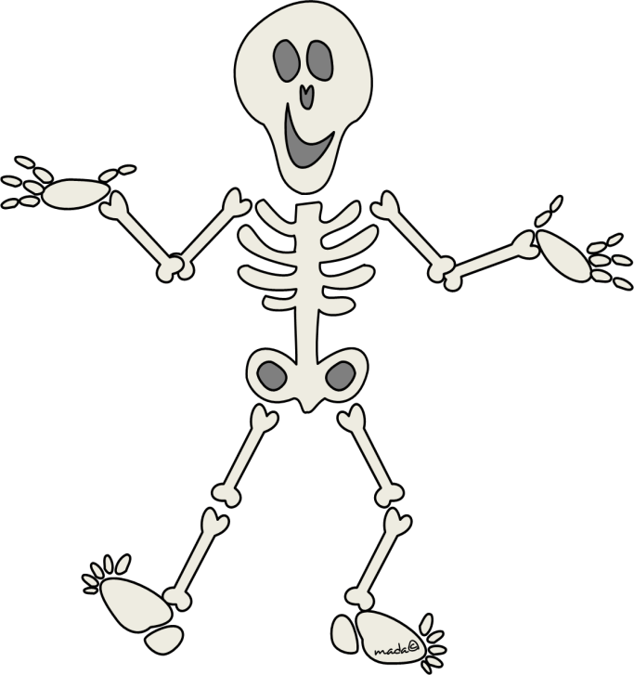
skeleton
ghost
zombie
A frame of bones that
supports a human body.

Slide 55
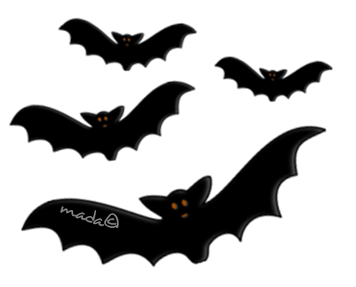
rats
bats
owls
Nocturnal small animals that look like mice with wings.

Slide 56
Jack-o-lantern
Tom-o-lantern
Miss Pumpkin
A hollowed out pumpkin with a face cut in one side and a candle put inside.

Slide 57
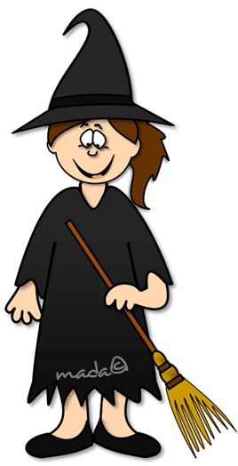
fairy
wizard
witch
A woman with evil
magic powers.

Slide 58
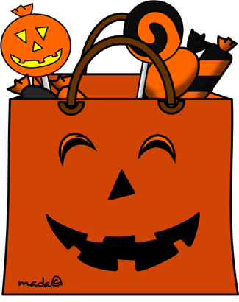
strolling
apple bobbing
trick or treat
Children dress up frightening costumes and visit people’s homes to demand sweets.

Slide 59
zombie
death
goblin
A representation of a
dead person.

Slide 84
Halloween
31st October

Slide 85
What’s this?
Jack-o-lantern

Slide 86
What’s this?
Black Cat

Slide 87
What’s this?
Ghost

Slide 88
What’s this?
Haunted
House

Slide 89
What’s this?
Devil

Slide 90
What’s this?
Bats

Slide 91
What’s this?
Skeleton

Slide 92
What’s this?
Mummy

Slide 93
What’s this?
Witch

Slide 94
What’s this?
Werewolf

Slide 95
What’s this?
Vampire

Slide 96
What’s this?
Spider

Slide 97
What’s this?
Cauldron

Slide 98
What’s this?
Monster

Slide 99
What’s this?
Candy

Slide 100
1
2
3
4
1
3
4
1
2
2
4
4
1
4
1
4
1
5
12
13
2
1
3
2
3
2
3
2
3
2
4
1
3
4
1
4
1
4
1
6
11
14
Halloween
Challenge
3
2
3
2
3
2
3
2
4
1
2
4
1
4
1
4
1
7
10
15
3
2
3
2
3
2
3
2
4
1
4
1
4
1
1
4
1
4
1
4
1
17
18
8
9
16
3
2
3
2
3
2
3
2
3
2
3
2
Notes:
Make up to 4 teams 1, 2, 3, 4.
Click the Devil to start the spinner and then again to stop. Allow at least 1 full spin.
Click on the number (1-4) inside the main boxes.
Example:
Team 1 spins a 2, click on number 1 in square 2.
This will then ask them a question.
Click on the green witch (top right) to return back to this slide.
If the got the question right move on to the next team.
BATS
Under each little box is a bat.
Click on the bat and the number will reappear.
Question right.
Example:
Team 4 are on square 6.
They roll a 3.
Click on 4 in square 9
They answer correctly.
Return back to this slide.
Click on the bat in square 6 and it will go away leaving only 1 bat for the team.
Incorrect Answer
Example:
Team 3 is on square 5. They role a 1.
You click on box 3 in square 6.
They answer incorrectly. Return back to this slide and click on the Bat and the number comes back.
This leaves team 3 on square 5 until the next spin.
Balloon Challenge.
Student need to walk around the classroom with an inflated orange balloon resting on a paper cup.
If it fall off more than 3 times it’s a fail.
Draw a Jack-o-lantern on the balloon
Ping Pong Challenge.
Students use chopsticks to carry a ping pong ball around a course.
Could change chopsticks to a spoon.
Can draw eyes on the ping pong balls

Slide 101
What’s this?

Slide 102
What’s this?

Slide 103
What’s this?

Slide 104
What’s this?

Slide 105
What’s this?

Slide 106
Challenge
Make a sound like a cat

Slide 107
What’s this?

Slide 108
What’s this?

Slide 109
Challenge
Act like a monster

Slide 110
Challenge
Act like a ghost

Slide 111
What’s this?

Slide 112
Challenge
Make a sound like a werewolf

Slide 113
What’s this?

Slide 114
What’s this?

Slide 115
What’s this?

Slide 116
What’s this?

Slide 117
What’s this?

Slide 118
What’s this?

Slide 119
What’s this?

Slide 120
What’s this?

Slide 121
Challenge
Ping Pong Ball

Slide 122
What’s this?

Slide 123
Challenge
Balloon walk

Slide 124
What’s this?

Slide 125
What’s this?

Slide 126
Challenge
Balloon walk

Slide 127
What’s this?

Slide 128
Challenge
Ping Pong Ball

Slide 129
What’s this?

Slide 130
Question
What color is a Jack-o-lantern?

Slide 131
Question
What color is the Ghost?

Slide 132
Question
What color is the Monster?

Slide 133
Question
What color is the Devil?

Slide 134
How do you spell me?

Slide 135
Challenge
Balloon walk

Slide 136
How do you spell me?

Slide 137
Challenge
Ping Pong Ball

Slide 138
Challenge
Balloon walk

Slide 139
How do you spell me?

Slide 140
Challenge
Ping Pong Ball

Slide 141
How do you spell me?

Slide 142
What’s this?

Slide 143
What’s this?

Slide 144
What’s this?

Slide 145
What’s this?

Slide 146
What’s this?

Slide 147
Challenge
Act like a witch

Slide 148
Challenge
Act like a ghost

Slide 149
What’s this?

Slide 150
Challenge
Act like a witch

Slide 151
What’s this?

Slide 152
What’s this?

Slide 153
Challenge
Act like a vampire

Slide 154
Challenge
Balloon walk

Slide 155
Challenge
Ping Pong Ball

Slide 156
How do you spell me?

Slide 157
How do you spell me?

Slide 158
GO
It’s
Halloween
Have fun

Slide 159
GO
witch
ghost
mummy
witch

Slide 160
GO
spider
black cat
bat
black cat

Slide 161
GO
scarecrow
Dracula
Frankenstein
Frankenstein

Slide 162
GO
mummy
ghost
spider
ghost

Slide 163
GO
pumpkin
carrot
orange
pumpkin

Slide 164
GO
dinosaur
witch
Trick or treat
Trick or treat

Slide 165
GO
pumpkin head
ghost
witch
pumpkin head

Slide 166
GO
Dracula
mummy
ghost
mummy

Slide 167
GO
costume
dress
mask
mask

Slide 168
GO
pot
cauldron
pan
cauldron

Slide 169
GO
bat
cat
spider
bat

Slide 170
GO
spider
ghost
pumpkin
spider

Slide 171
GO
Jack o’lantern
Jim o’lantern
Joe o’lantern
Jack o’lantern

Slide 172
GO
carving
cooking
slicing
carving

Slide 173
GO
mummies
costumes
aliens
costumes

Slide 174
GO
beans
peas
jelly beans
jelly beans

