Slide 2
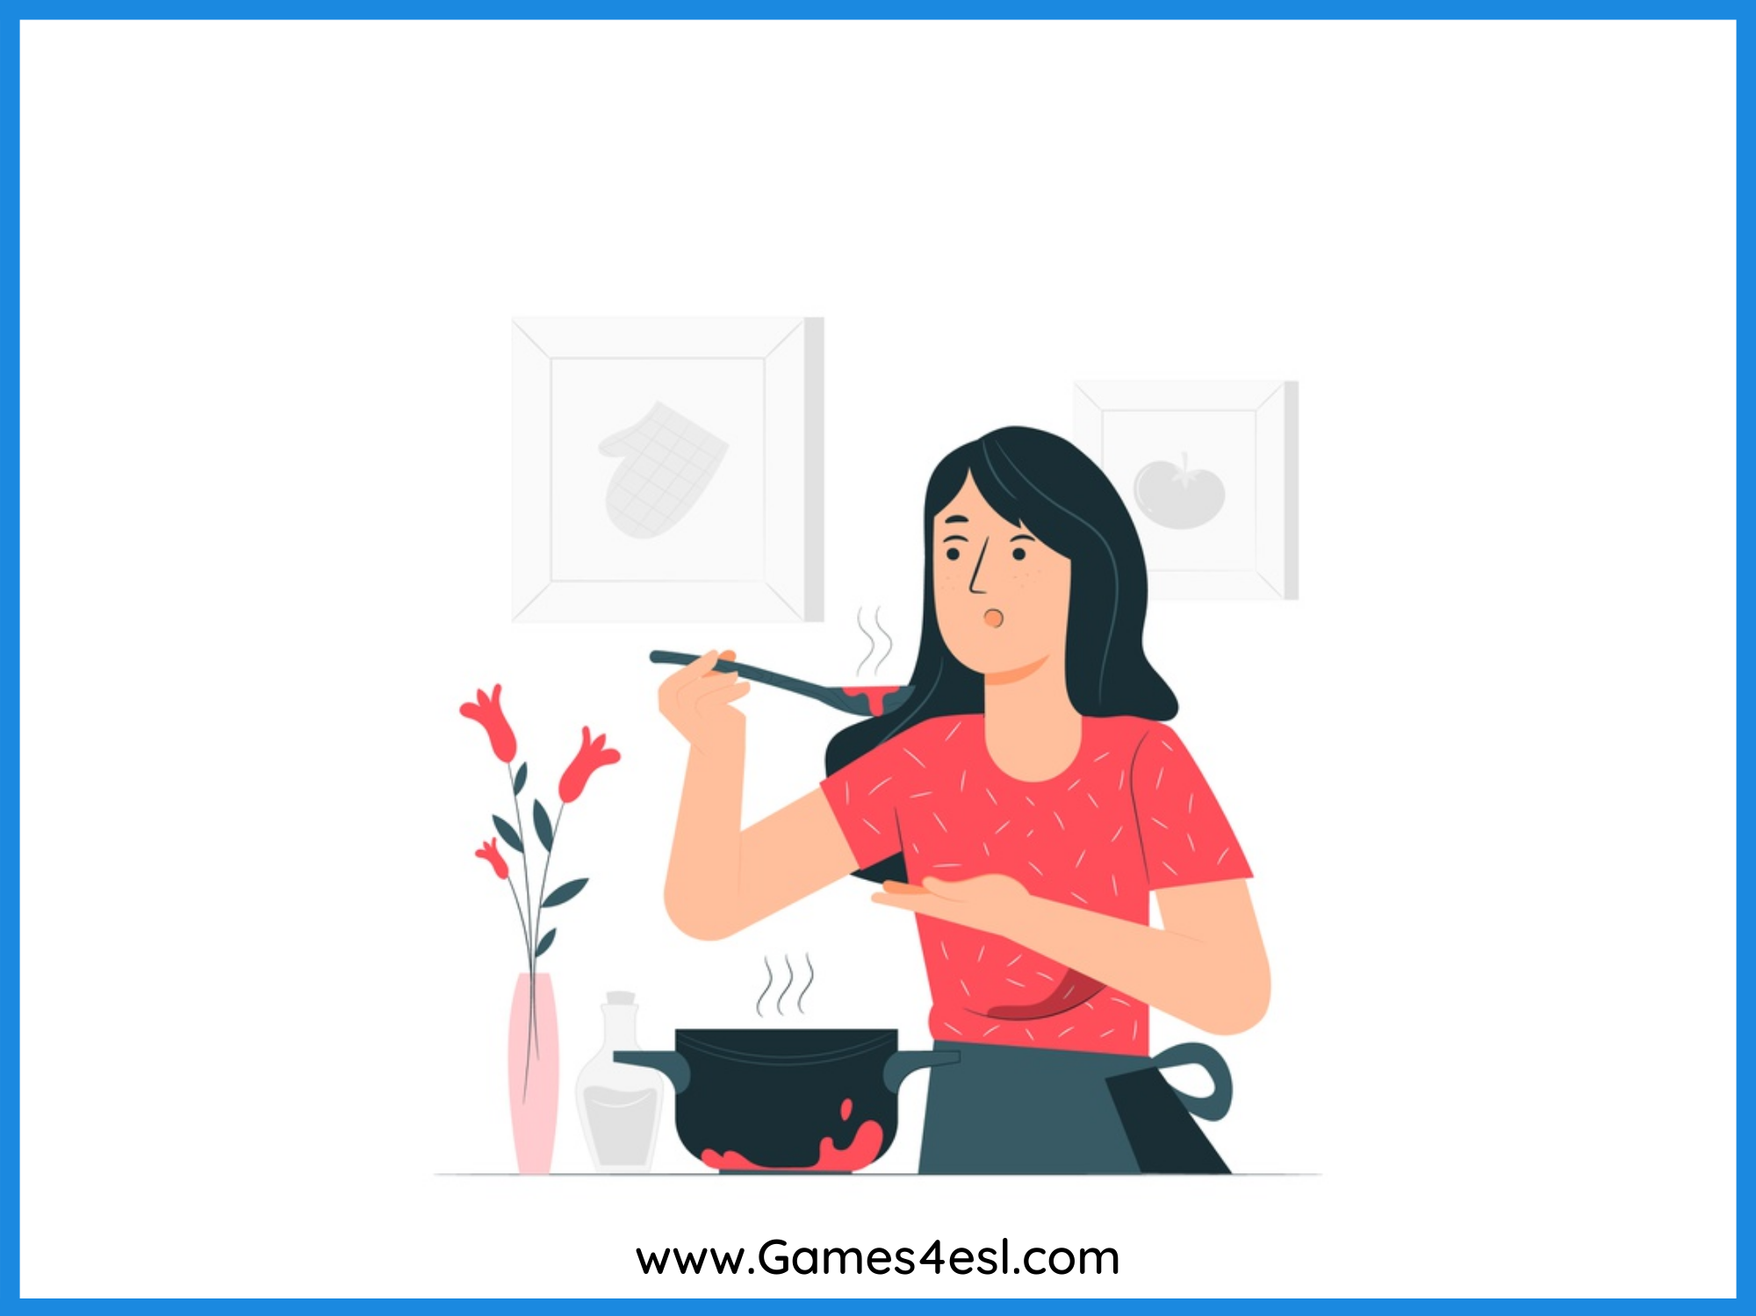
cooking
SHOW

Slide 3
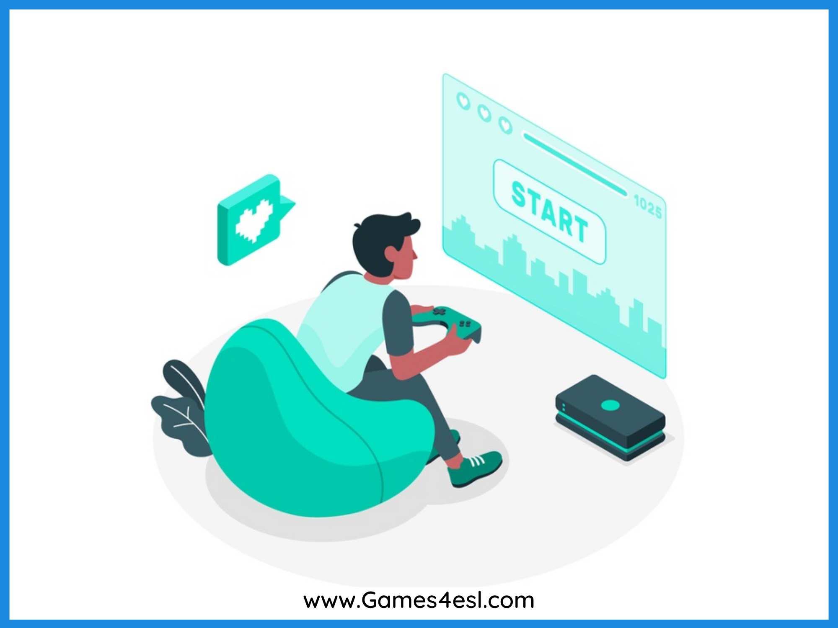
playing computer games
SHOW

Slide 4
surfing
SHOW

Slide 5
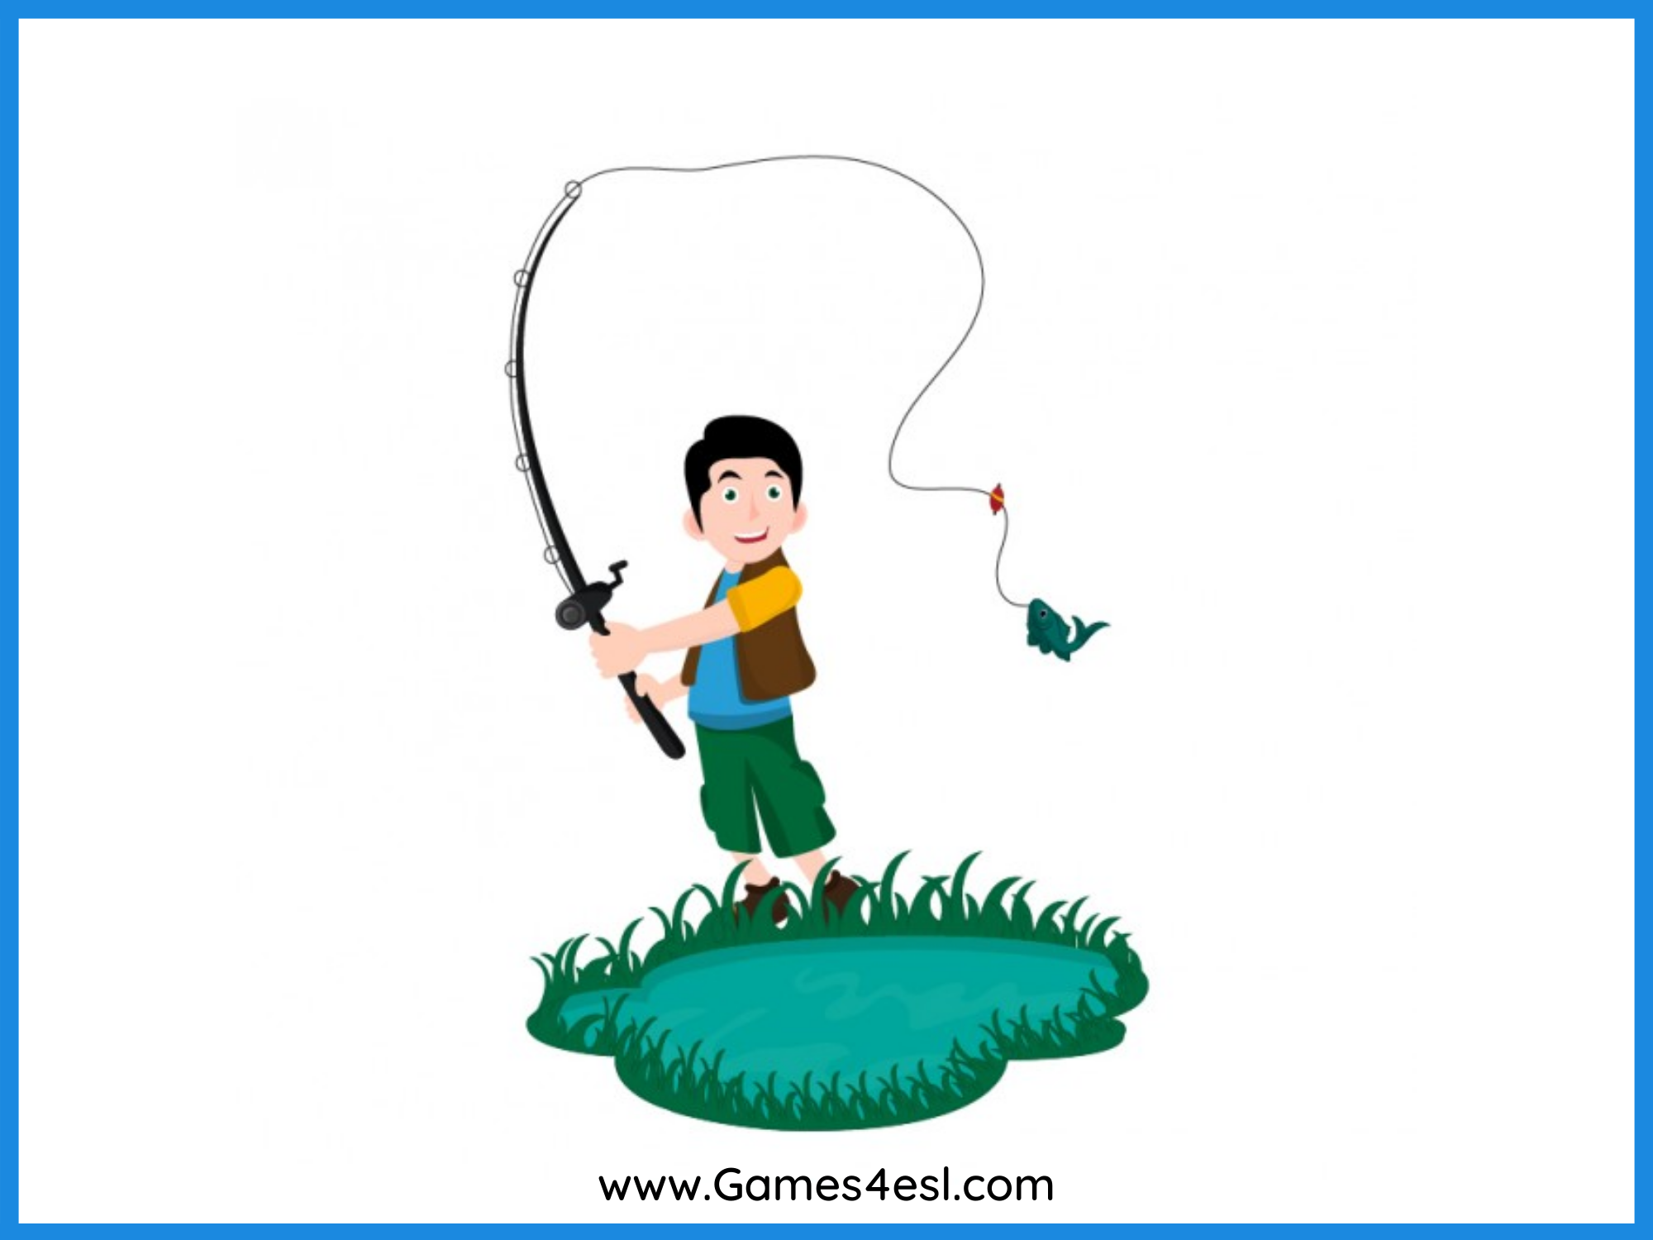
fishing
SHOW

Slide 6
hiking
SHOW

Slide 7
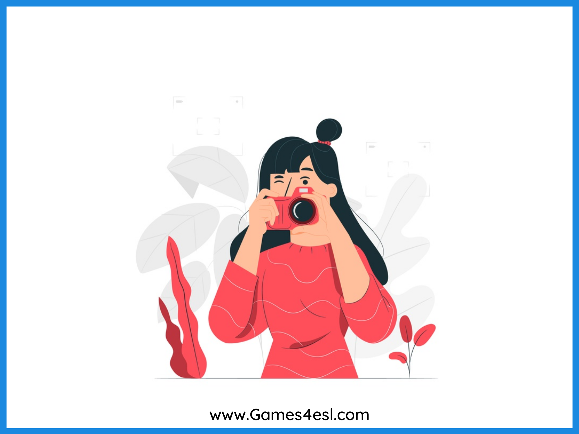
photography
SHOW

Slide 8
reading books
SHOW

Slide 9
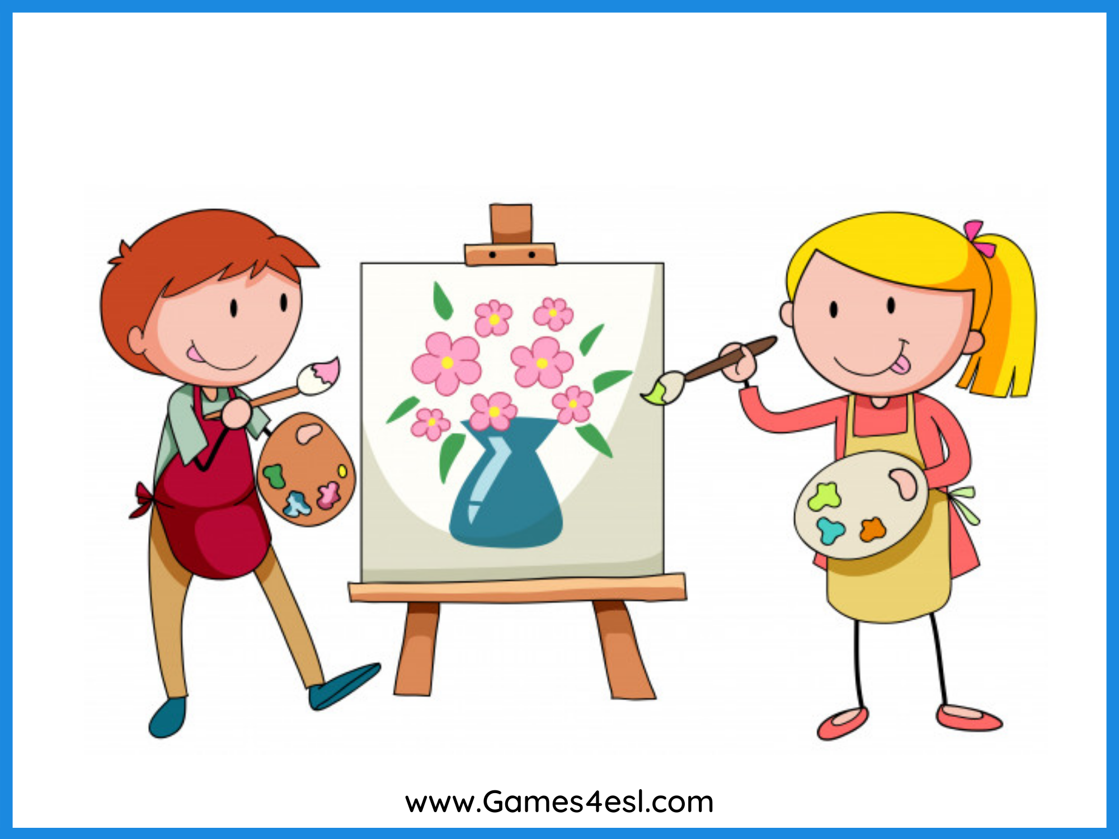
painting
SHOW

