Slide 1
I.N.I.T.I.A.L.S
(FIRST LETTER GAME)

Slide 2
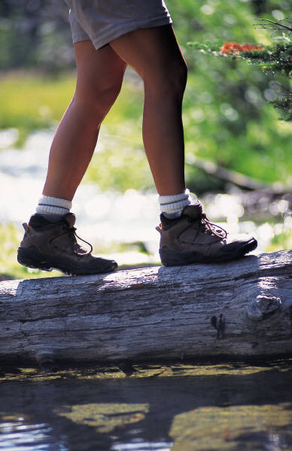
RULE
TAKE THE FIRST LETTERS FROM EACH PICTURE AND FORM THE MYSTERY WORD!
WASH
AIRPLANE
LEG
KITE
W A L K

Slide 3
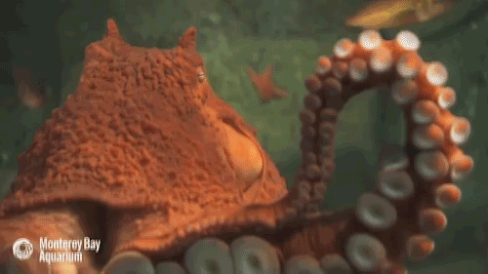
D
O
G
____ ____ ____
DEER
OCTOPUS
GIRL

Slide 4
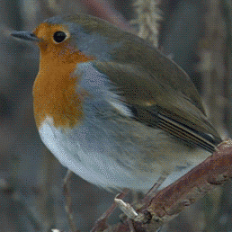
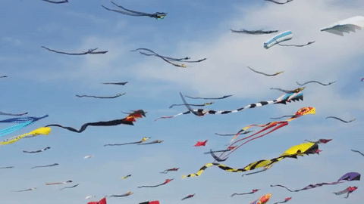
B
O
O
K
____ ____ ____ ____
BIRD
ONE
ONE
KITE

Slide 5
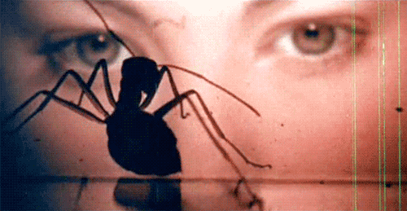
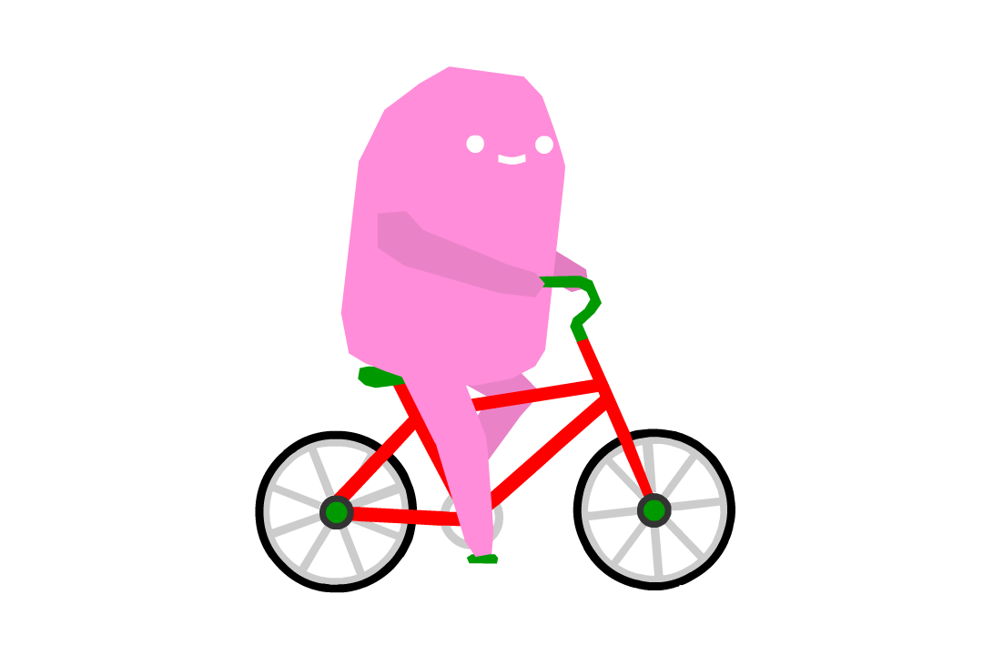
____ ____ ____ ____ ____
T
A
B
L
E
Notes:
>TEA >ANT > BIKE > LOVE > EGG

Slide 6
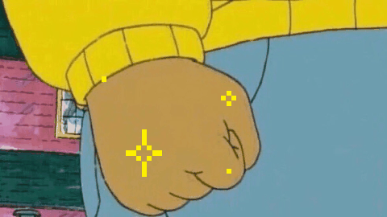
____ ____ ____ ____ ____ ____
F
L
O
W
E
R
Notes:
>FIST > LOVE > ONE > WIND > ELEPHANT > ROCK

Slide 7
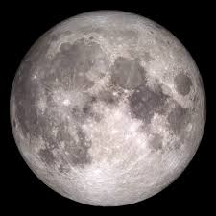
____ ____ ____ ____ ____ ____
S
W
I
M
Notes:
>FIST > LOVE > ONE > WIND > ELEPHANT > ROCK

Slide 8
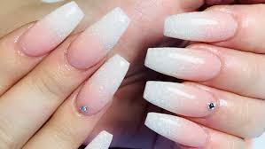
____ ____ ____ ____ ____ ____
R
U
N
Notes:
>FIST > LOVE > ONE > WIND > ELEPHANT > ROCK

Slide 9
____ ____ ____ ____ ____ ____
J
U
M
P
Notes:
>FIST > LOVE > ONE > WIND > ELEPHANT > ROCK

Slide 10
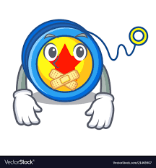
____ ____ ____ ____ ____ ____
H
A
P
P
Y
Notes:
>FIST > LOVE > ONE > WIND > ELEPHANT > ROCK

Slide 11
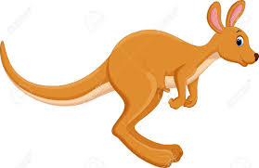
____ ____ ____ ____ ____ ____
B
I
K
E
Notes:
>FIST > LOVE > ONE > WIND > ELEPHANT > ROCK

Slide 12
____ ____ ____ ____ ____ ____
D
O
O
R
Notes:
>FIST > LOVE > ONE > WIND > ELEPHANT > ROCK

Slide 13
THANK YOU!
MORE .GIF IMAGES AT WWW.GIPHY.COM

Slide 14
Thank you for downloading this free resource!
I believe English teaching resources should be free but keeping a website is very costly! PLEASE help me continue making my resources FREE and keep my blog running by clicking some GOOGLE ADS that appear in my website. Average revenue I get per click is only $0.01 (LOL, no kidding!) but it’s up to you how willing you are to support my advocacy.
Sharing is caring! Please share my blog posts to your friends and colleagues.
For more resources and updates, follow me on social media:
https://www.facebook.com/EnglishTeaching101/
https://twitter.com/ENteaching101
https://www.pinterest.com/ENteaching101/
http://englishteaching101.com/

