Slide 1
Hidden Picture Games Template

Slide 2
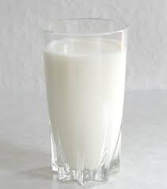
Milk
Remove

Slide 3
Is there milk in the glass?
Yes, there is!

Slide 4
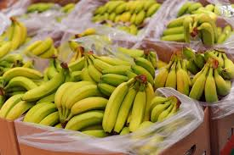
Bananas
Remove

Slide 5
Are there bananas in the box?
Yes, there are!

Slide 6
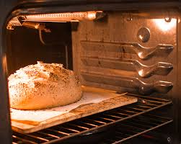
Bread
Remove

Slide 7
Is there bread in the oven?
Yes, there is!

Slide 8
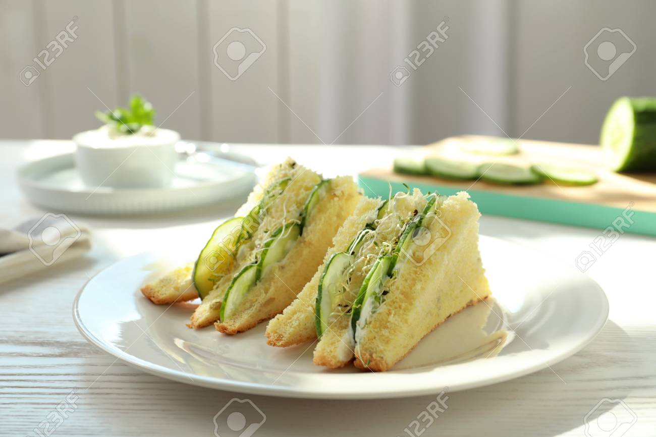
Sandwiches
Remove

Slide 9
Are there sandwiches on the table?
Yes, there are!

Slide 10
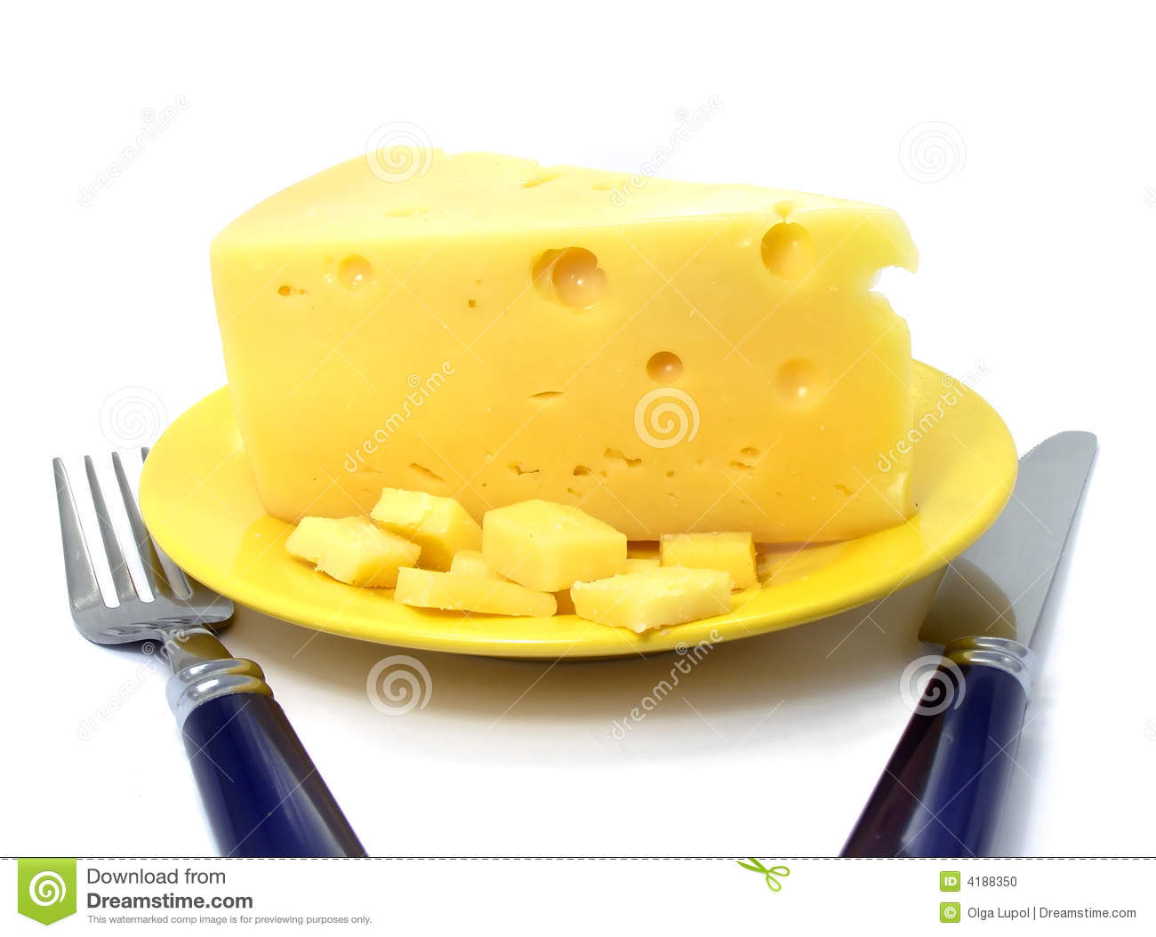
Cheese
Remove

Slide 11
Is there cheese on the plate?
Yes, there is!

Slide 12
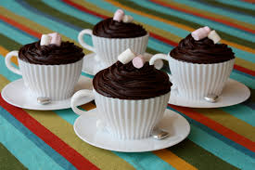
Cakes
Remove

Slide 13
Are there cakes in the cups?
Yes, there are!

Slide 14
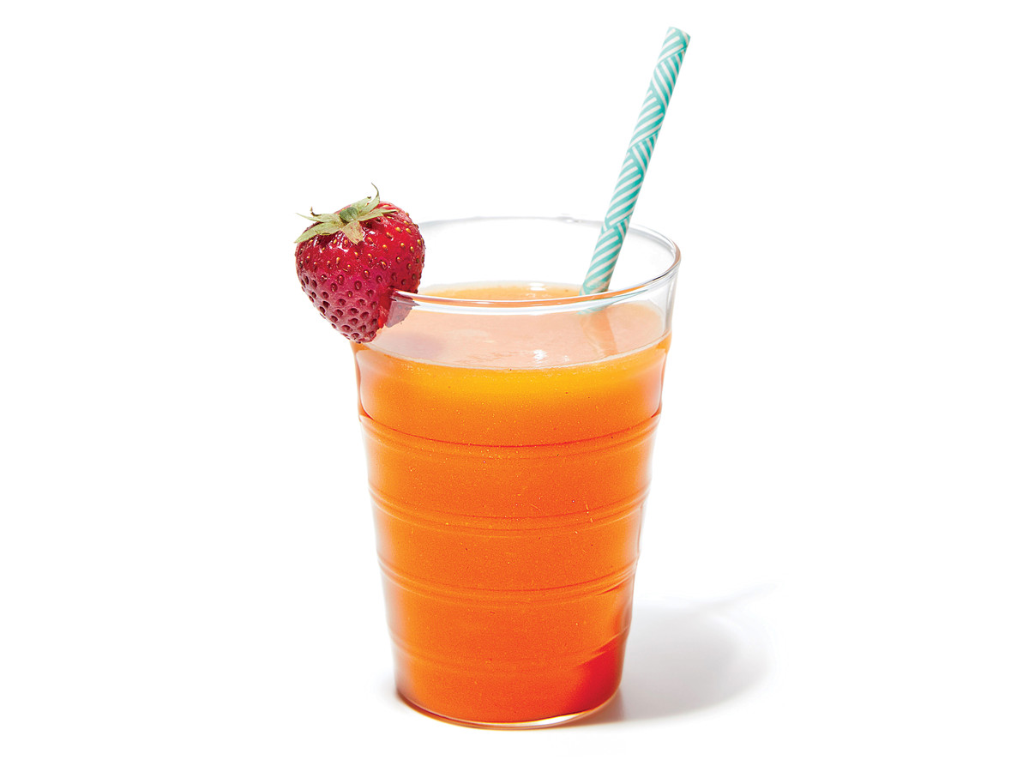
Juice
Remove

Slide 15
Is there juice in the glass?
Yes, there is!

Slide 16
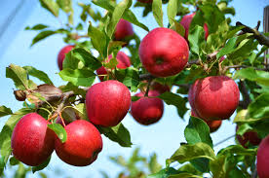
Apples
Remove

Slide 17
Are there apples on the tree?
Yes, there are!

Slide 18
Game Over

