Slide 1
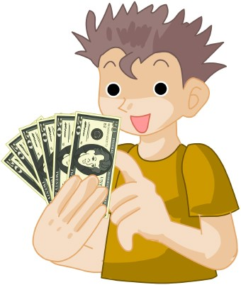
Who wants to win millions?
Hundred Dollar Questions

Slide 2
Tongue twisters
Hard words
Opposites
Riddles
Forfeits
$100
$100
$100
$100
$100
$200
$200
$200
$200
$200
$300
$300
$300
$300
$300
$400
$400
$400
$400
$400

Slide 3
$100
Say the following sentence:
She sells seashells by the seashore

Slide 4
$200
Say the following sentence:
Peter Piper picked a peck of pickled peppers
A peck of pickled peppers Peter Piper picked
If Peter Piper picked a peck of pickled peppers
Where’s the peck of pickled peppers Peter Piper picked?

Slide 5
$300
Say the following sentence:
How much wood would a woodchuck chuck if a woodchuck could chuck wood?
He would chuck, he would, as much as he could, and chuck as much wood
As a woodchuck would if a woodchuck could chuck wood

Slide 6
$400
Say the following sentence:
Betty Botter bought some butter
But she said the butter’s bitter
If I put it in my batter, it will make my batter bitter
But a bit of better butter will make my batter better
So ‘twas better Betty Botter bought a bit of better butter

Slide 7
$100
Choir

Slide 8
$200
Anemone

Slide 9
$300
Colonel

Slide 10
$400
Antidisestablishmentarianism

Slide 11
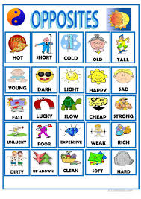
$100
Strong

Slide 12
$200
Likeable

Slide 13
$300
Dismantle

Slide 14
$400
Abundant

Slide 15
$100
What comes down but never goes up?

Slide 16
$200
How many months of the year have 28 days?

Slide 17
$300
What word is shorter when you add two letters
to it?

Slide 18
$400
What has hands but can’t clap?

Slide 19
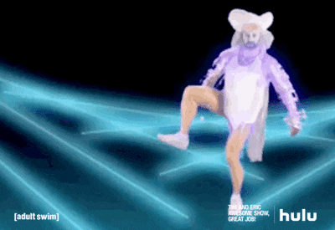
$100
Jump on one leg 10 times.

Slide 20
$200
Pretend to be a dinosaur.

Slide 21
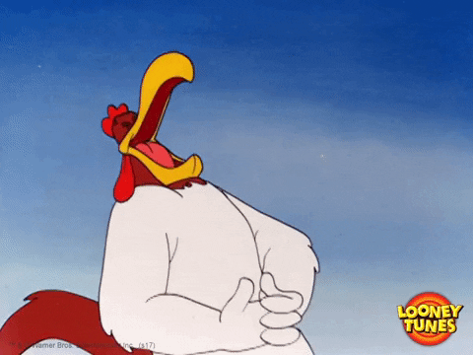
$300
Tell a joke.

Slide 22
$400
Pretend to be a monkey.

