Slide 1
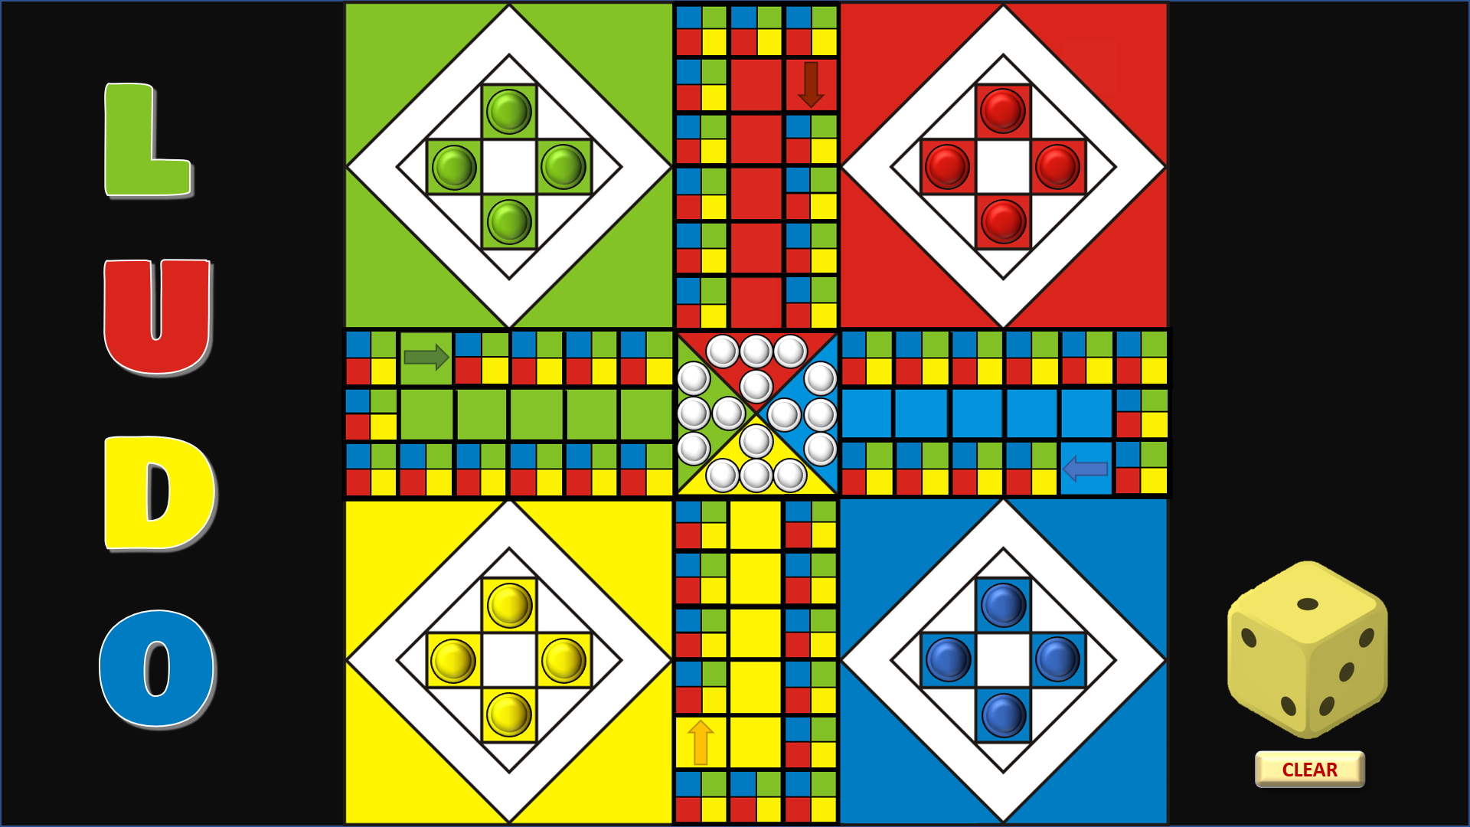
Play to the standard rules of Ludo.
Click on a counter in the corner yard for it to disappear (if necessary, click on a blank square in a corner for a counter to re-appear)
According to the throw of the die, click on the small square of your colour for a counter to appear.
Click on the counter for it to disappear.
Click on a small white counter in the centre when you have got a counter ‘home’.
Roll the die by clicking in the yellow die below, then hit the ‘Clear’ button for the next turn.
RULES
PLAY

Slide 2
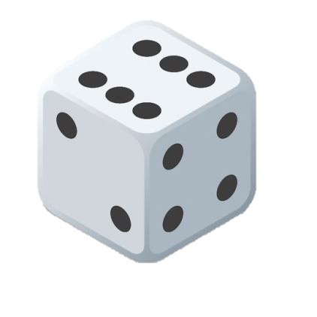
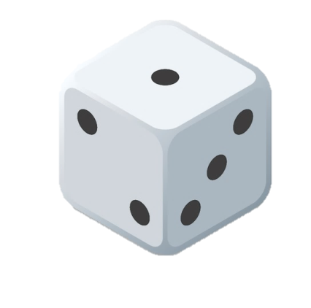
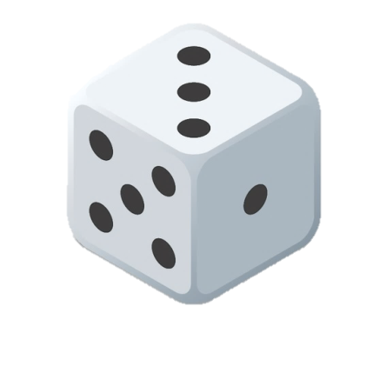
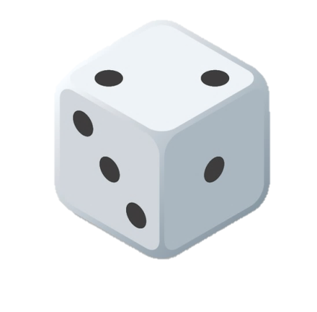
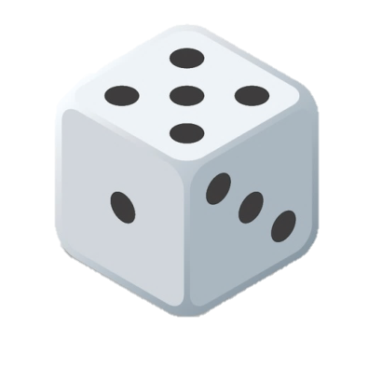
LUDO
HOME
RULES
CLEAR

Slide 3
LUDO – STANDARD RULES
Each player rolls the die; the highest roller begins the game. Players alternate turns in a clockwise direction.
To enter a counter into play from its corner yard to its starting square, a player must roll a 6. If the player has no counters yet in play and rolls other than a 6, the turn passes to the next player.
Once a player has one or more counters in play, they select a counter and move it forwards along the track the number of squares indicated by the die. Players must always move a counter according to the die value rolled. If no move is possible, the turn moves to the next player.
When a 6 is rolled, the player may choose to advance a counter already in play, or may enter another counter to its starting square from the corner yard. Rolling a 6 earns the player an additional or "bonus" roll in that turn. If the bonus roll results in a 6 again, the player earns an additional bonus roll. If the third roll is also a 6, the player may not move and the turn immediately passes to the next player.
Players may not end their move on a square they already occupy. If the advance of a counter ends on a square occupied by an opponent's counter, the opponent’s counter is returned to its owner's yard. The returned counter can be re-entered into play only when the owner rolls a 6.
A player's starting and home column squares are always safe as no opponent may enter them.
The first player to bring all their counters to the finish wins the game. Play can continue to determine second-, third-, and fourth-place finishers if desired.
HOME
PLAY

