Slide 1
Learn English with movies

Slide 2
The Incredibles
Watch the video
Answer the questions
Place your bets
Win real fake money!

Slide 3
Match the expressions

Slide 4
Place your bets...
$$$

Slide 5
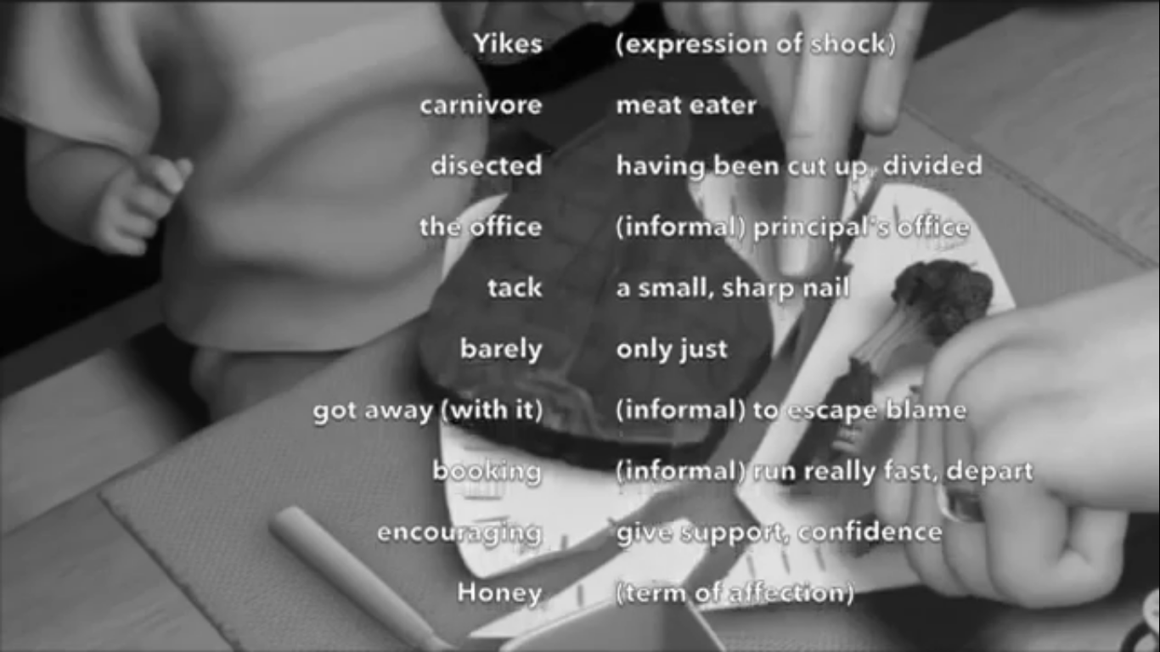
And the answers are...

Slide 6
Lord of the rings
Watch the video here:
Answer the questions
Place your bets
Win real fake money!

Slide 7
Match the expressions...

Slide 8
Place your bets...
$$$

Slide 9
And the answers are...

Slide 10
Finding Nemo
Watch the video here:
Answer the questions
Place your bets
Win real fake money!

Slide 11
Match the expressions...

Slide 12
Place your bets...
$$$

Slide 13
And the answers are...

Slide 14
Toy story
Watch the video here:
Answer the questions
Place your bets
Win real fake money!

Slide 15
Match the expressions...

Slide 16
Place your bets...
$$$

Slide 17
And the answers are...

