Slide 1
MEMORIZE
PLAY
PLAY

Slide 2
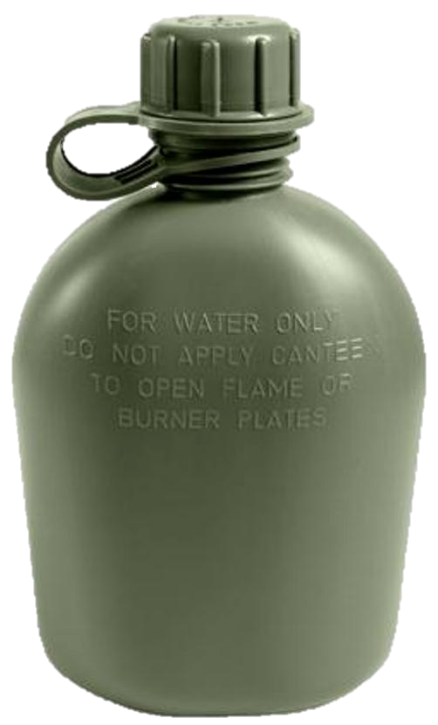
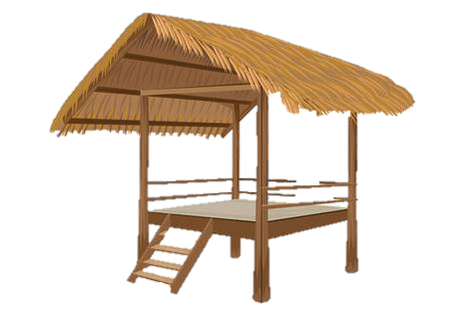
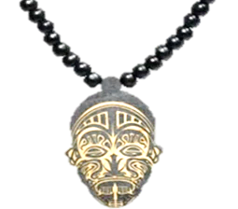
SURVIVAL
MEMORIZE
A
B
C
D
E
F
1
1
2
2
3
3
8
7
9
1
2
3
4
5
0
6
6
0
5
8
9
3
1
4
2
7
A
B
C
D
E
F

Slide 3
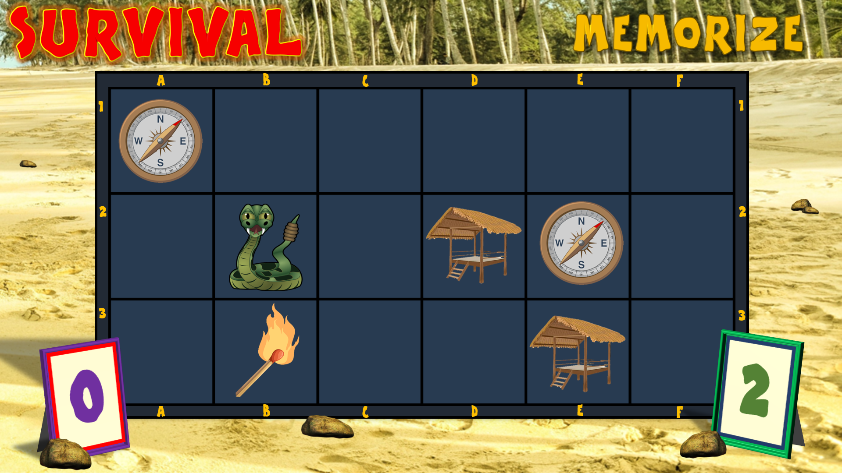
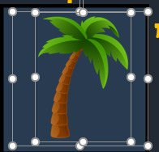
INSTRUCTIONS:
1. Establish Green & Purple teams and who goes first
To re-position the images for another game, select the image and the transparent rectangle over it and drag both to a different square
(The transparent rectangle is the trigger for the image to fade in & out).
2. Ask a question to the first team.
If correct, they can choose two squares from the board to view (E.g. call out
B2 & B3)
3. Click on the two chosen squares (but not near the top)
If different: click on them again to hide them
If the same: click on the top of the 2nd square chosen for crowd cheering, (invisible on the slide). Leave the 2 pictures visible then…
Click here for music and cheers for the winner
Click here to reset and hide all the pictures
4. Click on the scoreboards to progress the scores for each matching pair chosen
5. If team’s answer incorrect, it goes to the other team to answer and choose two squares

