Slide 1
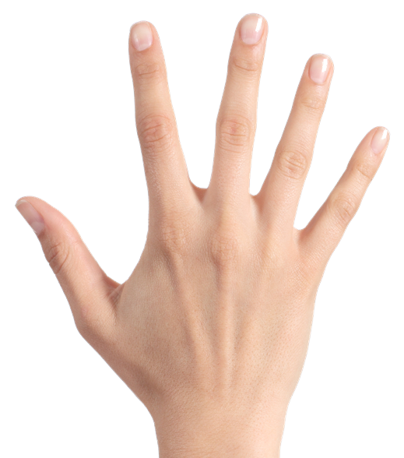
HOW TO PLAY
PLAY

Slide 2
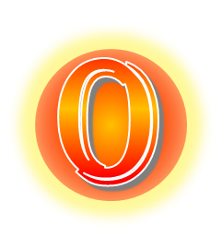
0
1
2
3
4
5
0
1
2
3
4
5
START
0
1
2
3
4
5
reset
0
1
2
3
4
5

Slide 3
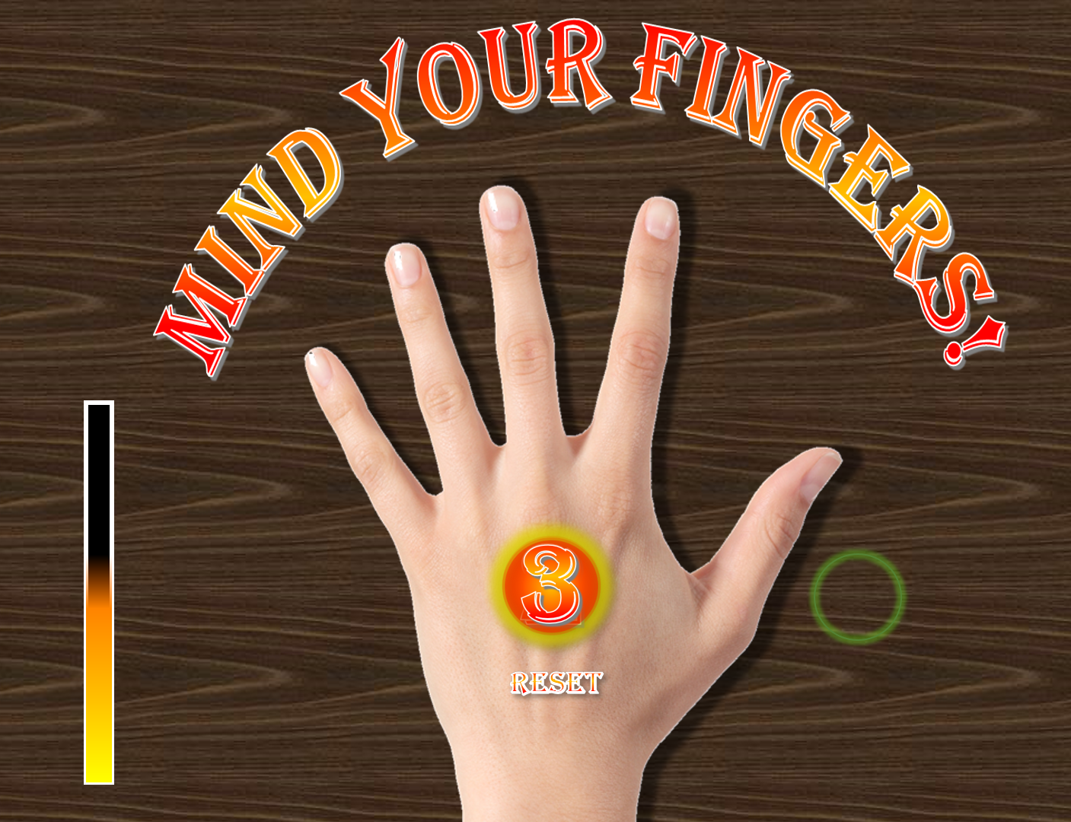
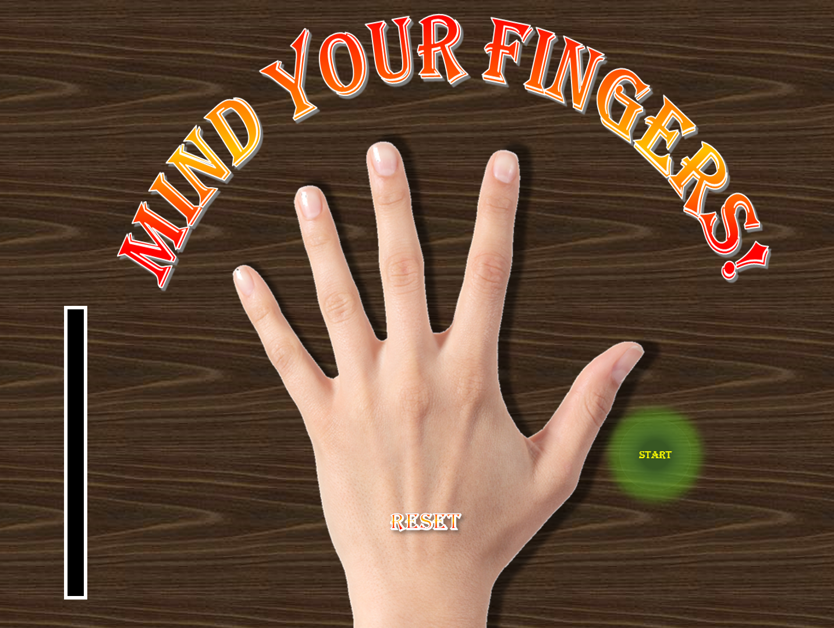
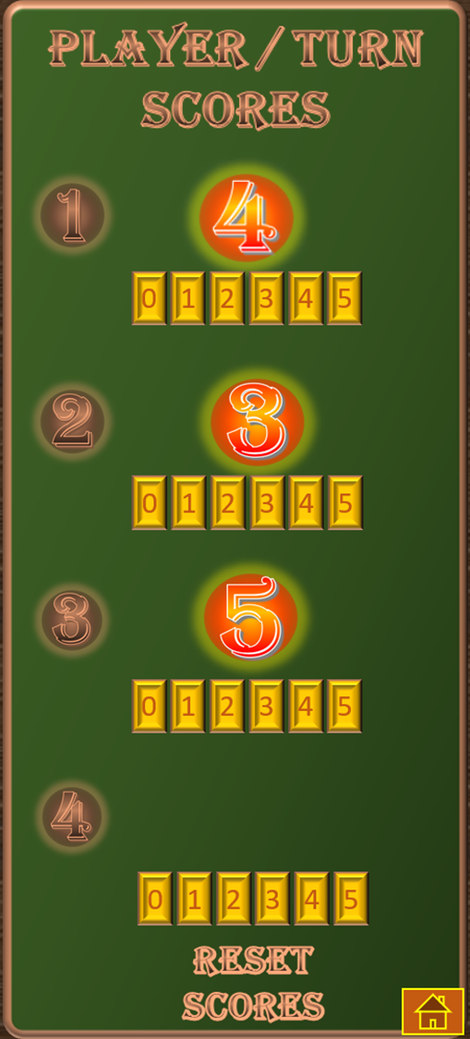
HOW TO PLAY
2. Click on all the spaces on each side of the hand and between the fingers as fast as you can from right to left and back again.
Avoid clicking on a finger!
1. Click here to start and finish
3. This scoring button will show the number of back & forth ‘rounds’ completed.
6. To score, deduct the number of clicked fingers (red dots) from the number of rounds achieved within the time limit then click on the relevant number. The highest score at the end of the game wins.
7. Reset the scores at the end of the game
4. Aim to achieve the completion of 5 rounds before you hear the sound of the timer finishing. If you hear any applause, you have beaten the timer!
5. At the end of the 5 rounds, click on the ‘Reset’ button for the next turn .
Make sure you finish your 5th round before resetting even if you don’t beat the timer.
play

