Slide 1
HOW TO PLAY
PLAY

Slide 2
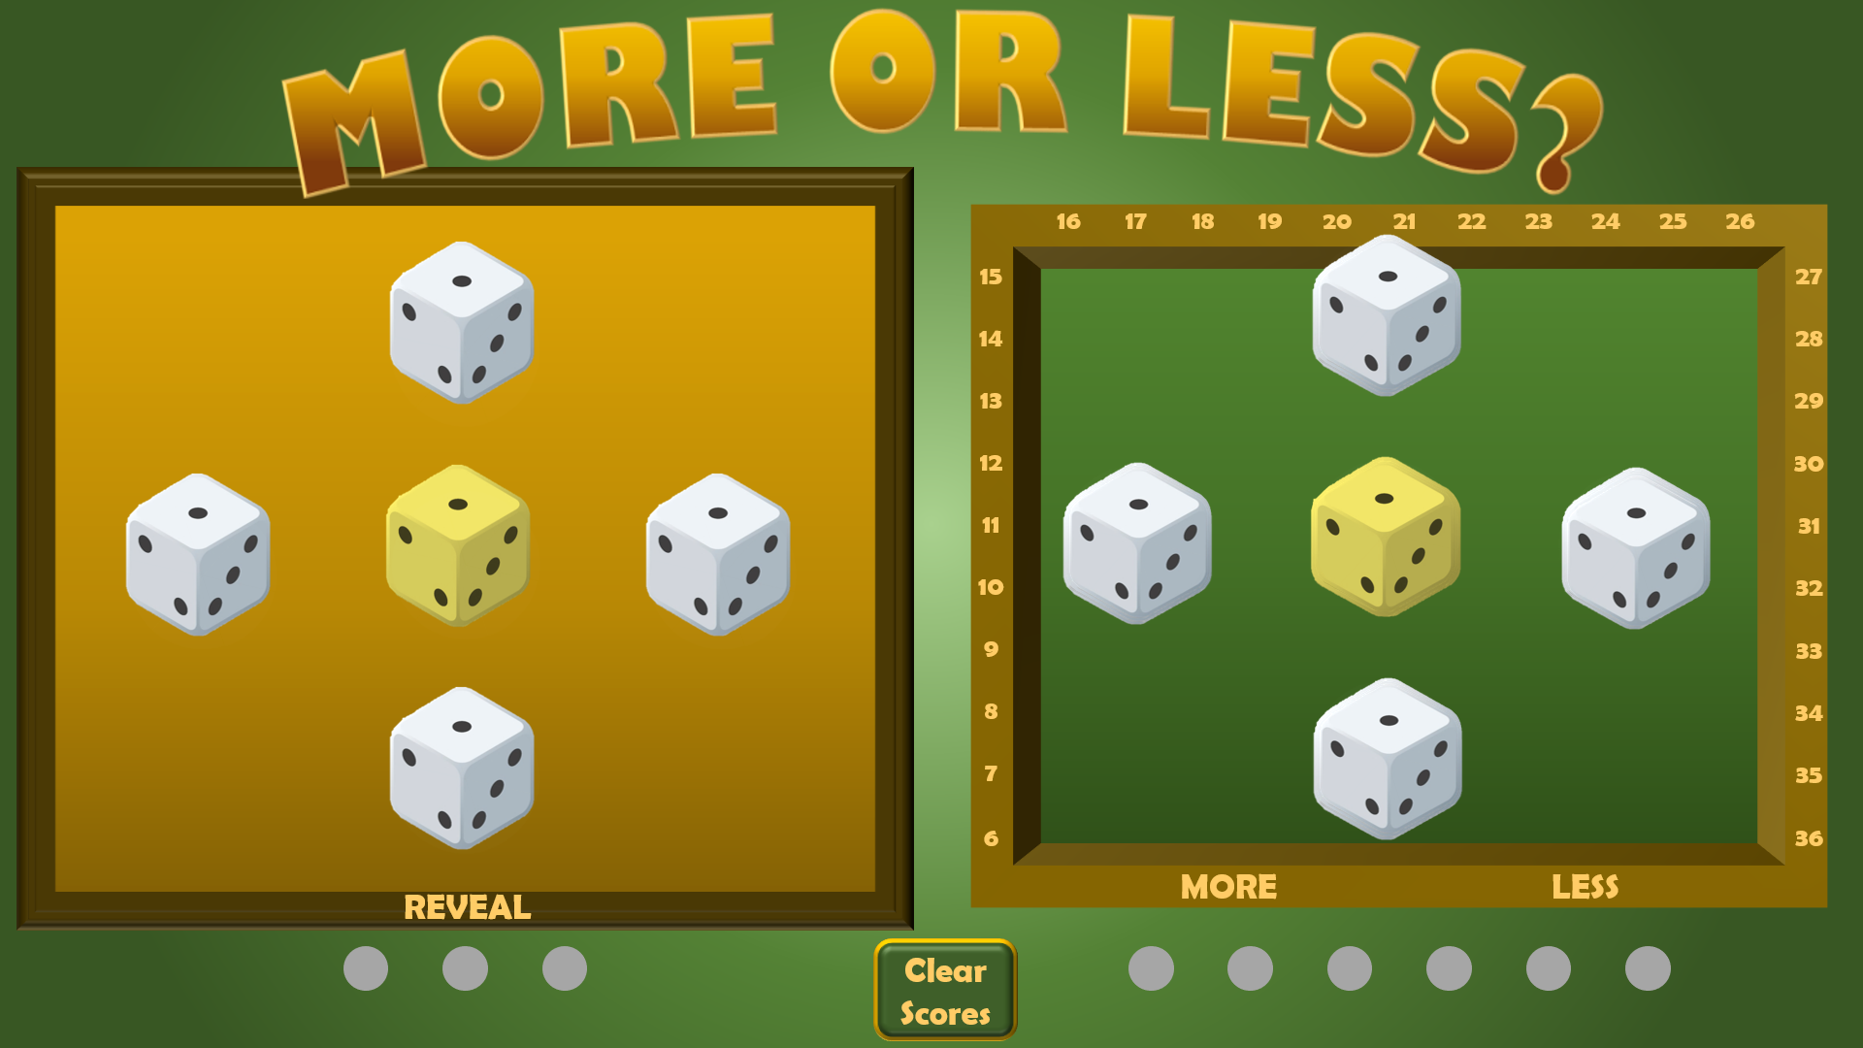
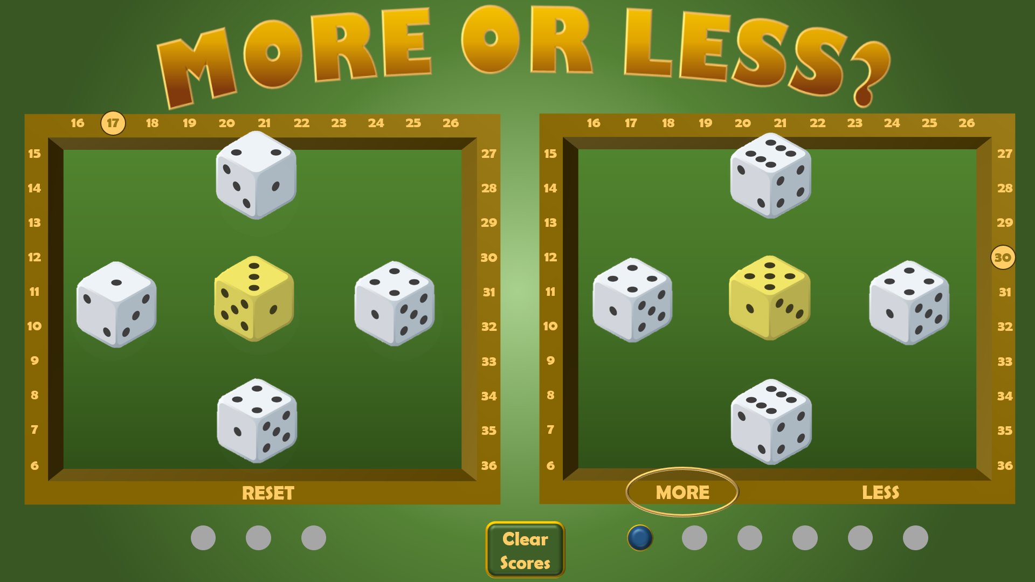
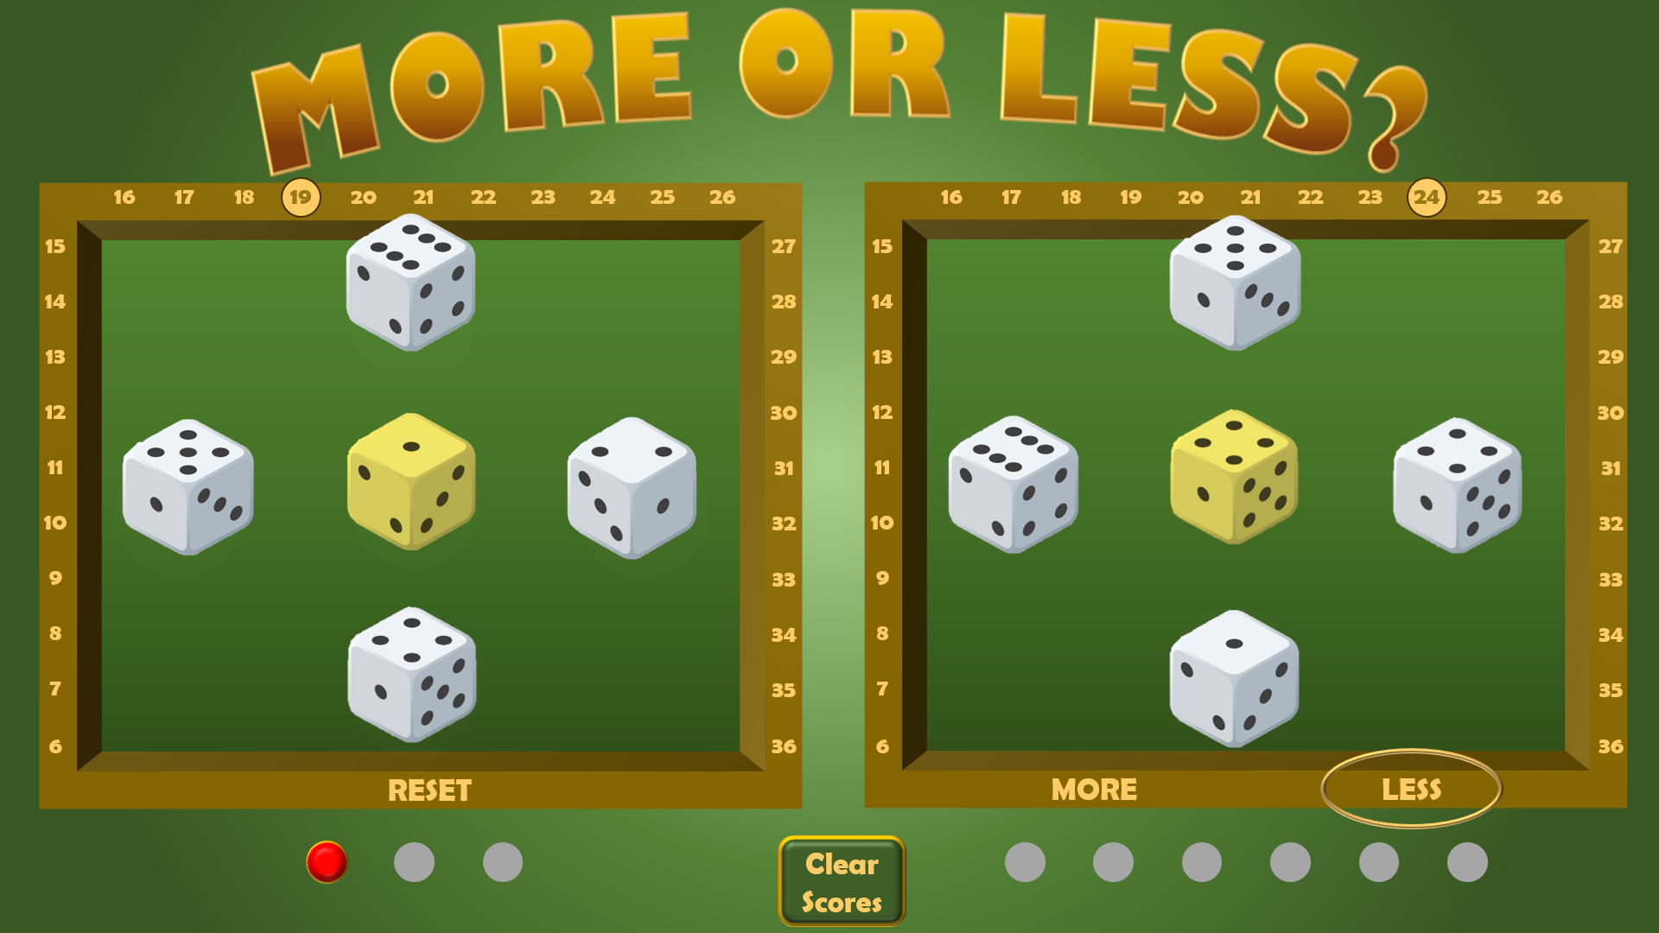
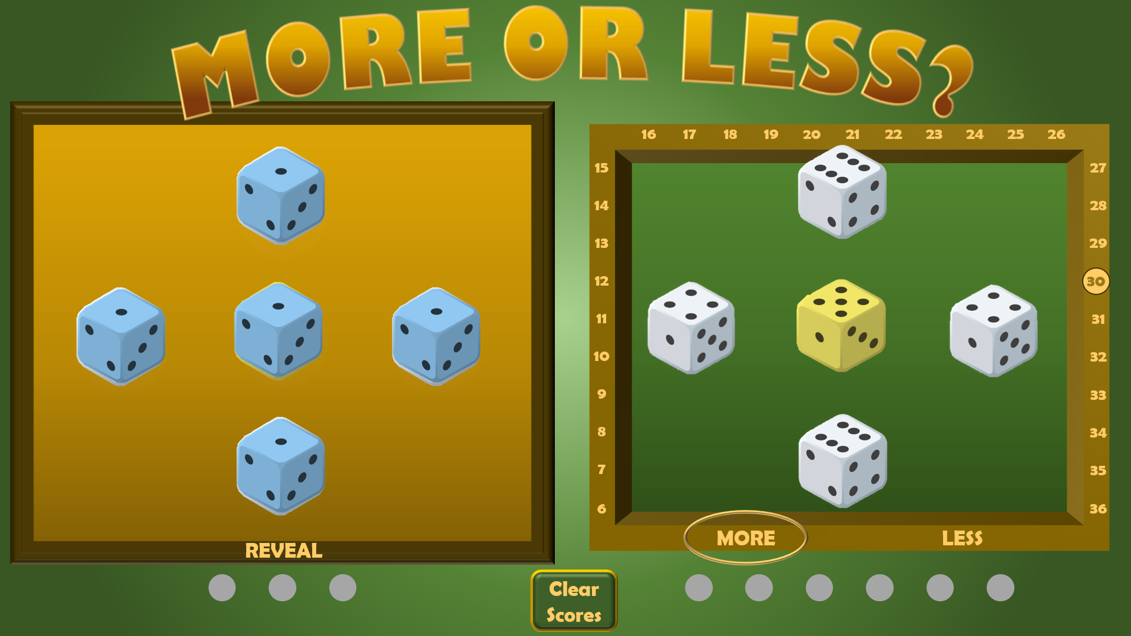
HOW TO PLAY
PLAY
4. ADD UP THE DICE NUMBERS ON THE LEFT. THE YELLOW DICE IS ALSO WORTH DOUBLE
IF YOUR ESTIMATION OF MORE OR LESS IS CORRECT, CLICK ON A GREY DOT BELOW YOUR FRAME (BLUE) AS A WIN FOR YOU. THEN CLICK ON THE ‘RESET’ BUTTON
1. CLICK ON THE DICE ON THE LEFT SO THEY ALL TURN BLUE. THIS WILL SPIN THE DICE BENEATH THE COVER
2. CLICK ON THE DICE ON THE RIGHT (YOUR SIDE) SO THEY SPIN AND REVEAL THEIR NUMBERS.
THE YELLOW DICE IS WORTH DOUBLE THE NUMBER SHOWN
ADD THESE UP AND CLICK ON THE RELEVANT NUMBER ON THE FRAME
5. IF YOUR ESTIMATION OF MORE OR LESS IS INCORRECT CLICK ON A DOT BELOW THE FRAME ON THE LEFT (RED) AS A LOSS FOR YOU. THEN CLICK ON THE RESET BUTTON
6. YOU WIN THE GAME BY GETTING SIX BLUE DOTS BEFORE THE OTHER SIDE GETS THREE RED DOTS
CLICK ON THE ‘CLEAR SCORE’ BUTTON TO START A NEW GAME
3. THEN INDICATE WHETHER YOU THINK YOUR SCORE IS HIGHER OR LOWER (MORE OR LESS) THAN THE TOTAL DICE SCORE BENEATH THE COVER – AND THEN CLICK ‘REVEAL’

Slide 3
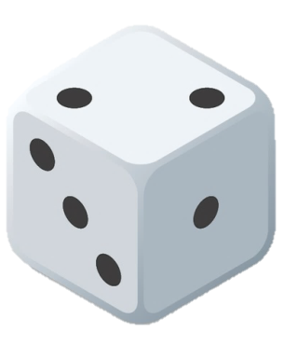
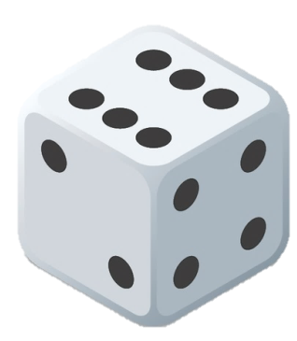
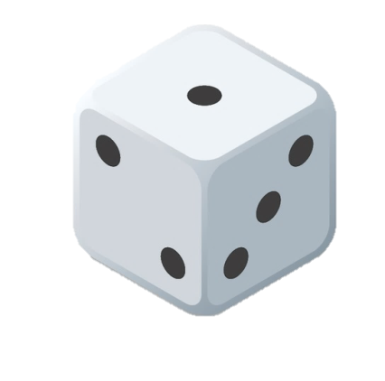
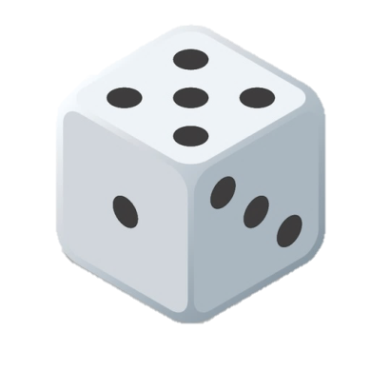
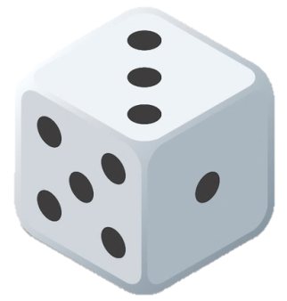
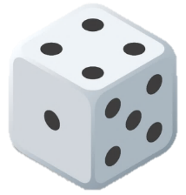
16
16
17
17
18
18
19
19
20
20
21
21
22
22
23
23
24
24
25
25
26
26
16
16
17
17
18
18
19
19
20
20
21
21
22
22
23
23
24
24
25
25
26
26
15
15
27
27
15
15
27
27
14
14
14
28
14
28
28
28
13
13
13
29
13
29
29
29
12
12
12
30
12
30
30
30
11
11
11
31
11
31
31
31
10
10
10
32
10
32
32
32
9
9
9
33
9
33
33
33
8
8
8
34
8
34
34
34
7
7
7
35
7
35
35
35
6
6
36
36
6
6
36
36
RESET
MORE
LESS
REVEAL
Clear Scores

