Slide 2
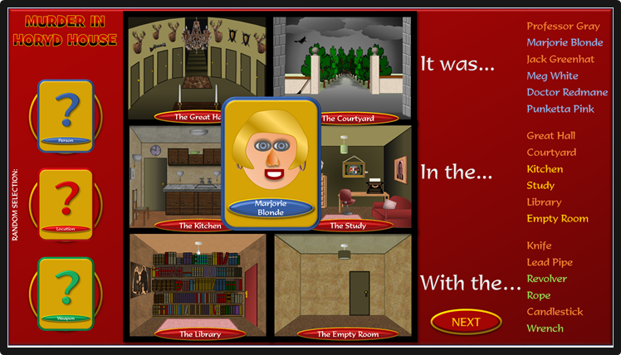
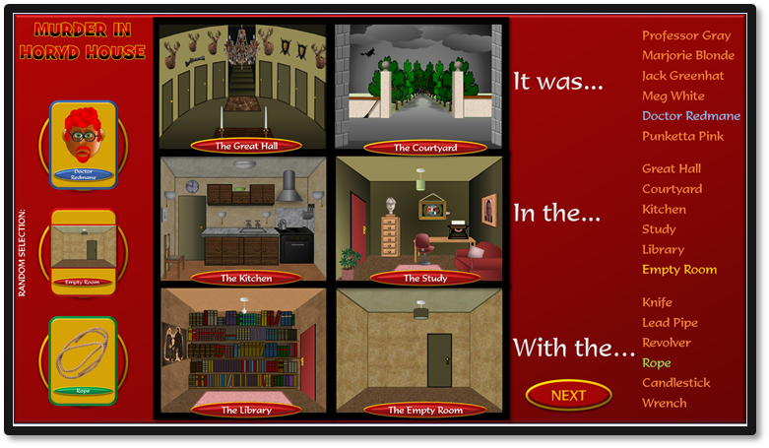
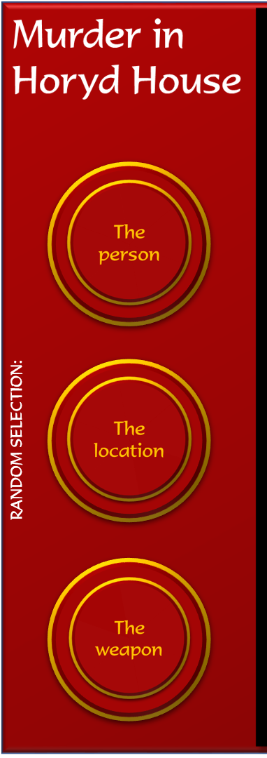
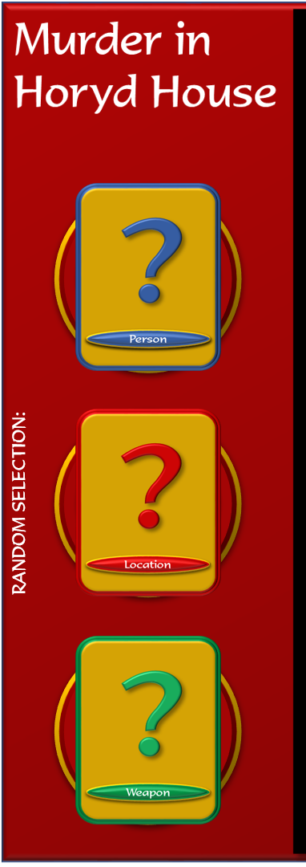
1
2
3
Click on the random selection buttons to select who carried out the murder, in what location, and with what weapon.
The ‘?’ cards that cover the buttons must remain in place until the end.
Move your cursor to search around all the rooms / locations. When you see a pointing finger - click.
A card will then pop up to reveal a person, a location or a weapon.
Whatever it is – click on the corresponding name on the list, where it will change colour.
(Click again to reverse the colour change if you make a mistake).
When you have eliminated all but one person, location and weapon, click on each of the ‘?’ cards to reveal who carried out the murder, in what location, and with what weapon.
If they match, you have solved the case!
The card will drop down again automatically after two seconds.
Click on the ‘Next’ button to start a new game.

Slide 3
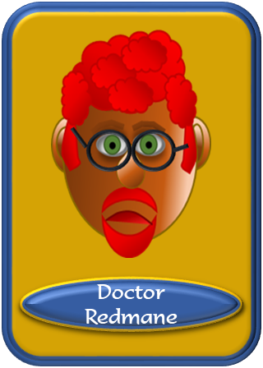
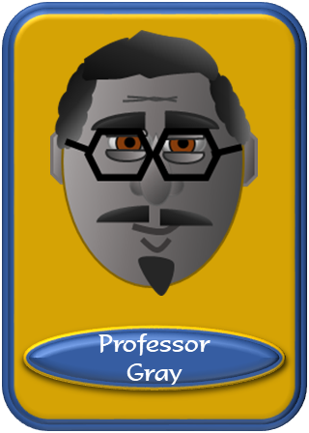
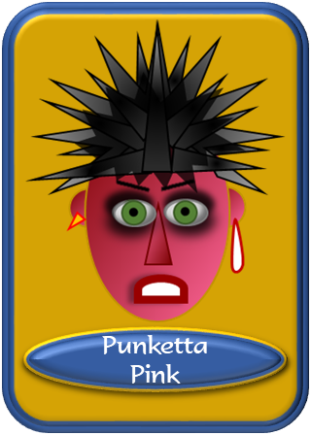
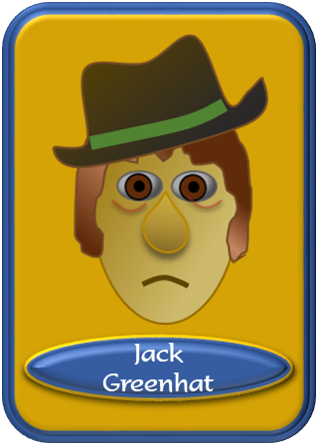
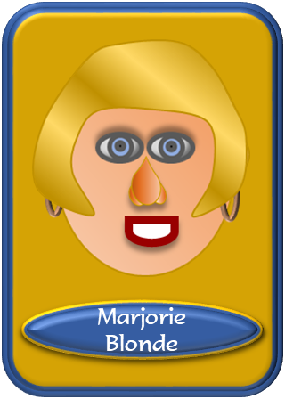
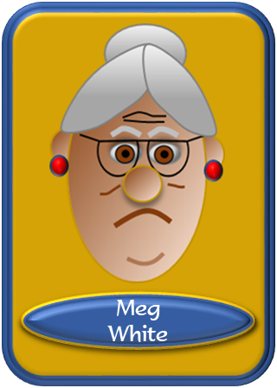
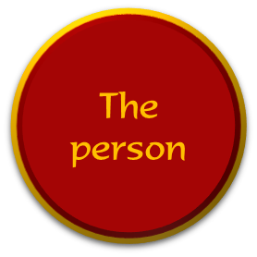
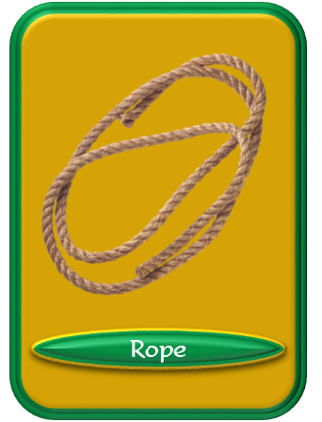
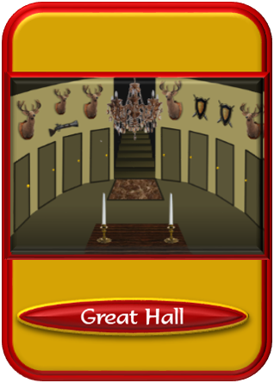
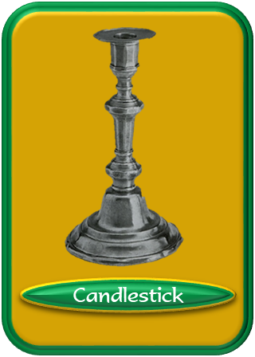
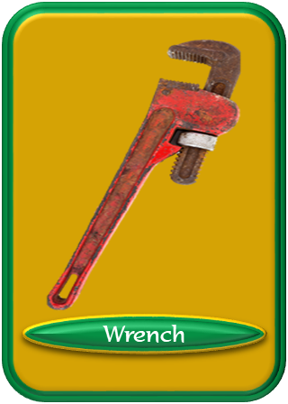
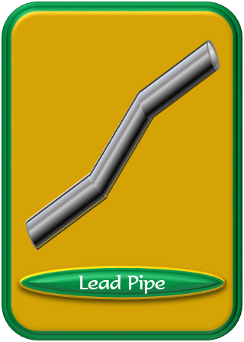
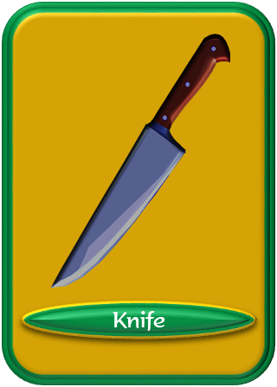
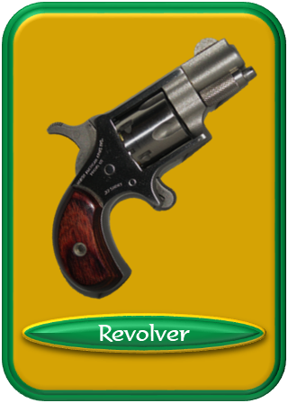
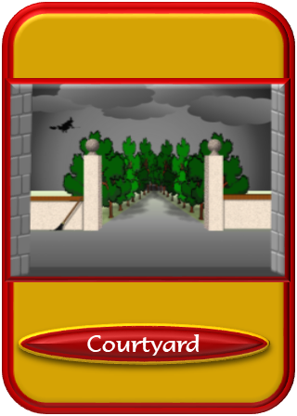
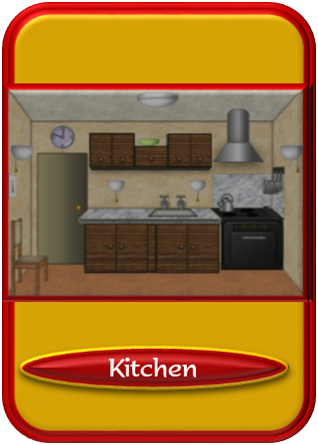
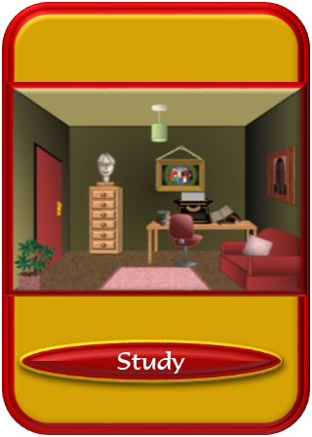
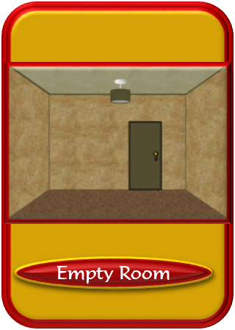
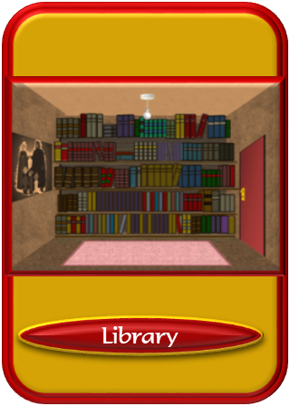
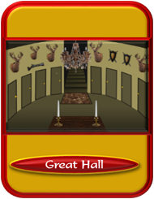
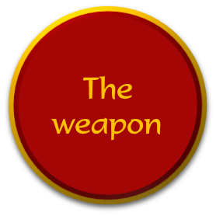
Professor Gray
Marjorie Blonde
It was...
Jack Greenhat
Meg White
The person
Doctor Redmane
Punketta Pink
Great Hall
Courtyard
In the...
Kitchen
The location
Study
RANDOM SELECTION:
Library
Empty Room
Knife
The weapon
Lead Pipe
With the…
Revolver
Rope
Candlestick
NEXT
Wrench

Slide 4
Professor Gray
Marjorie Blonde
It was...
Jack Greenhat
Meg White
The person
Doctor Redmane
Punketta Pink
Great Hall
Courtyard
In the...
Kitchen
The location
Study
RANDOM SELECTION:
Library
Empty Room
Knife
The weapon
Lead Pipe
With the…
Revolver
Rope
Candlestick
NEXT
Wrench

Slide 5
Professor Gray
Marjorie Blonde
It was...
Jack Greenhat
Meg White
The person
Doctor Redmane
Punketta Pink
Great Hall
Courtyard
In the...
Kitchen
The location
Study
RANDOM SELECTION:
Library
Empty Room
Knife
The weapon
Lead Pipe
With the…
Revolver
Rope
Candlestick
NEXT
Wrench

Slide 6
Professor Gray
Marjorie Blonde
It was...
Jack Greenhat
Meg White
The person
Doctor Redmane
Punketta Pink
Great Hall
Courtyard
In the...
Kitchen
The location
Study
RANDOM SELECTION:
Library
Empty Room
Knife
The weapon
Lead Pipe
With the…
Revolver
Rope
Candlestick
NEXT
Wrench

Slide 7
Professor Gray
Marjorie Blonde
It was...
Jack Greenhat
Meg White
The person
Doctor Redmane
Punketta Pink
Great Hall
Courtyard
In the...
Kitchen
The location
Study
RANDOM SELECTION:
Library
Empty Room
Knife
The weapon
Lead Pipe
With the…
Revolver
Rope
Candlestick
NEXT
Wrench

