Slide 2
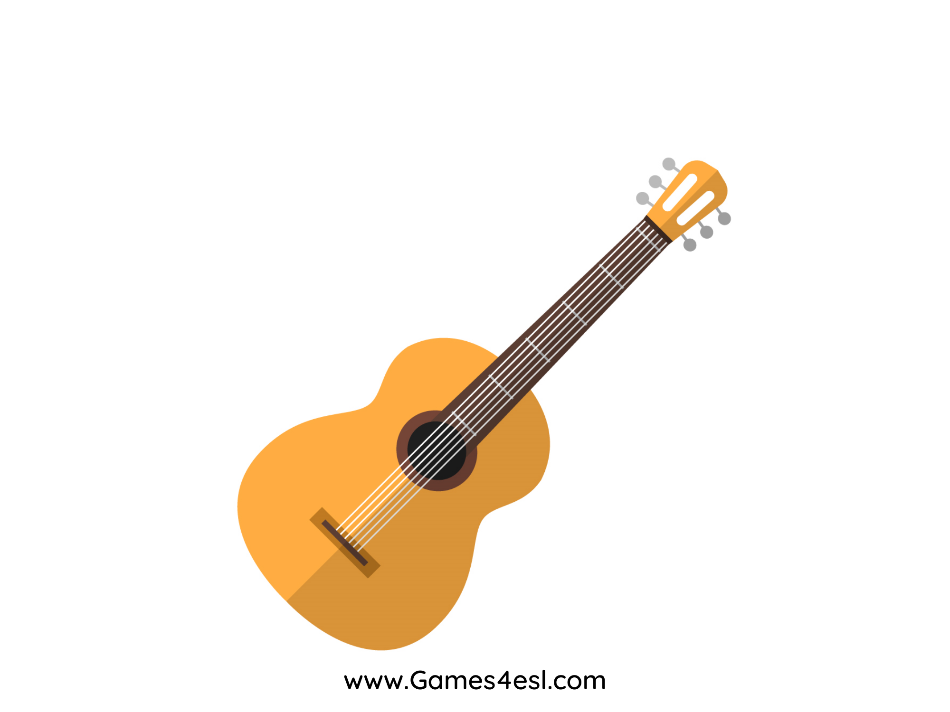
guitar
SHOW

Slide 3
tambourine
SHOW

Slide 4
xylophone
SHOW

Slide 5
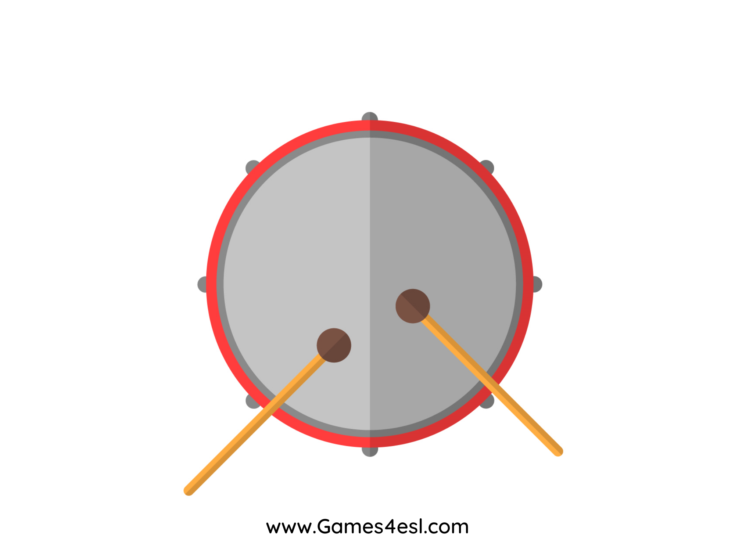
drum
SHOW

Slide 6
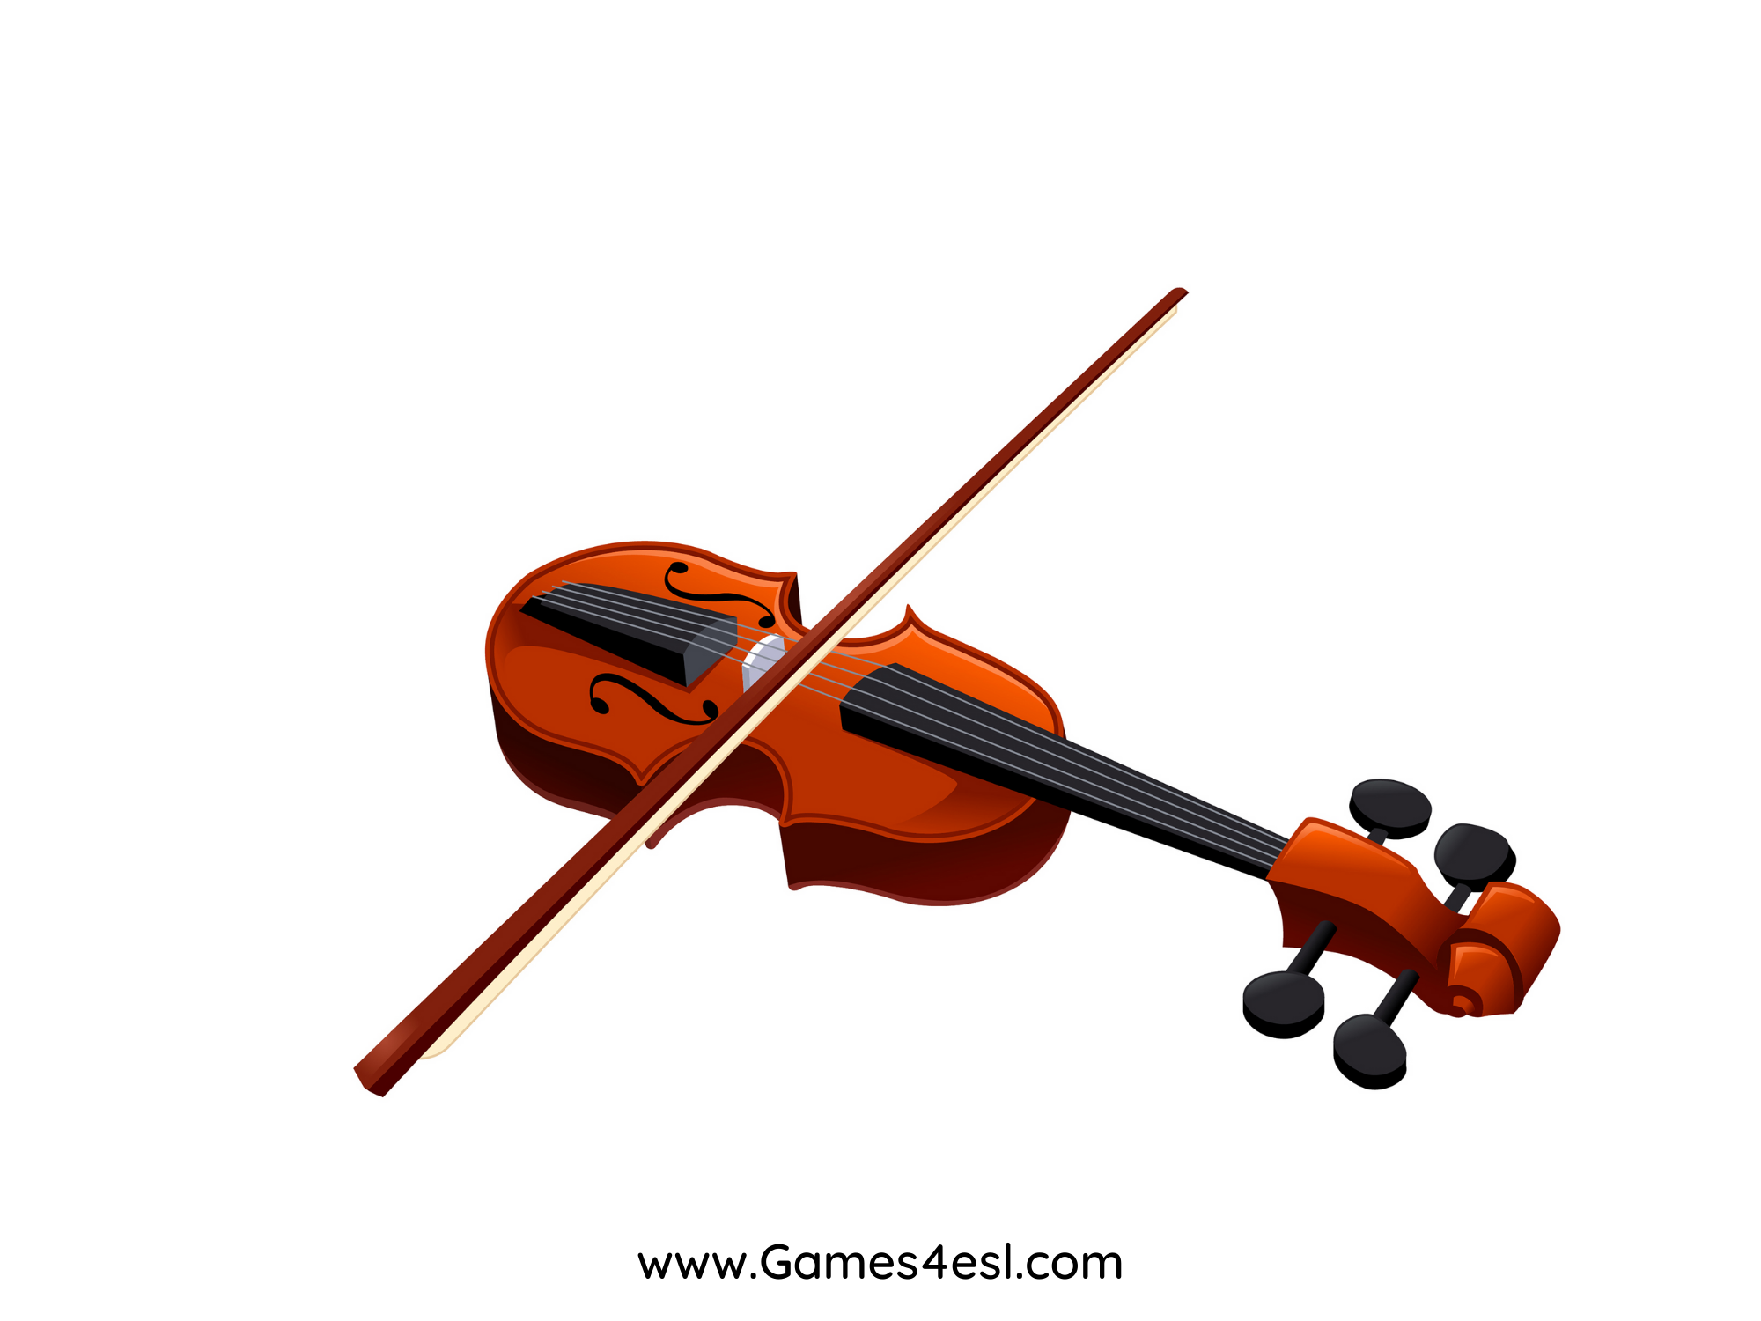
violin
SHOW

Slide 7
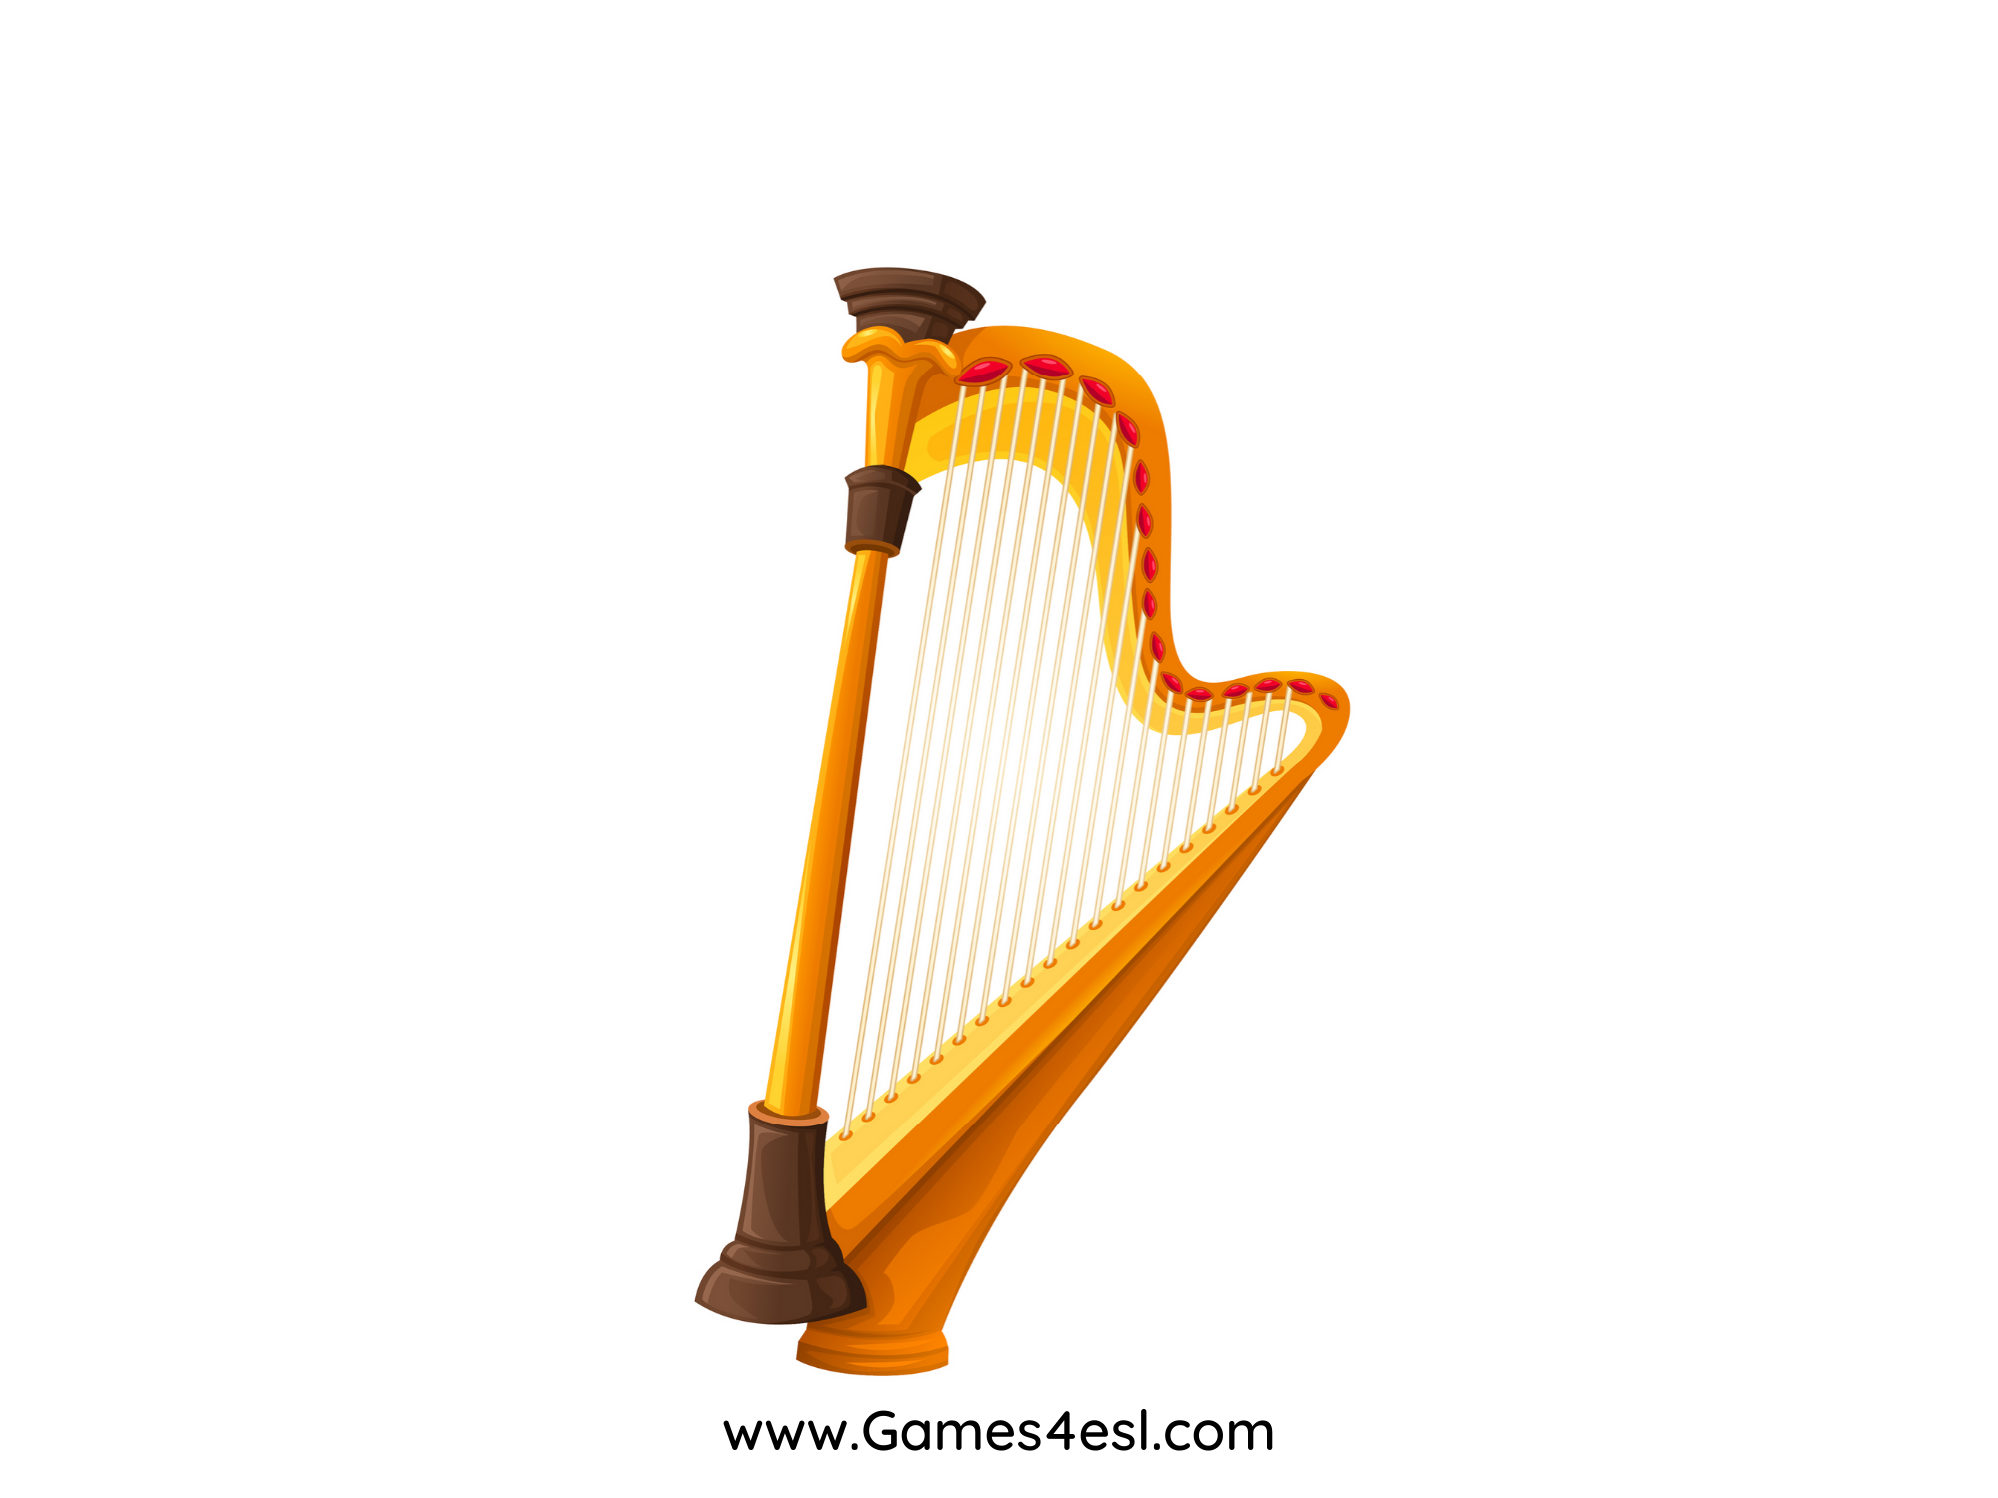
harp
SHOW

Slide 8
saxophone
SHOW

Slide 9
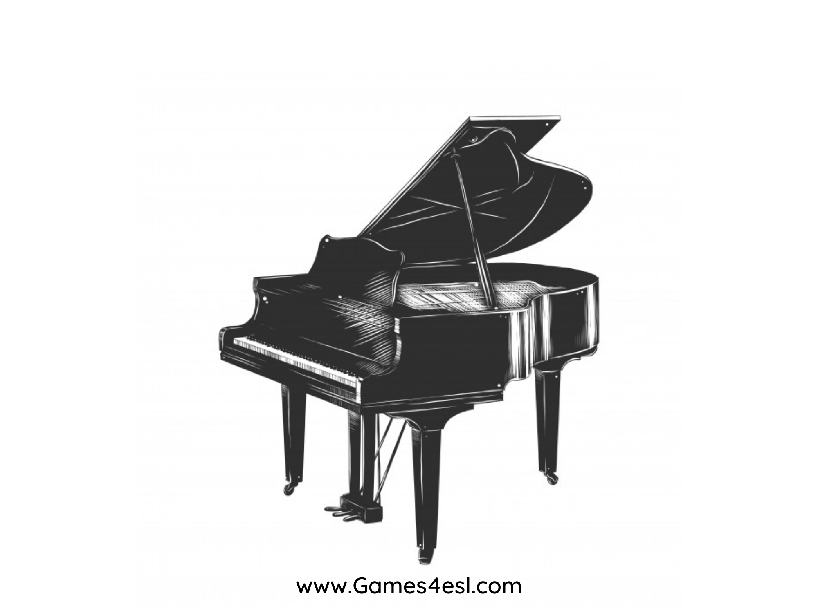
piano
SHOW

