Slide 1
Natural disasters

Slide 2
Contents
Hurricanes
Tornadoes
Earthquakes
Tsunamis
Volcanoes
Flooding

Slide 3
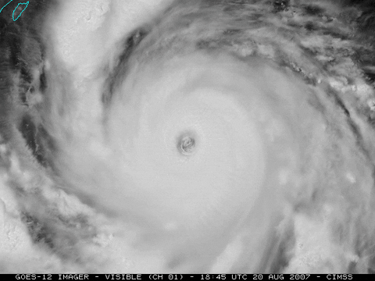
Hurricanes

Slide 10
Now play the game...
https://www.stopdisastersgame.org/

Slide 11
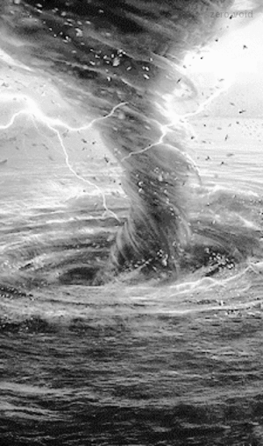
Tornadoes

Slide 14
Now play the game...
https://www.stopdisastersgame.org/

Slide 15
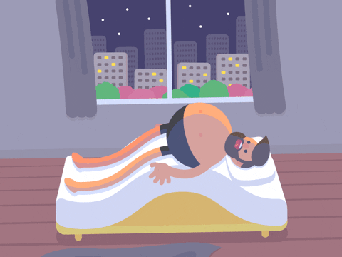
Earthquakes

Slide 19
Now play the game...
https://www.stopdisastersgame.org/

Slide 20

Tsunamis

Slide 22
Now play the game...
https://www.stopdisastersgame.org/

Slide 23
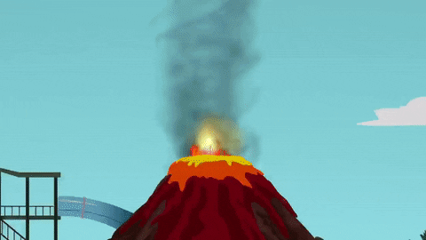
Volcanoes

Slide 25
Now play the game...
https://www.stopdisastersgame.org/

Slide 26
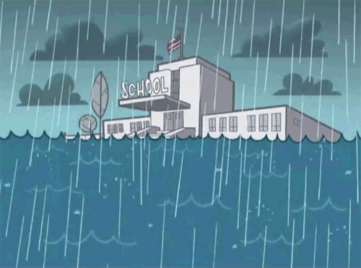
Flooding

Slide 27
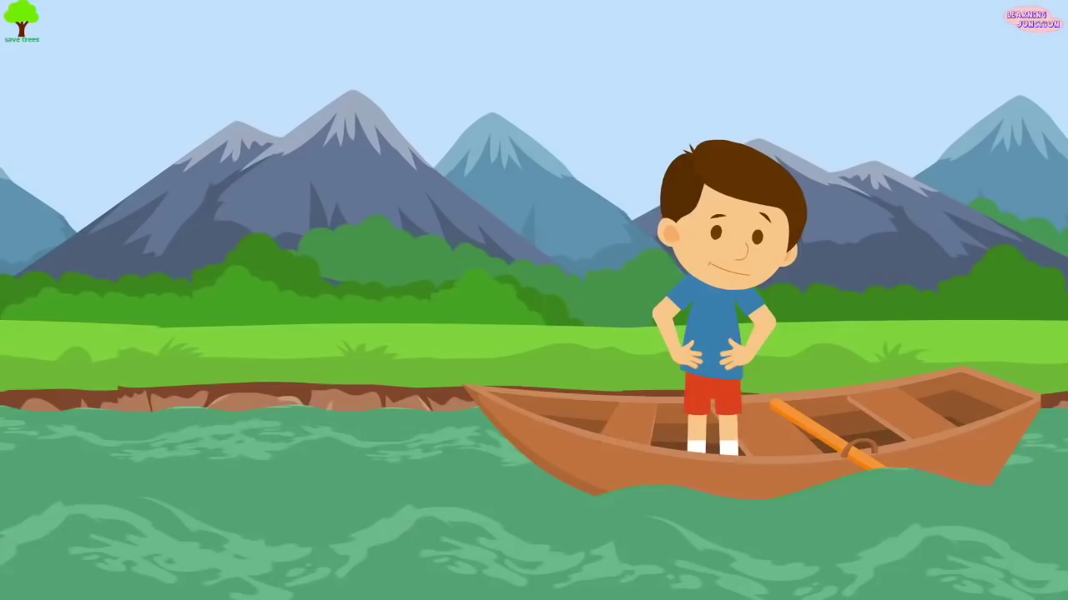

Slide 28
Now play the game...
https://www.stopdisastersgame.org/

