Slide 1
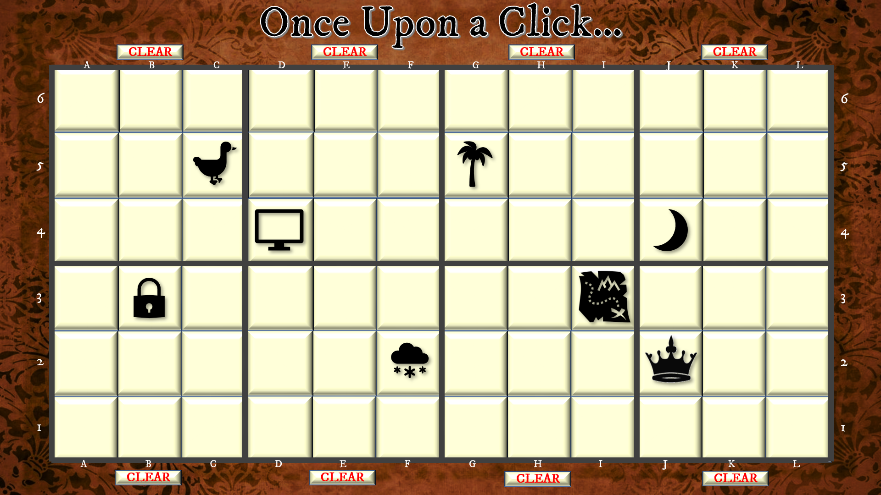
Once Upon a Click…
The storytelling icon game
There are many ways to play:
Choose (click on) 1 square from each mini block of 9.
Choose all nine in one mini block.
Choose all the centre or corner squares in a mini block or a number of mini blocks.
Choose as many squares as you want in random positions.
Make up the story as each icon is revealed.
Reveal all the icons you want, then make up your story using them in any sequence and/or…
Print a screen-shot and draw the lines to link the icons as the story develops.
Get someone else to choose your squares by the reference numbers (A5 / H4 / L1 etc).
If two or more players, take turns to choose one or more squares and follow-on the story from the previous player.
Just click on any number of squares to reveal icons, then make up a story based on the icons you’ve revealed
Click on the blanks
Each blank square can reveal three different icons
Click on a
button to delete all the icons in the mini block above or below it
CLEAR

Slide 2
Once Upon a Click…
CLEAR
CLEAR
CLEAR
CLEAR
CLEAR
CLEAR
CLEAR
CLEAR

