Slide 1
The game is played by moving the cursor along the red arteries and clicking on the various pieces of your patient’s anatomy that are ailing him to remove them. Move the cursor off the artery and you will hear a buzzer.
Start by deciding who will play first, second, third and so on. Each player must choose a colour for scoring purposes: (Red, Blue, Yellow or Green)
The first player clicks in the box at the bottom left of the screen and the first piece of anatomy to be removed will be revealed in the box at the top left.
This first piece must be removed before any others.
From the ‘Start Here’ button, the first player then moves their cursor along the red arteries to get to the first piece of anatomy and click on it. If the cursor strays from the artery and you hear the buzzer, the mouse must be passed to the next player to continue from that point.
When the first piece of anatomy is clicked, the Scoring Table will open and the player then clicks on their colour next to the piece that they have just removed. This colour will then appear and cover the relevant piece on the left hand side of the screen. The player then clicks on the anatomy piece again to return to the Operating Table.
The player can continue to move along the arteries and click on as many other pieces of anatomy as possible and go back and forth to the Scoring screen until they stray from an artery and the buzzer sounds. The mouse must then be passed to the next player in line. The next player will then continue from that point.
(A buzzer immediately after returning to the Operating Table will not require the mouse to be passed on – a move must be intentional)
THE WINNER IS THE PLAYER WITH THE HIGHEST NUMBER OF ANATOMY PIECES COVERED BY THEIR COLOUR ON THE SCORING TABLE
PLAY

Slide 2
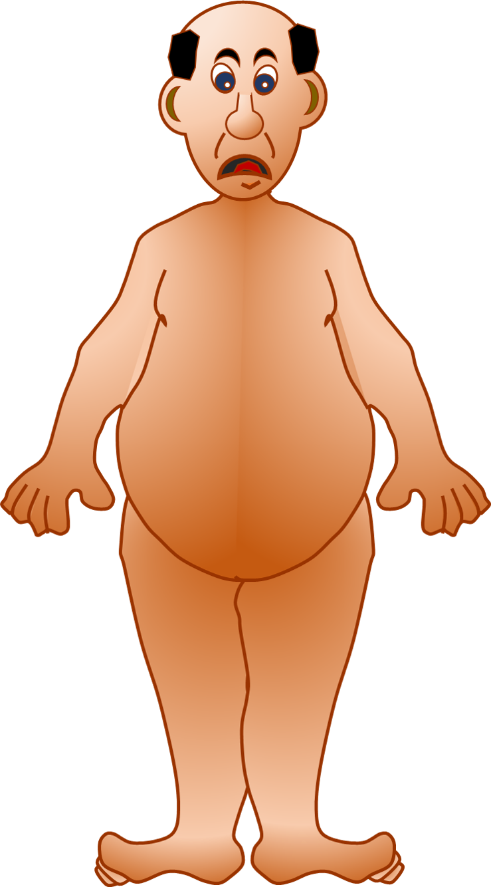
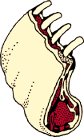
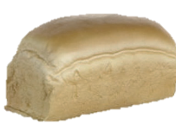
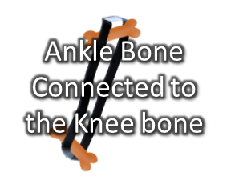
FIRST PIECE OF ANATOMY FOR REMOVAL
NEW GAME
SELECT THE FIRST PIECE OF ANATOMY TO REMOVE HERE
START HERE
RESET

Slide 3
CLEAR ALL

