Slide 1
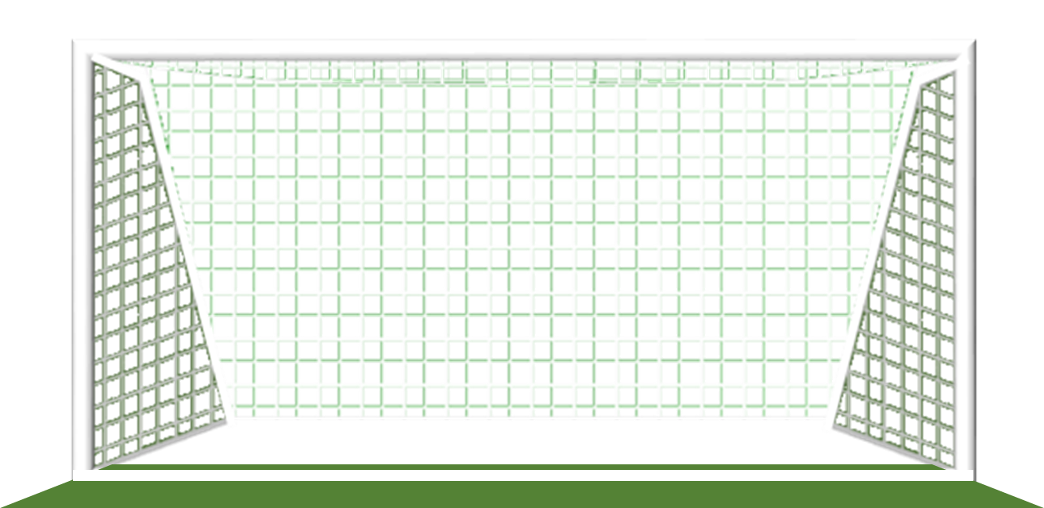
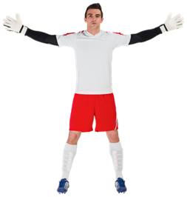
START

Slide 2
GOAL!
SAVED!
Red 1

Slide 3
GOAL!
SAVED!
White 1

Slide 4
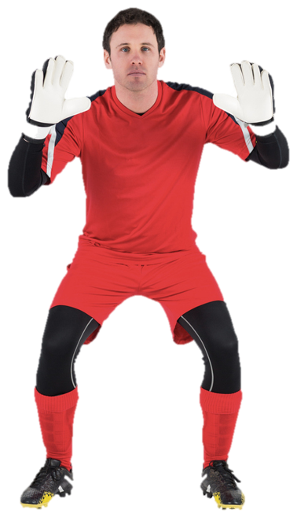
GOAL!
SAVED!
Red 2

Slide 5
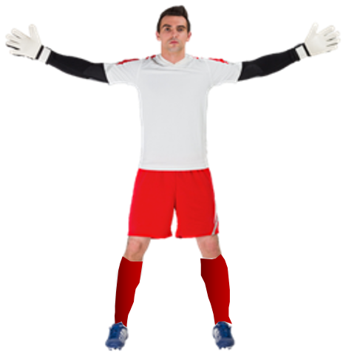
GOAL!
SAVED!
White 2

Slide 6
GOAL!
SAVED!
Red 3

Slide 7
GOAL!
SAVED!
White 3

Slide 8
GOAL!
SAVED!
Red 4

Slide 9
GOAL!
SAVED!
White 4

Slide 10
GOAL!
SAVED!
Red 5

Slide 11
GOAL!
SAVED!
White 5

Slide 12
SCOREBOARD
If a goal was scored click the ‘NEXT’ button
FINAL SCORE
LAST
NEXT
NEXT
NEXT
NEXT
NEXT
NEXT
NEXT
NEXT
SAVED
SAVED
If a penalty was saved click the relevant score box
Then click the ‘NEXT’ button
5
4
3
2
1
0
5
4
3
2
1
0

