Slide 1
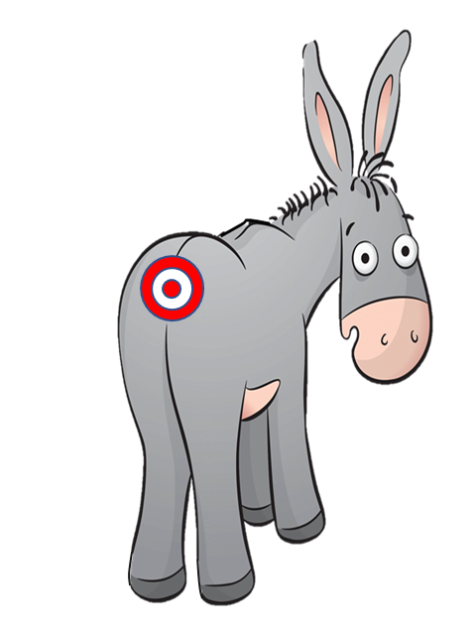
PIN THE TAIL ON THE DONKEY
A GAME FOR 1 – 4 PLAYERS
HOW TO PLAY
CLICK ON THE MOON TO START THE DONKEY MOVING – AND MAKE IT DARK
(YOU CAN TRACE THE MOVEMENT OF THE TARGET WITH YOUR CURSOR IF YOU WANT)
WHEN YOU HEAR THE CHIMES, THE DONKEY HAS STOPPED, SO CLICK WHERE
YOU THINK THE TARGET IS
(PLAYERS TAKE TURNS TO CLICK BUT CANNOT CLICK IN THE SAME SPACE AS ANY OTHER PLAYER)
THEN CLICK ON THE SUN TO MAKE IT LIGHT AGAIN, AND SEE HOW CLOSE YOU
ARE TO THE TARGET
PLAY
<<< (THIS IS HOW THE DONKEY WILL MOVE)

Slide 2
PIN THE TAIL ON THE DONKEY
NEXT

Slide 3
PIN THE TAIL ON THE DONKEY
NEXT

Slide 4
PIN THE TAIL ON THE DONKEY
NEXT

Slide 5
PIN THE TAIL ON THE DONKEY
NEXT

Slide 6
PIN THE TAIL ON THE DONKEY
NEXT

Slide 7
EXIT

