Slide 1
Ready to use ESL activities for busy English Teachers
www.YouTube.com/Games4esl
Visit us on YouTube to see our FREE, FUN, and ENGAGING, ESL Games and Activities.

Slide 2
rat
SHOW

Slide 3
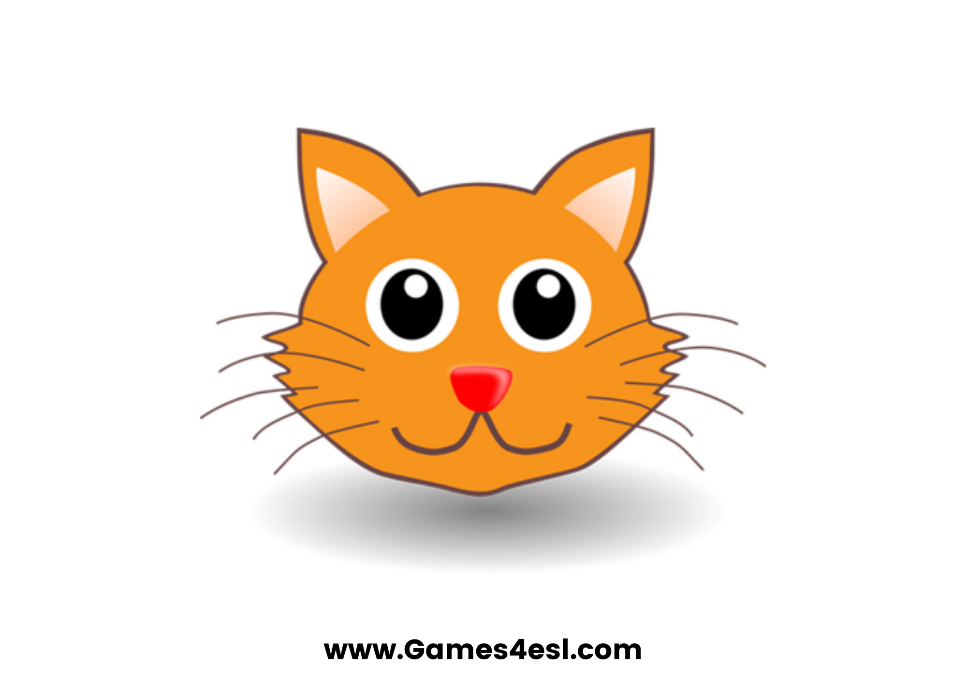
cat
SHOW

Slide 4
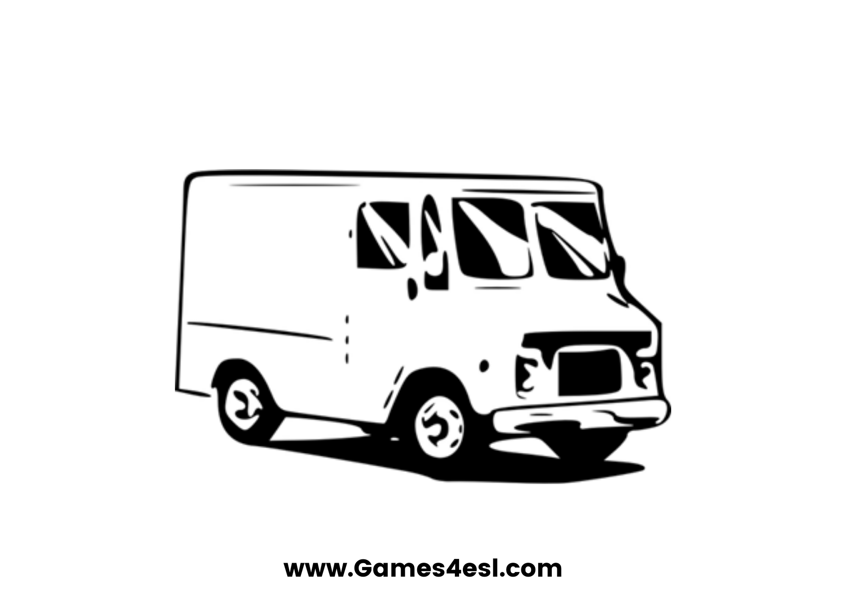
van
SHOW

Slide 5
can
SHOW

Slide 6
man
SHOW

Slide 7
tag
SHOW

Slide 8
bag
SHOW

Slide 9
map
SHOW

Slide 10
tap
SHOW

Slide 11
www.Games4esl.com
Ready to use ESL activities for busy English Teachers
www.YouTube.com/Games4esl
Visit us on YouTube to see our FREE, FUN, and ENGAGING, ESL Games and Activities.

