Slide 1
How to play
Click on the Start Button AND PLACE YOR CURSOR ON THE CENTRAL BUTTON OF THE RED CIRCLES
AFTER the third downward beat of the hands
(AFTER you hear the boom)…
PLAY
DOUBLE CLICK
on your chosen Rock Paper or Scissors picture (your hand is on the left)
CLICK ON THE SCORING BUTTON OF THE WINNER, then click ‘Start’ for a new game.
If your choices are the same, no-one scores, so just hit the ‘Start’ button again
FIRST PLAYER TO SCORE 20 POINTS IS THE WINNER
rock beats scissors, scissors beat paper, paper beats rock.

Slide 2
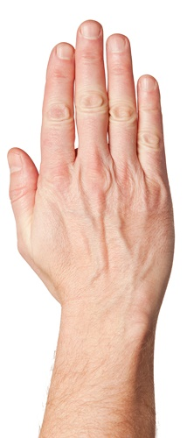
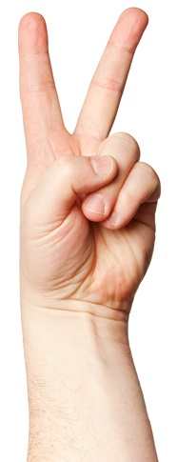
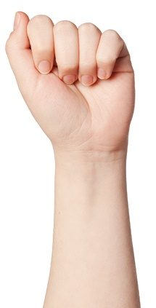
20
19
18
17
16
15
14
13
12
11
10
9
8
7
6
5
4
3
2
1
0
20
19
18
17
16
15
14
13
12
11
10
9
8
7
6
5
4
3
2
1
0
START
rock beats scissors, scissors beat paper, paper beats rock.

