Slide 1
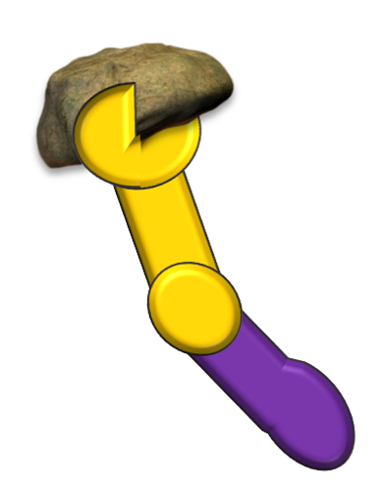
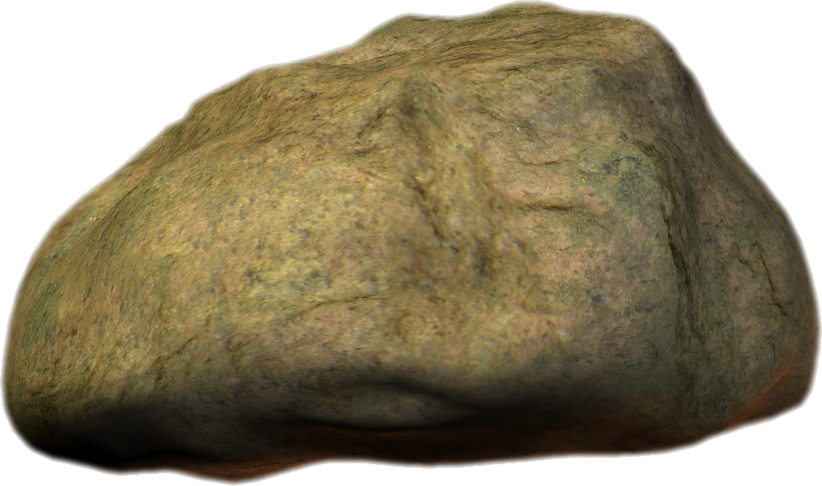
ROCKS FROM THE BOX
PLAY

Slide 2
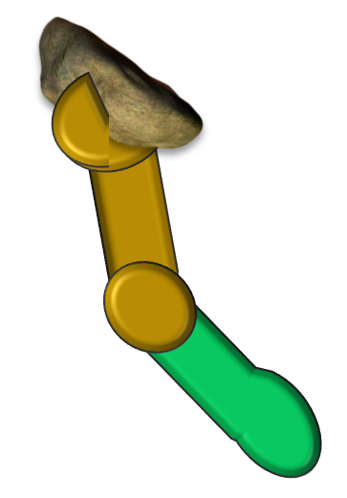
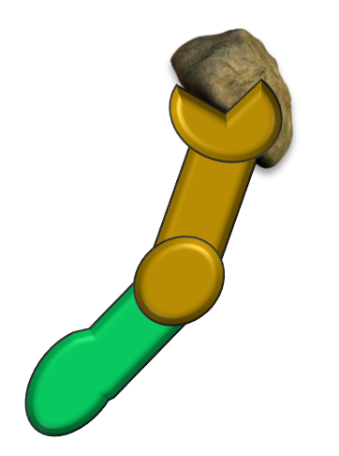
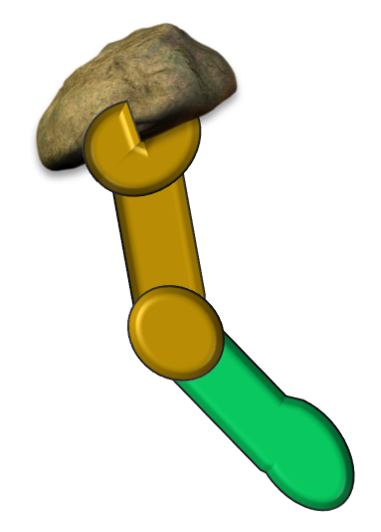
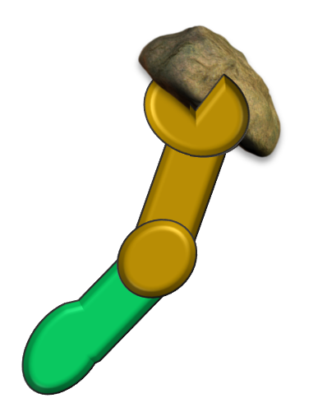
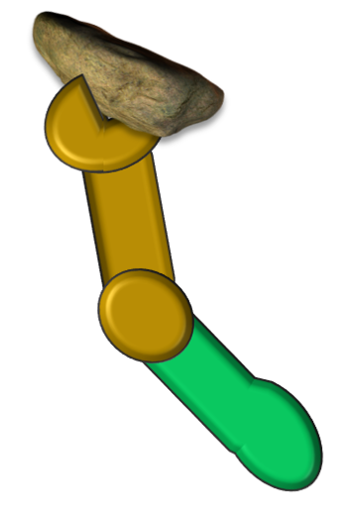
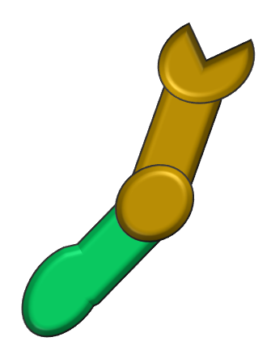
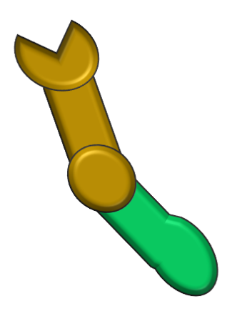
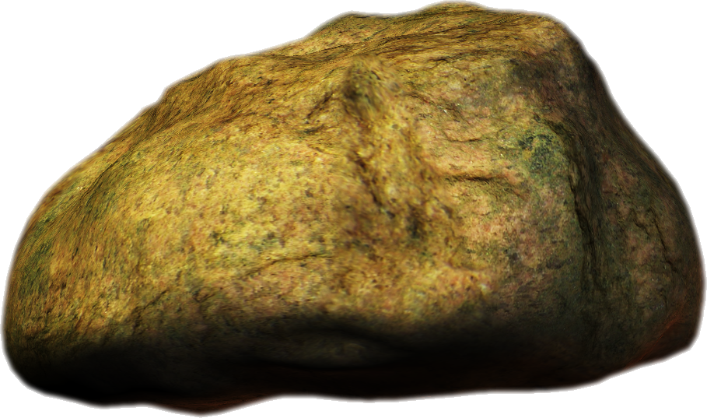
SURVIVAL
ROCKS FROM THE BOX

Slide 3
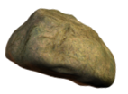
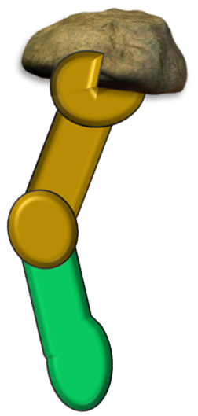
SURVIVAL
ROCKS FROM THE BOX

Slide 4
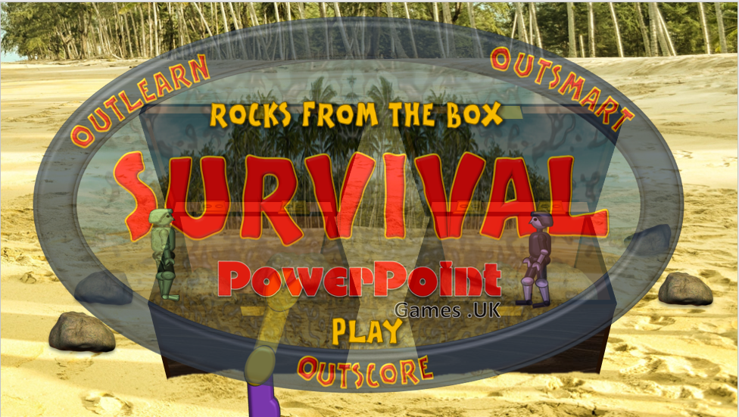
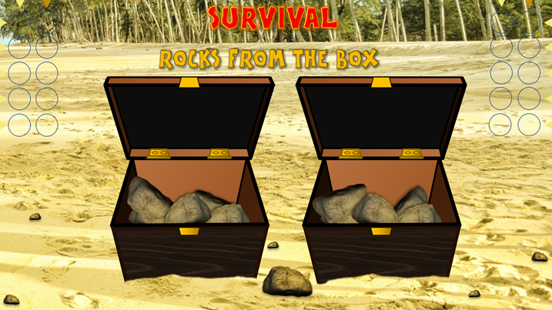
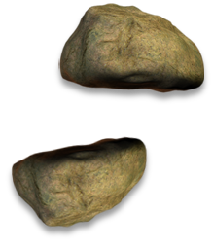
INSTRUCTIONS:
2. ASK A QUESTION
3. IF ANSWER CORRECT, CLICK ON TOP LEFT CIRCLE. IF INCORRECT CLICK ON TOP RIGHT CIRCLE (THEN WORK DOWNWARDS)
BEFORE PLAYING: Select these circles and remove outlines then use the little arrows to show where to click
1. CLICK HERE TO PLAY
These big rocks indicate the score
THIS IS A 2-PART GAME:
PART 1 ESTABLISHES THE NUMBER OF ROCKS THAT EACH TEAM CAN TAKE FORWARD TO PART 2
Click this little rock to play the Survival theme music with cheers when you want
4. AFTER 5 QUESTIONS TO EACH TEAM, NOTE THE NUMBER OF SCORING ROCKS ON EACH SIDE THEN CLICK ON THE CENTRAL ROCK TO MOVE TO PART 2 OF THE GAME

Slide 5
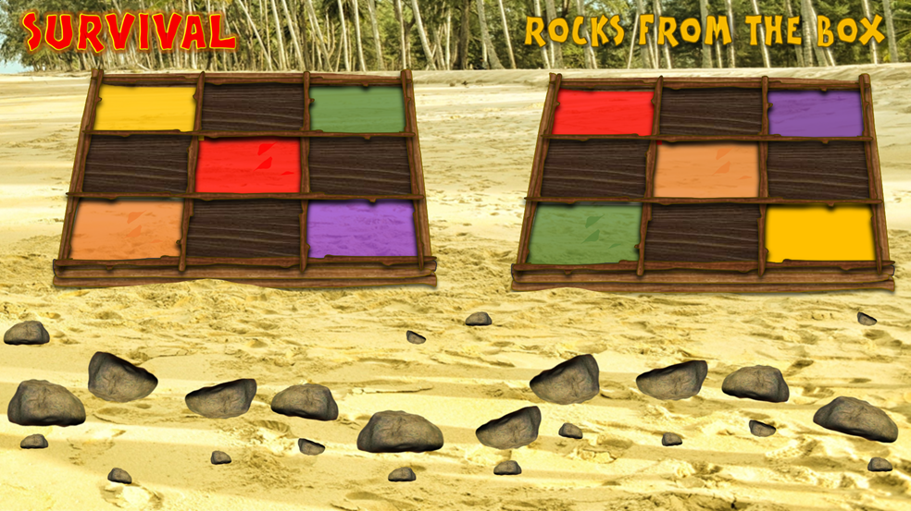
INSTRUCTIONS PART 2:
Click on this small rock for cheering and the Survival theme music (E.g. for when you have a final winner)
1. CLICK ON A SMALL ROCK TO REMOVE THE LARGE ROCK ABOVE IT. (E.g. if a team scores 3 in the box game, remove 2 large rocks here)
If you make a mistake, click the small rock again.
2. ASK A QUESTION
3a. IF ANSWER CORRECT, CLICK ON THE LEFT SIDE OF A LARGE ROCK.
3b. IF ANSWER INCORRECT CLICK ON THE RIGHT SIDE.

