Slide 1
ROLLERPOOL
PLAY

Slide 2
SURVIVAL
ROLLERPOOL
1
2
3
4
5
5
0
3
1
4
2
0

Slide 3
SURVIVAL
ROLLERPOOL

Slide 4
SURVIVAL
ROLLERPOOL

Slide 5
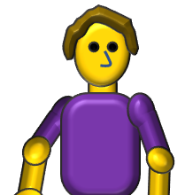
SURVIVAL
ROLLERPOOL

Slide 6
SURVIVAL
ROLLERPOOL

Slide 7
SURVIVAL
ROLLERPOOL

Slide 8
SURVIVAL
ROLLERPOOL

Slide 9
SURVIVAL
ROLLERPOOL

Slide 10
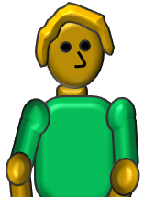
SURVIVAL
ROLLERPOOL

Slide 11
SURVIVAL
ROLLERPOOL

Slide 12
SURVIVAL
ROLLERPOOL

Slide 13
SURVIVAL
ROLLERPOOL

Slide 14
SURVIVAL
ROLLERPOOL

Slide 15
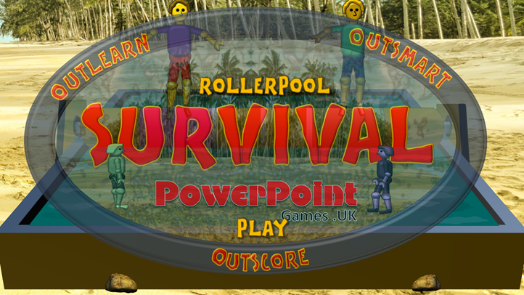
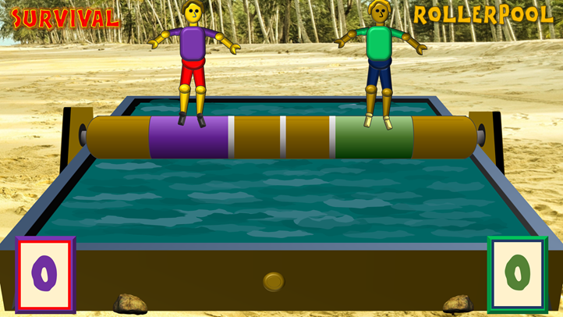
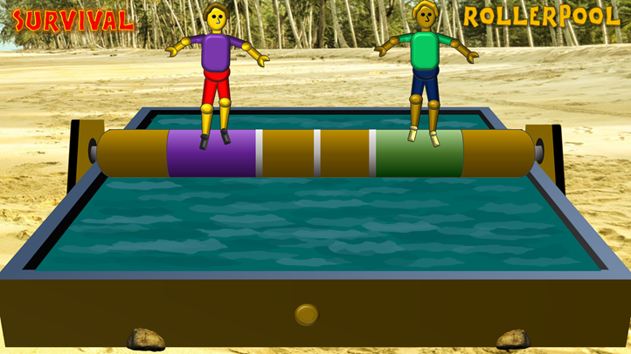
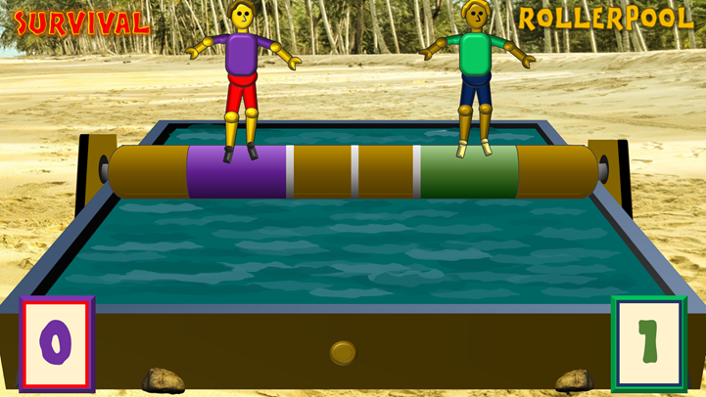
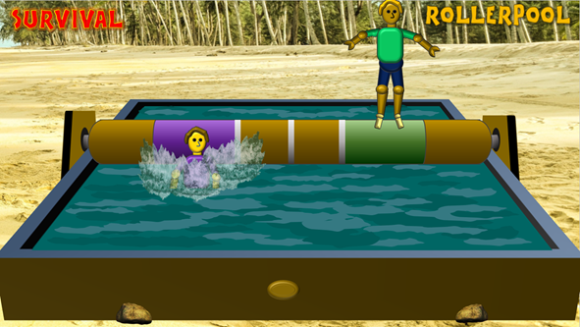
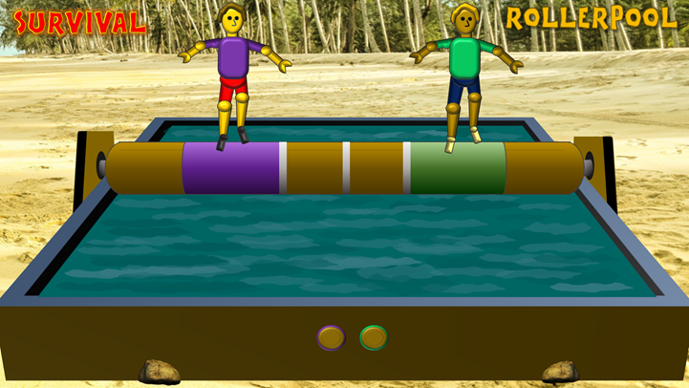
Click here to move to next screen
Click here to start
Establish teams and who will go first
(E.g. the Green team)
2. Ask question 1 to the first team, note their answer, then click on the brown button
3. Ask question 2 to the first team, note their answer, then click on the brown button (The roller spins faster on each slide)
Click here for music and cheers for winning team
5. After losing team’s player has fallen into the water, click on the oval button to return to the first slide – with the scoreboards
4. Ask question 3 to the first team and note their answer
If answers to all questions were correct – click on the brown button with the green outline (colour of winning team)
If any answer was incorrect, click on the button with the purple outline (colour of opposing team) who will be deemed the winners
6. Click on the scoreboard to progress the score of the winning team.
Then repeat the process with the first question to the next (e.g. Purple) team
THE WINNER WILL BE THE FIRST TEAM TO SCORE FIVE POINTS
This is a game where a team needs to answer three consecutive questions correctly to win a point

