Slide 1
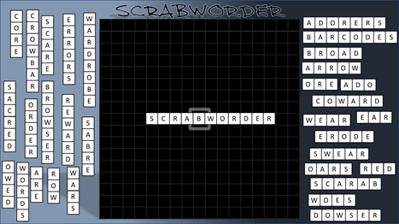
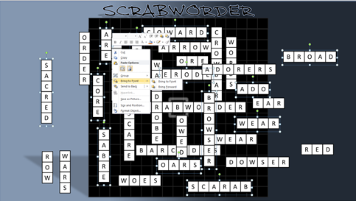
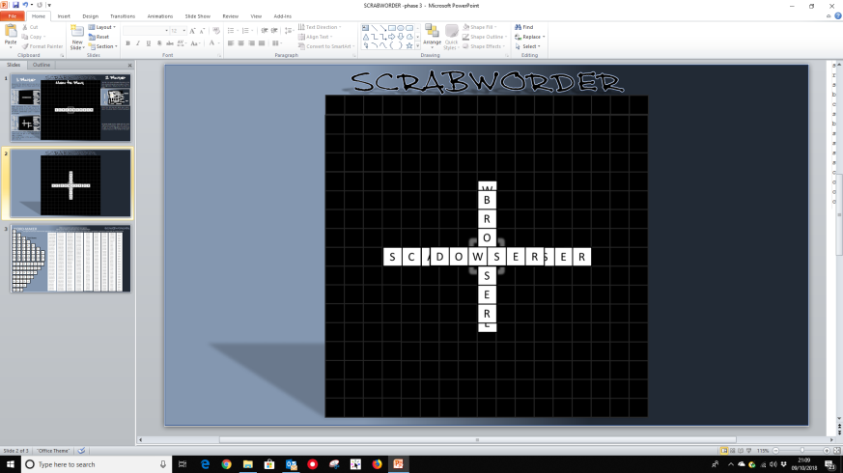
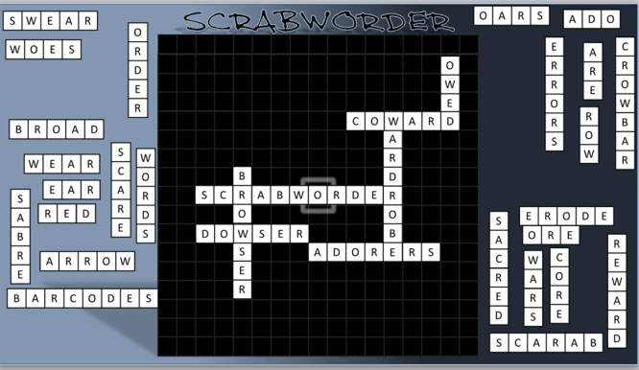
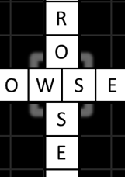
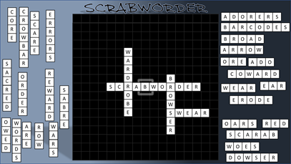
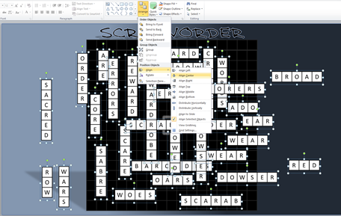
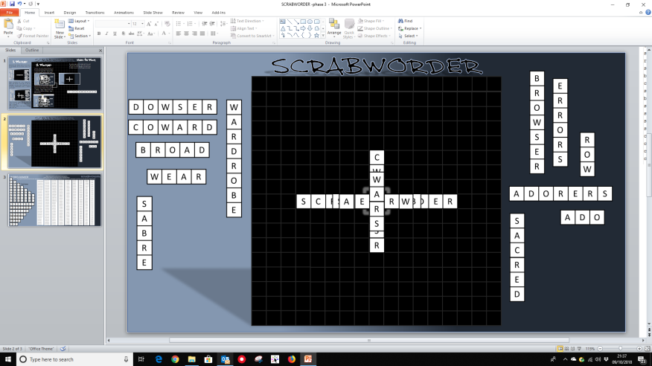
1. Move all of the ‘Across’ words to one side of the central grid, and the ‘Down’ words to the other
1. ‘Shuffle’ the words wherever they are on the slide by selecting a random number of them then right-click > ‘Bring to front’ or ‘Send to Back’. (Repeat as you wish)
3. With all words still selected, use your arrow keys to move the ‘cross’ of words into the centre of the grid with the four corners of the highlighted square visible
5. The game begins by the player with the word ‘Scrabworder’ placing it across the centre of the grid so that the highlighted central square is covered by a letter.
2. Begin by placing the word ‘Scrabworder’ across the centre of the grid so that the highlighted central square is covered by one of the letters. (Alternatively, place it anywhere on the grid).
2. Press & hold the Shift key and drag your cursor across the whole screen to select every word. Then click on the Home tab > Arrange > Align > Align Centre.
Then while all still selected: Arrange > Align > Align Middle
4. Now each player in turn clicks within the highlighted corners (the centre of the cross) to select a word then holds and drags it to their side of the slide. (Left or right of the grid). Continue until all of the words are equally distributed on both sides – then play can begin
6. The game then continues with each player taking turns to add a word to the grid in line with the rules for making words in Scrabble
7. The winner is the first player to insert all of their words onto the grid, or the player who has the fewest words left when no more words can be added. If one player cannot add another word, the other player can continue to add words until the first player can go or no more words can be added.
SLIDE 2 IS READY TO START
3. From this point simply grab and move the words onto the grid as you might see in a game of Scrabble.
Aim to place as many of the words onto the grid as you can. PLAY ON SLIDE 2
CUSTOMISATION
CUSTOMISE YOUR GAMES BY MAKING NEW WORDS OR CHANGING CURRENT WORDS FROM ‘ACROSS’ TO ‘DOWN’ (or vice-versa) AND SWAPPING THEM WITH THE ORIGINALS. YOU WILL FIND READY-MADE TEXT BOXES AND LISTS OF USEABLE WORDS ON SLIDE 3

Slide 3
A
B
C
D
E
F
G
H
A
B
C
D
E
F
G
H
A
B
C
D
E
F
G
A
B
C
D
E
F
A
B
C
D
E
S
C
R
A
B
W
O
R
A
B
C
D
A
B
C
I
A
B
C
D
E
F
G
H
I
A
B
C
D
E
F
G
H
D
A
B
C
D
E
F
G
E
R
A
B
C
D
E
F
A
B
C
D
E
A
B
C
D
A
B
C

