Slide 1
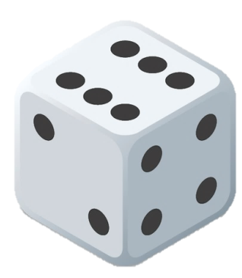
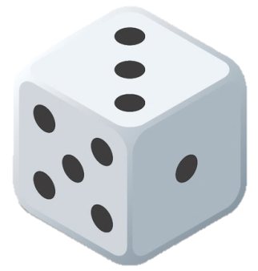
SHUT THE BOX!
RULES
INSTRUCTIONS
PLAY

Slide 2
RULES
Shut the Box is a traditional English pub game. Variations of equipment and rules abound. Where there is doubt, locally played rules should always apply.
Shut the Box can be played by any number of players although it is usually played with two, three or four. The game can also be played solo as a pastime akin to patience.
Description of equipment
The "box" contains a set of blocks numbered one to nine. Each block has a way of showing when it is out of play and unavailable. The game requires two dice for play.
The Play
A round of the game consists of each player taking one turn. A player's takes a turn by repeatedly throwing the dice until the player cannot continue. Each throw of the dice is taken as follows:
The player throws the die or dice into the box and adds up the dots. The player must then cover up a set of unique available numbers that add up to the sum thrown. So for instance, if the number of dots adds up to 8, the player may choose one of the following sets of numbers as long as all of the numbers in the set are available:
8
7 & 1
6 & 2
5 & 3
5 & 2 & 1
4 & 3 & 1
The player then does exactly the same thing with a second throw and so on.
Once a number is made unavailable, it stays unavailable for the rest of the turn. Eventually, the player may throw a total for which it is not possible to find a set of available numbers. When this happens, the player scores the sum of the remaining available numbers. So if the numbers 1, 5 and 9 are available and the player throws a 4 (with only options 4 or 3 & 1) the turn finishes and the player's score is 15.
If 7, 8 and 9 are all unavailable, the player decides whether to throw one die or two. If any of these 3 numbers are still available, the player must use both dice.
If anyone succeeds in shutting the box i.e. closing all the numbers, that player wins outright immediately. Otherwise, after each player has taken one turn, the winner of the round is the player with the lowest score.
INSTRUCTIONS
PLAY

Slide 3
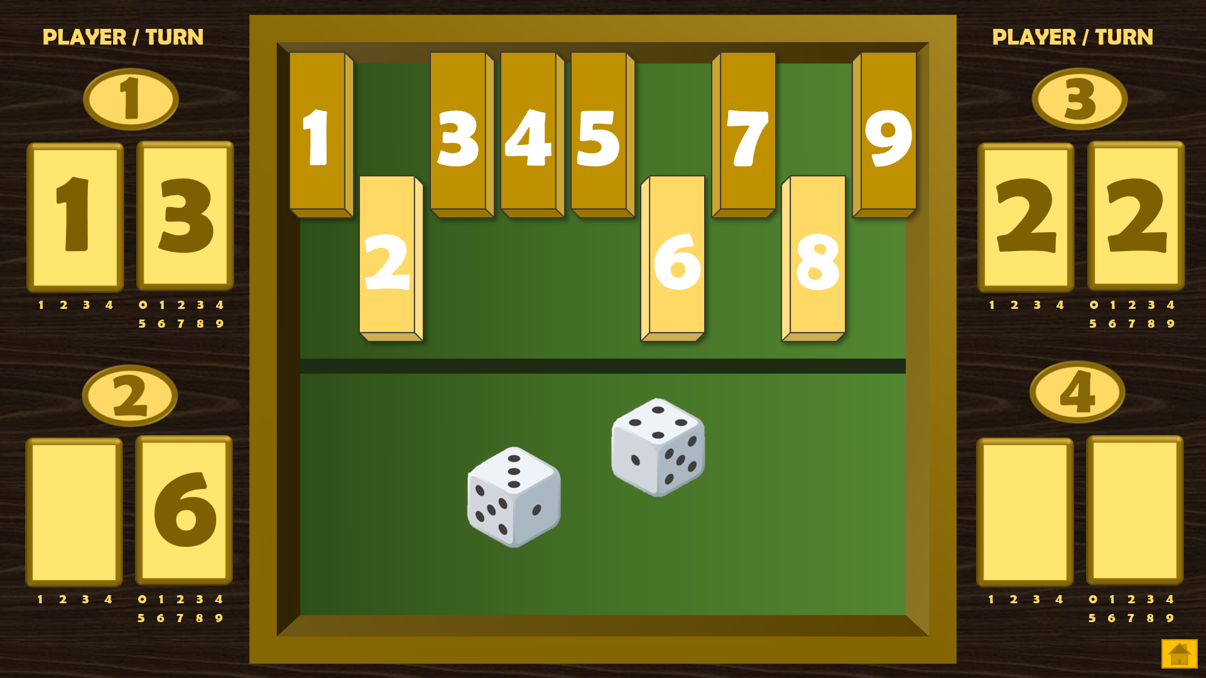
INSTRUCTIONS
Available Blocks
(Click to make unavailable)
Reset button
(Click to reset all blocks)
Unavailable Blocks
(Click to make available again)
Player / Turn Numbers
Scoring Blocks for each player (up to 4)
Or for each turn if playing solo
Scoring Blocks
(At the end of a turn, click on the appropriate number beneath the blocks)
Scoring Blocks
(Click on the numbers inside the blocks to remove them)
Dice
Click on each die to roll
RULES
PLAY
Home Button
(Click to return to slide 1)

Slide 4
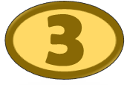
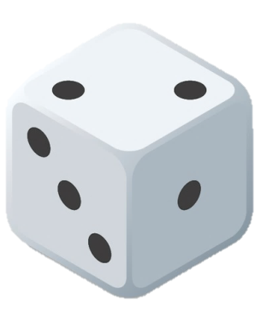
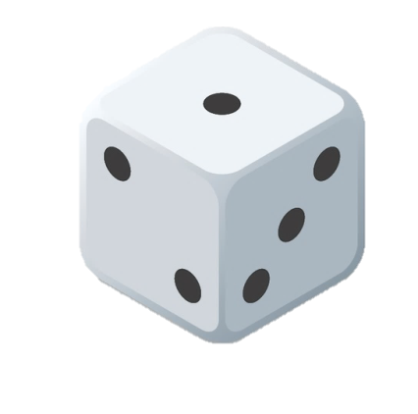
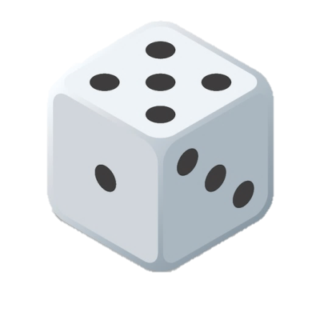
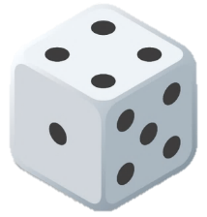
PLAYER / TURN
PLAYER / TURN
SHUT THE BOX!
1
2
3
4
5
6
7
8
9
1
2
3
4
1
2
3
4
5
6
7
8
9
0
1
2
3
4
1
2
3
4
5
6
7
8
9
0
1
2
3
4
5
6
7
8
9
1
2
3
4
0
1
2
3
4
1
2
3
4
0
1
2
3
4
5
6
7
8
9
5
6
7
8
9
1
2
3
4
1
2
3
4
5
6
7
8
9
0
1
2
3
4
1
2
3
4
5
6
7
8
9
0
1
2
3
4
0
1
2
3
4
1
2
3
4
0
1
2
3
4
5
6
7
8
9
5
6
7
8
9

