Slide 1
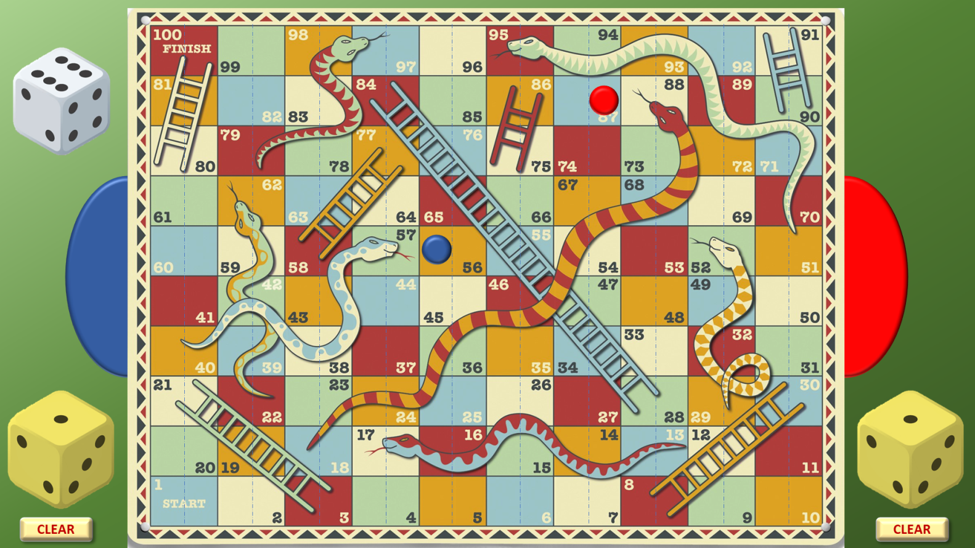
Play to the standard rules of Snakes & Ladders
Click here to roll your dice
Once you have clicked to reveal the position of your new counter,
click on the previous counter to remove it
Count along the number of boxes according to your dice throw –
and click on that box
Click here to clear the throw
Blue player clicks on the Left side of the dotted line
Red player clicks on the Right side of the dotted line

Slide 2
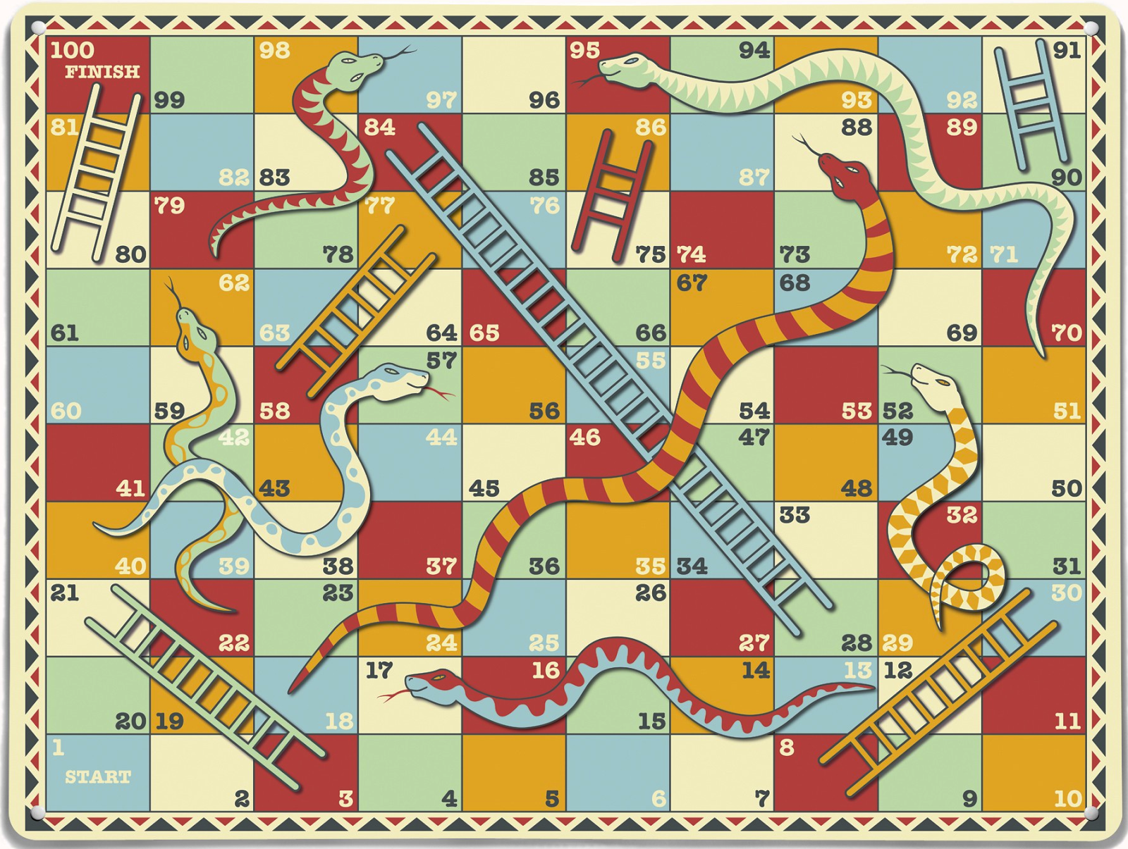
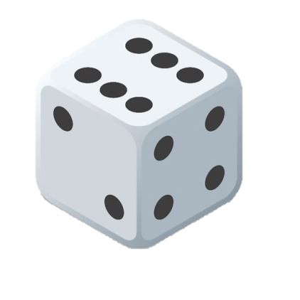
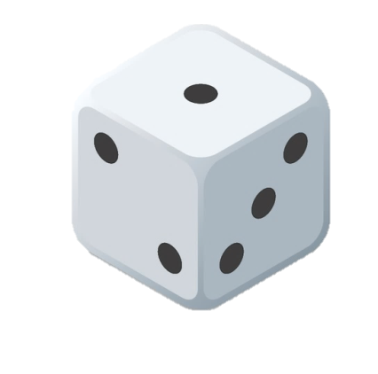
CLEAR
CLEAR

