Slide 1
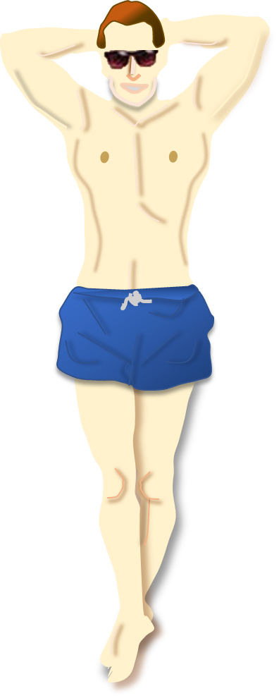
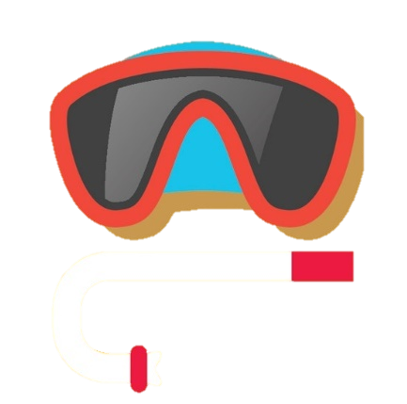
SUNBURN!

Slide 2
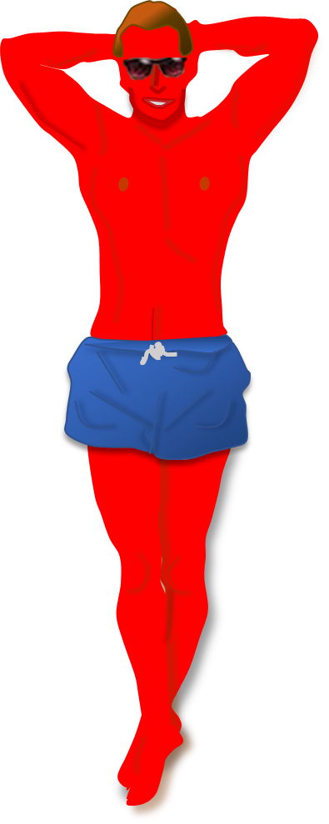
Click the bottle. Quick!

Slide 3
Want to keep searching?
Click here
SUNBURN!

Slide 4
You saved me from sunburn!
Press ‘Esc’ to exit
SUNTAN!

