Slide 1
math
SHOW

Slide 2
English
SHOW

Slide 3
science
SHOW

Slide 4
P.E
SHOW

Slide 5
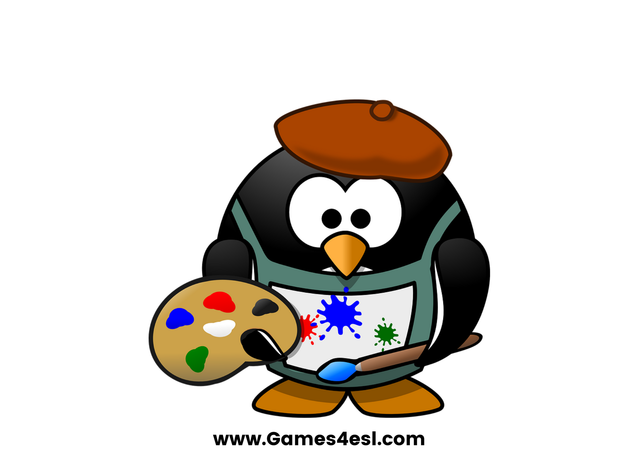
art
SHOW

Slide 6
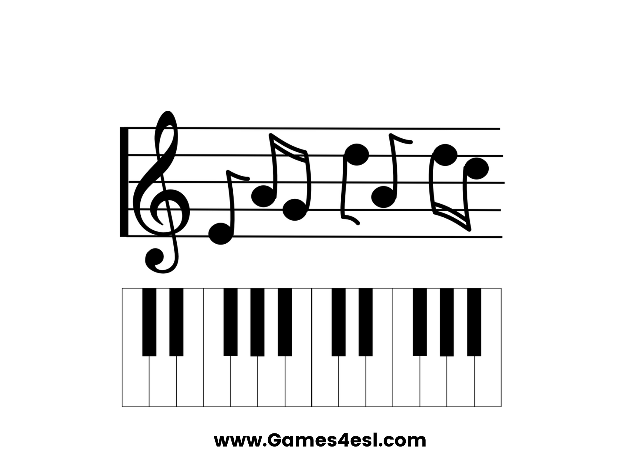
music
SHOW

Slide 7
geography
SHOW

Slide 8
I.T
SHOW

