Slide 1
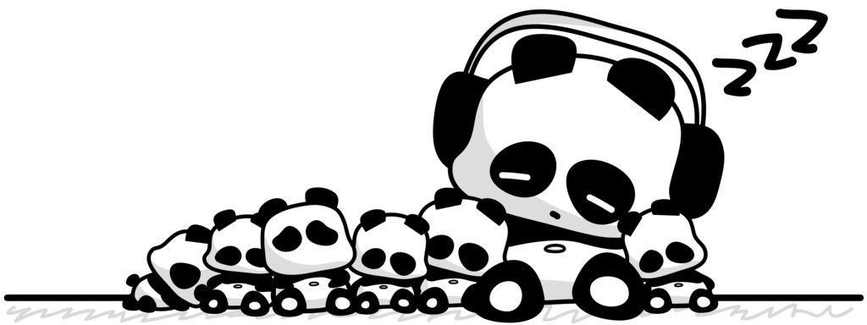
Sleeping Pandas

Slide 2
Rules
Students form groups of four.
Members of each group are numbered from 1-4.
Students will all “sleep” (heads down).
Teacher will call numbers and they will “wake up.”
Student must remember what they see,
and go back to sleep.
Everyone “wakes up” and puts the word
or sentence together.

Slide 3
ARE YOU READY?

Slide 4
Go to sleep…
1
2
3
4

Slide 5
Panda 1, wake up!
L
1
2
3
4

Slide 6
Go to sleep…
1
2
3
4

Slide 7
Panda 2, wake up!
M
1
2
3
4

Slide 8
Go to sleep…
1
2
3
4

Slide 9
Panda 3, wake up!
1
2
S P
3
4

Slide 10
Go to sleep…
1
2
3
4

Slide 11
Panda 4, wake up!
1
2
E A
3
4

Slide 12
GET READY!

Slide 13
Write it down!

Slide 14
Show me!
SAMPLE

Slide 15
ARE YOU READY?

Slide 16
Go to sleep…
1
2
3
4

Slide 17
Panda 1, wake up!
VE
1
2
3
4

Slide 18
Go to sleep…
1
2
3
4

Slide 19
Panda 2, wake up!
IT
1
2
3
4

Slide 20
Go to sleep…
1
2
3
4

Slide 21
Panda 3, wake up!
1
2
NM
3
4

Slide 22
Go to sleep…
1
2
3
4

Slide 23
Panda 4, wake up!
1
2
A
3
4

Slide 24
GET READY!

Slide 25
Write it down!

Slide 26
Show me!
Vietnam

Slide 27
ARE YOU READY?

Slide 28
Go to sleep…
1
2
3
4

Slide 29
Panda 1, wake up!
NT
1
2
3
4

Slide 30
Panda 1, wake up!
VE
1
2
3
4

Slide 31
Go to sleep…
1
2
3
4

Slide 32
Panda 2, wake up!
HA
1
2
3
4

Slide 33
Go to sleep…
1
2
3
4

Slide 34
Panda 3, wake up!
1
2
LP
3
4

Slide 35
Go to sleep…
1
2
3
4

Slide 36
Panda 4, wake up!
1
2
EE
3
4

Slide 37
GET READY!

Slide 38
Write it down!

Slide 39
Show me!
Elephant

Slide 40
ARE YOU READY?

Slide 41
Go to sleep…
1
2
3
4

Slide 42
Panda 1, wake up!
RR
1
2
3
4

Slide 43
Go to sleep…
1
2
3
4

Slide 44
Panda 2, wake up!
OT
1
2
3
4

Slide 45
Go to sleep…
1
2
3
4

Slide 46
Panda 3, wake up!
1
2
C
3
4

Slide 47
Go to sleep…
1
2
3
4

Slide 48
Panda 4, wake up!
1
2
OS
3
4

Slide 49
GET READY!

Slide 50
Write it down!

Slide 51
Show me!
CARROTS

Slide 52
Thank you for downloading this free resource!
I believe English teaching resources should be free but keeping a website is very costly! PLEASE help me continue making my resources FREE and keep my blog running by clicking some GOOGLE ADS that appear in my website. Average revenue I get per click is only $0.01 (LOL, no kidding!) but it’s up to you how willing you are to support my advocacy.
Sharing is caring! Please share my blog posts to your friends and colleagues.
For more resources and updates, follow me on social media:
https://www.facebook.com/EnglishTeaching101/
https://twitter.com/ENteaching101
https://www.pinterest.com/ENteaching101/
http://englishteaching101.com/

