Slide 1
Spot the hidden object!

Slide 2
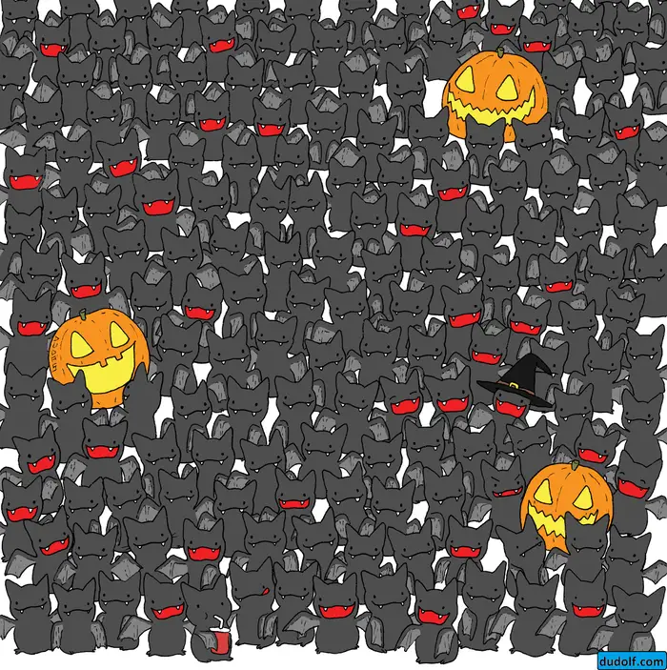
Find the cat amongst the bats!

Slide 3
(Hint: It's the only one without wings!)

Slide 4
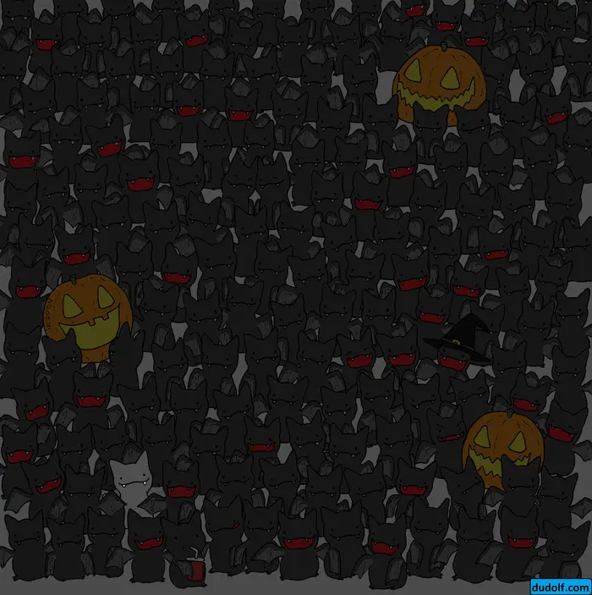
There he is!

Slide 5
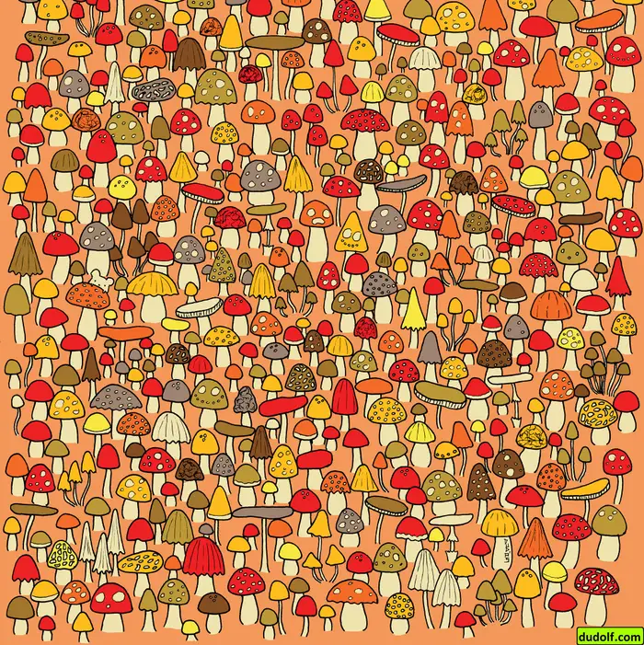
Find the mouse, hiding amongst the mushrooms!

Slide 6
(Hint: He's hiding behind a mushroom)

Slide 7
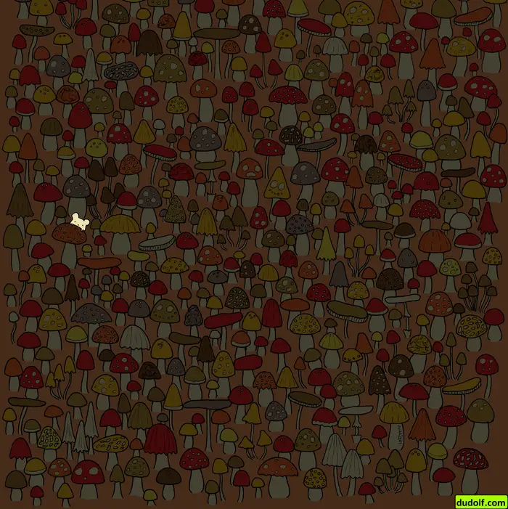
There he is!

Slide 8
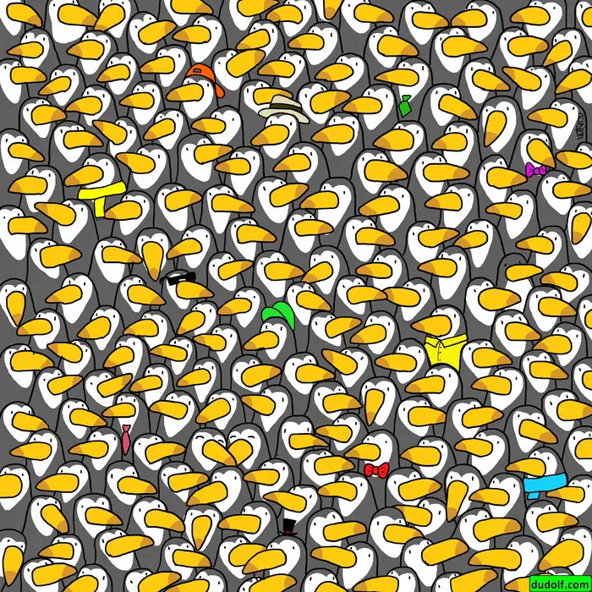
Find the penguin amongst the toucans!

Slide 9
(Hint: He's the only one without a white face)

Slide 10
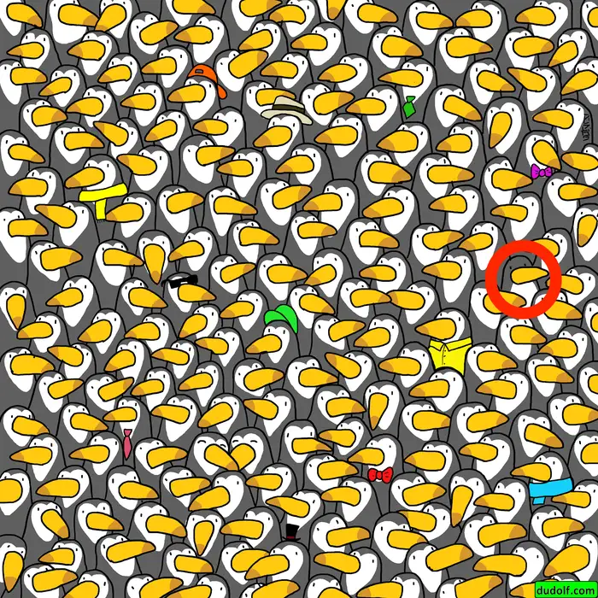
There he is!

Slide 11
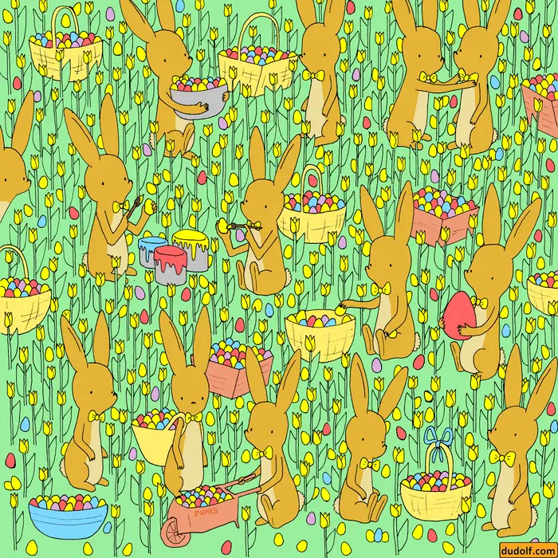
Where is the baby chicken?

Slide 12
(Hint: He's hiding on a rabbit's ear!)

Slide 13
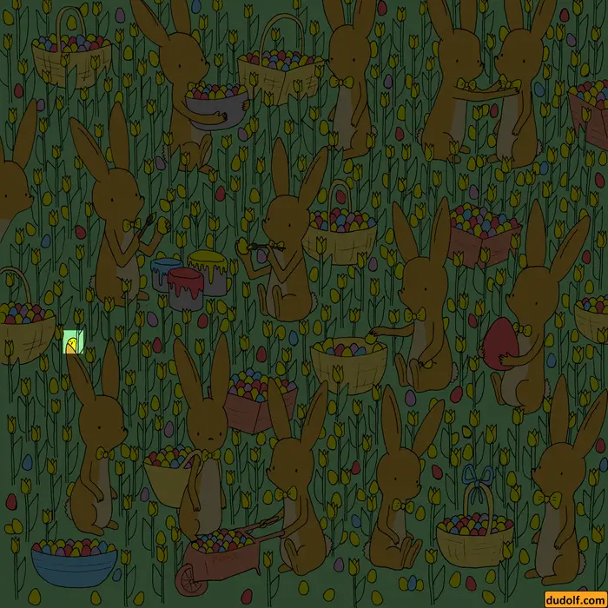
There he is! (look very carefully).

Slide 14
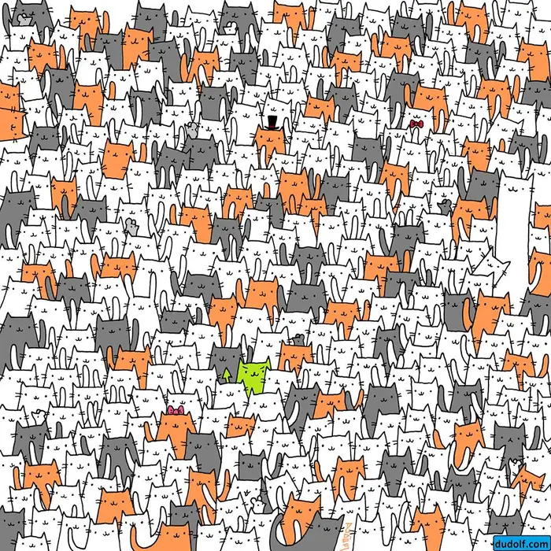
Where is the rabbit?

Slide 15
(Hint: He has long white ears!)

Slide 16
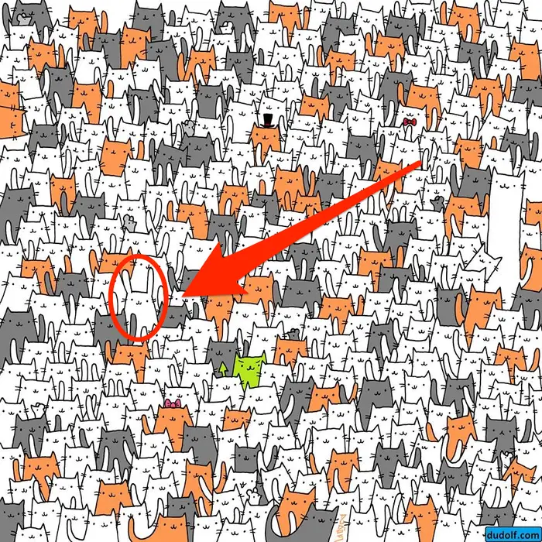
(Hint: He has long white ears!)

Slide 17
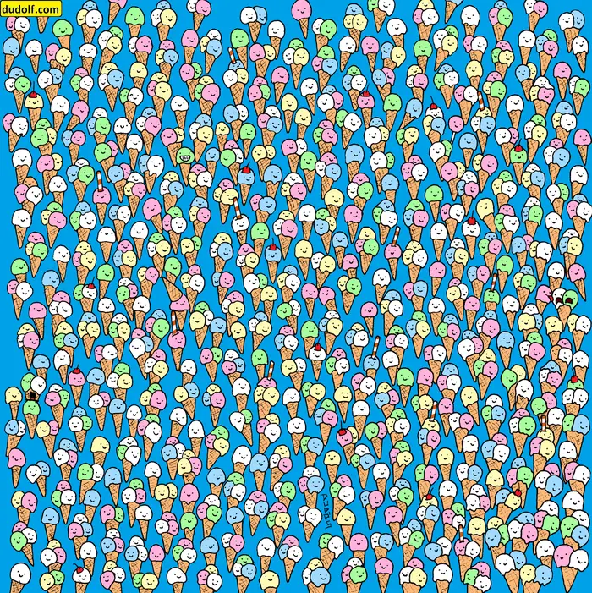
Find the lollipop amongst the ice creams

Slide 18
(Hint: It is pink!)

Slide 19
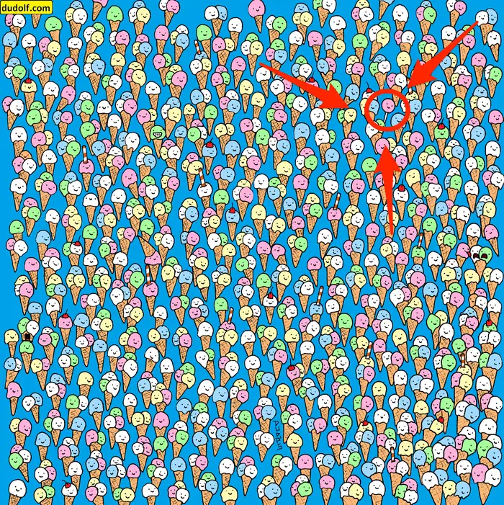
(Hint: It is pink!)

