Slide 1
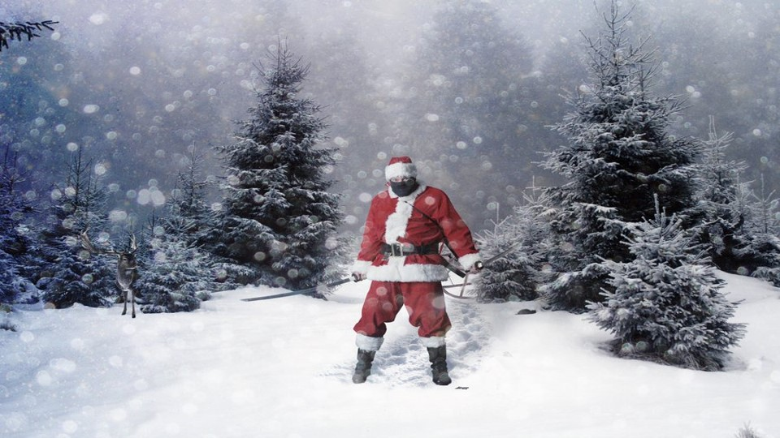
When you’ve thrown all the snowballs, click here.
AND A HAPPY NEW YEAR!
Now click on the items to dress your snowman
Quick! Click on all the snowballs and bombard him!

