Slide 1
Stop the monsters
Synonyms

Slide 2
run
rush
grunt
speak

Slide 3
drink
eat
gulp
throw

Slide 4
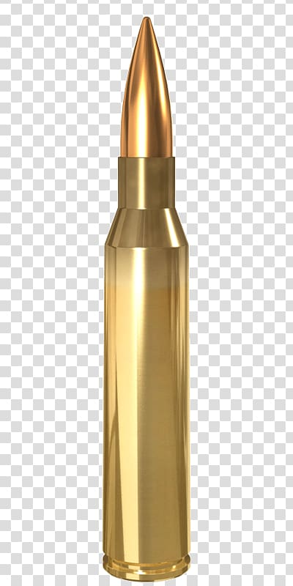
incredible
poor
amazing
bad

Slide 5
frightening
smelly
scary
funny

Slide 6
joyous
happy
sad
smile

Slide 7
negative
amazing
rush
bad

Slide 8
huge
cold
tiny
big

Slide 9
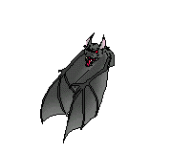
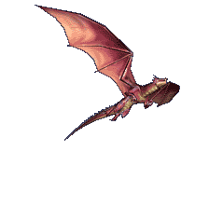
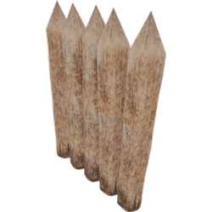
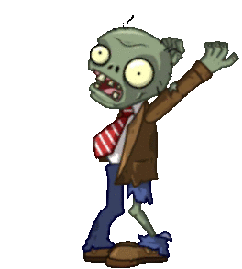
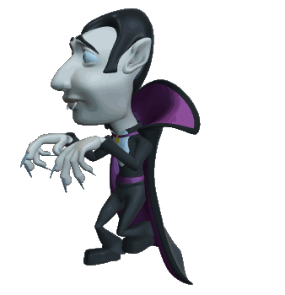
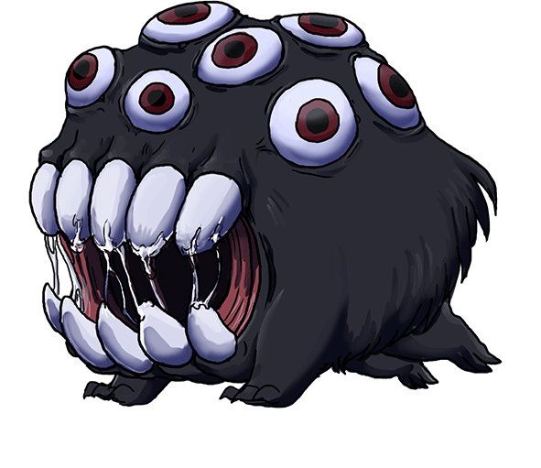
Shoot the monsters!

Slide 10
You lose!

Slide 11
You win

Slide 12
hollow
empty
funny
long

Slide 13
laugh
slip
giggle
run

Slide 14
slip
stretch
trip
walk

Slide 15
tiny
massive
little
huge

Slide 16
said
spoke
saw
joked

Slide 17
afraid
happy
smile
scared

Slide 18
beautiful
dumb
happy
pretty

Slide 19
Shoot the monsters!

Slide 20
You win!

