Slide 1
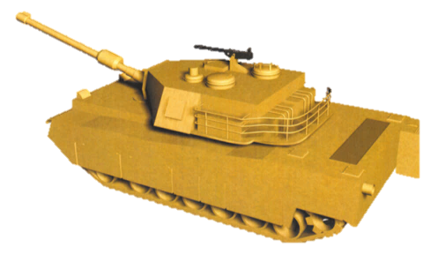
ENEMY MISSILES HAVE BEEN LAUNCHED AGAINST YOUR TANK FORMATION
SHOOT DOWN THE MISSILES BEFORE THEY HIT AND DESTROY YOUR TANKS
CLICK HERE AND BE READY

Slide 2
