Slide 1
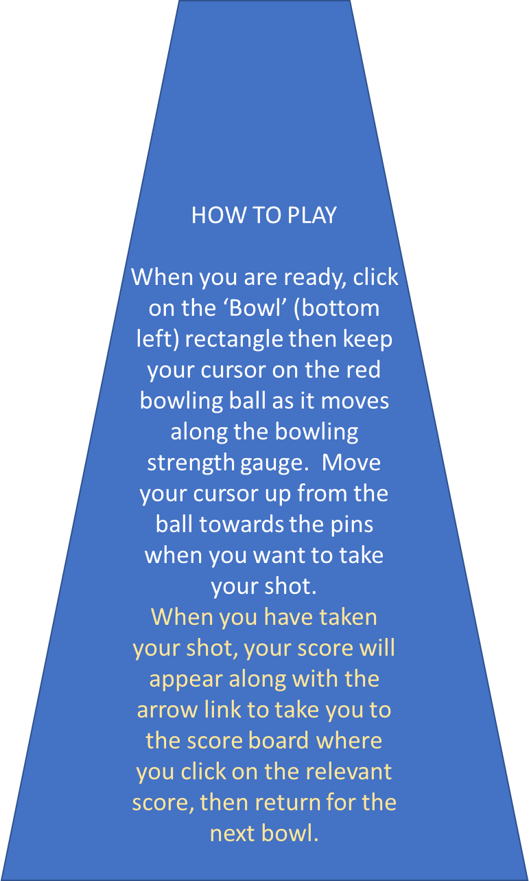

Slide 3
0

Slide 4
0

Slide 5
1

Slide 6
2

Slide 7
3

Slide 8
4

Slide 9
5

Slide 10
6

Slide 11
7

Slide 12
8

Slide 13
9

Slide 16
BOWL | SCORE
1 | 0 | 1 | 2 | 3 | 4 | 5 | 6 | 7 | 8 | 9 | 10
2 | 0 | 1 | 2 | 3 | 4 | 5 | 6 | 7 | 8 | 9 | 10
3 | 0 | 1 | 2 | 3 | 4 | 5 | 6 | 7 | 8 | 9 | 10
4 | 0 | 1 | 2 | 3 | 4 | 5 | 6 | 7 | 8 | 9 | 10
5 | 0 | 1 | 2 | 3 | 4 | 5 | 6 | 7 | 8 | 9 | 10
6 | 0 | 1 | 2 | 3 | 4 | 5 | 6 | 7 | 8 | 9 | 10
7 | 0 | 1 | 2 | 3 | 4 | 5 | 6 | 7 | 8 | 9 | 10
8 | 0 | 1 | 2 | 3 | 4 | 5 | 6 | 7 | 8 | 9 | 10
9 | 0 | 1 | 2 | 3 | 4 | 5 | 6 | 7 | 8 | 9 | 10
10 | 0 | 1 | 2 | 3 | 4 | 5 | 6 | 7 | 8 | 9 | 10
NEXT
NEXT
NEXT
BOWL
1
NEXT
NEXT
NEXT
BOWL
2
NEXT
NEXT
NEXT

Slide 18
0

Slide 19
0

Slide 20
1

Slide 21
2

Slide 22
3

Slide 23
4

Slide 24
5

Slide 25
6

Slide 26
7

Slide 27
8

Slide 28
9

Slide 32
0

Slide 33
0

Slide 34
1

Slide 35
2

Slide 36
3

Slide 37
4

Slide 38
5

Slide 39
6

Slide 40
7

Slide 41
8

Slide 42
9

Slide 46
0

Slide 47
0

Slide 48
1

Slide 49
2

Slide 50
3

Slide 51
4

Slide 52
5

Slide 53
6

Slide 54
7

Slide 55
8

Slide 56
9

Slide 60
0

Slide 61
0

Slide 62
1

Slide 63
2

Slide 64
3

Slide 65
4

Slide 66
5

Slide 67
6

Slide 68
7

Slide 69
8

Slide 70
9

Slide 74
0

Slide 75
0

Slide 76
1

Slide 77
2

Slide 78
3

Slide 79
4

Slide 80
5

Slide 81
6

Slide 82
7

Slide 83
8

Slide 84
9

Slide 88
0

Slide 89
0

Slide 90
1

Slide 91
2

Slide 92
3

Slide 93
4

Slide 94
5

Slide 95
6

Slide 96
7

Slide 97
8

Slide 98
9

Slide 102
0

Slide 103
0

Slide 104
1

Slide 105
2

Slide 106
3

Slide 107
4

Slide 108
5

Slide 109
6

Slide 110
7

Slide 111
8

Slide 112
9

Slide 116
0

Slide 117
0

Slide 118
1

Slide 119
2

Slide 120
3

Slide 121
4

Slide 122
5

Slide 123
6

Slide 124
7

Slide 125
8

Slide 126
9

Slide 129
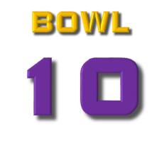

Slide 130
0

Slide 131
0

Slide 132
1

Slide 133
2

Slide 134
3

Slide 135
4

Slide 136
5

Slide 137
6

Slide 138
7

Slide 139
8

Slide 140
9

