Slide 2
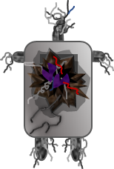

Slide 5
WE CAME IN PEACE
YOU FIRED FIRST
NOW IT’S WAR

Slide 7
WE CAME IN PEACE
YOU FIRED FIRST
NOW IT’S WAR

