Slide 1
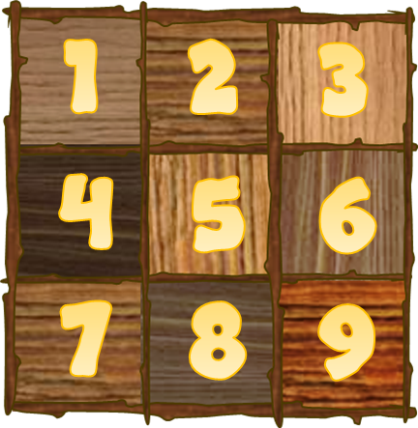
TIC TAC SPLAT
PLAY

Slide 2
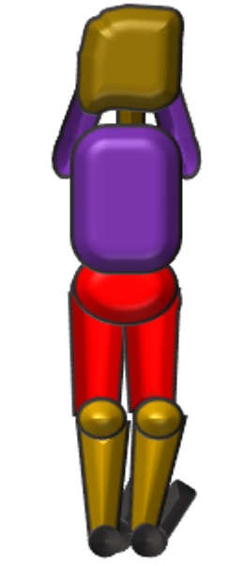
SURVIVAL
TIC TAC SPLAT
1
2
3
4
5
0
5
3
1
4
2
0

Slide 3
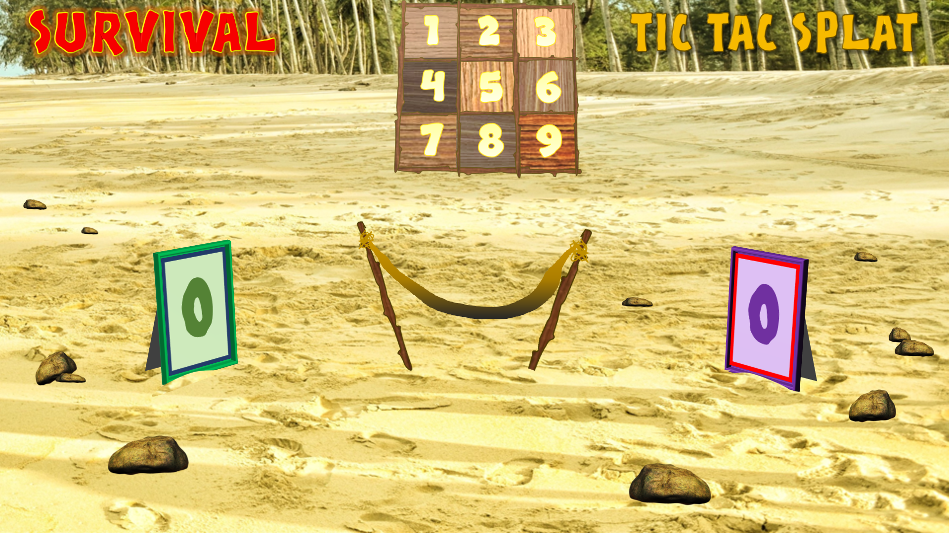
INSTRUCTIONS:
3. IF GREEN TEAM CORRECT CLICK ON TOP LEFT CORNER OF THE RELEVANT SQUARE
1. 1ST TEAM (E.G. GREEN PICK A NUMBER ON THE BOARD)
4. IF GREEN TEAM INCORRECT CLICK ON BOTTOM LEFT CORNER OF THE RELEVANT SQUARE
2. ASK A QUESTION TO GREEN TEAM
Click to progress scores
5. NEXT QUESTION TO PURPLE TEAM –
CORRECT: CLICK TOP RIGHT
INCORRECT: CLICK BOTTOM RIGHT
Click for Survival theme and cheering
Click to reset for new game
6. PLAY TO USUAL TIC-TAC-TOE RULES
Outright winner (gets 3 in a row) scores a point
If a drawn game – both teams get a point
(Or devise any rules that work for you!)

