Slide 1
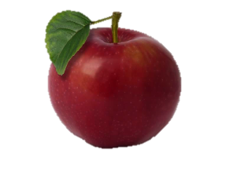
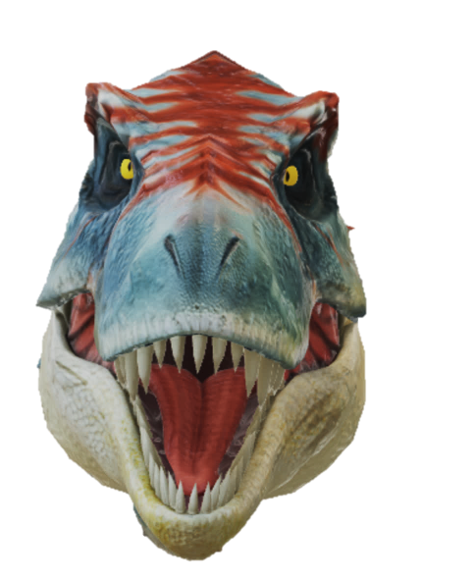
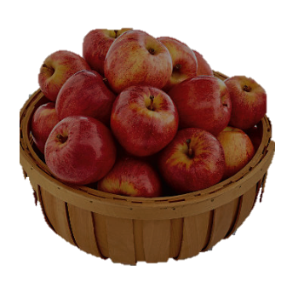
TILLY THE TAME T-REX
Tilly is a lovely tame T-Rex.
She loves it when people feed her with delicious red apples.
Take turns to click on the hanging apple to find out how many apples to feed her with. Then click on the bowl of apples to feed her that number of times.
Click on the number again to clear it before the next turn.
Please be aware though that she still likes the taste of meat occasionally.
START

Slide 2
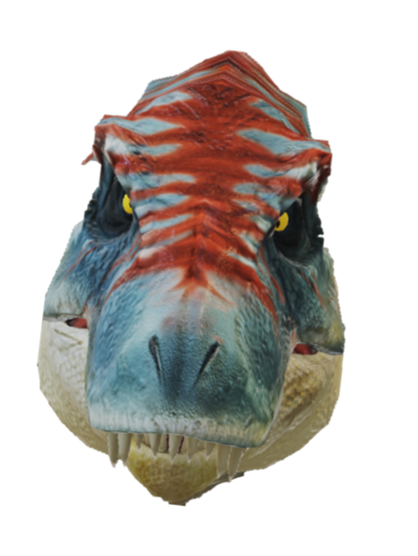
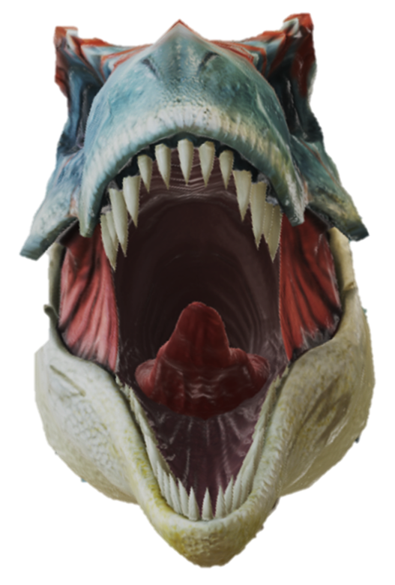
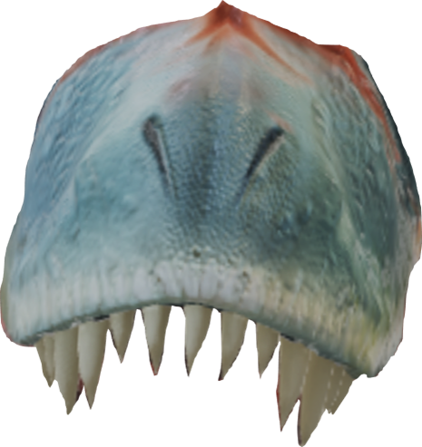
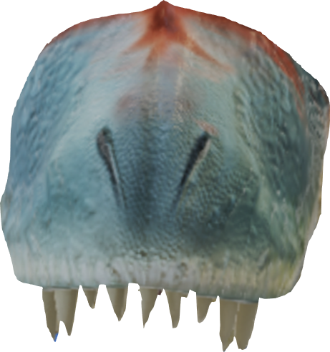
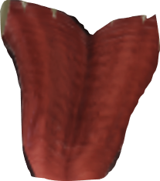
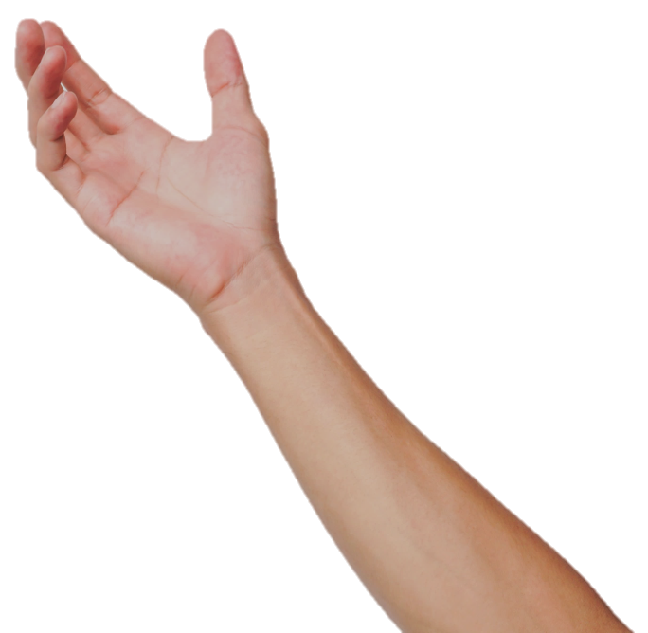
3
2
1

