Slide 1
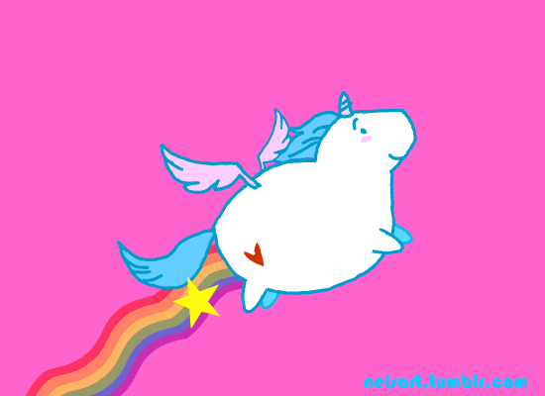
Unicorn racing Start!

Slide 2
You won the race!

Slide 3
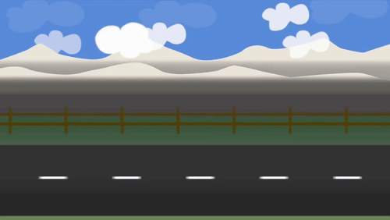
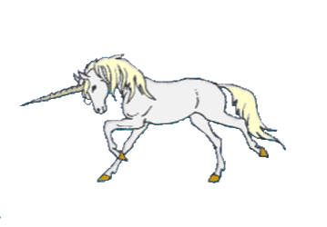
He ____ running.
was
were
are

Slide 4
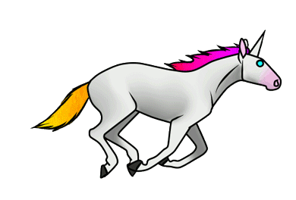
_____the book interesting?
are
was
were

Slide 5
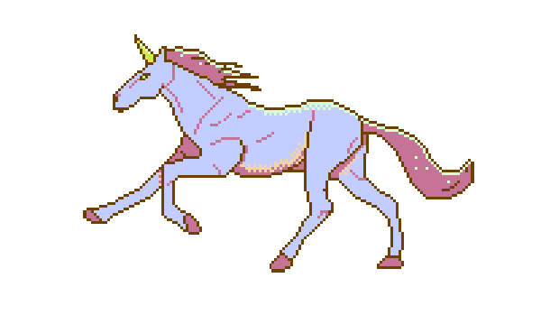
The photos ____ in the newspaper.
is
were
was

Slide 6
The horse ____ in its stable.
were
was
are

Slide 7
The teachers ____nice.
is
were
was

Slide 8
It ___your birthday last week.
can be
were
was

Slide 9
____ it your birthday last week?
is
was
are

Slide 10
_____ the teachers nice?
is
were
was

Slide 11
____ the horse in its stable?
are
was
were

Slide 12
_____ the photos in the newspaper?
was
were
what

Slide 13
______ the book interesting?
was
were
are

Slide 14
____ the teacher funny?
was
are
were

Slide 15
_____the horses in their stable?
is
was
were

Slide 16
____ the photo in the book?
was
were
aren't

Slide 17
she _____beautiful
were
are
wasn't

Slide 18
they ____tired
wasn't
weren't
was

Slide 19
where ____you?
were
was
i

Slide 20
why _____we hungry?
is
were
was

Slide 21
when ___he at the cinema?
were
was
aren't

Slide 22
_____they at work?
be
was
were

Slide 23
YOU LOSE. NOW YOUR UNICORN IS SAD.

