Slide 2
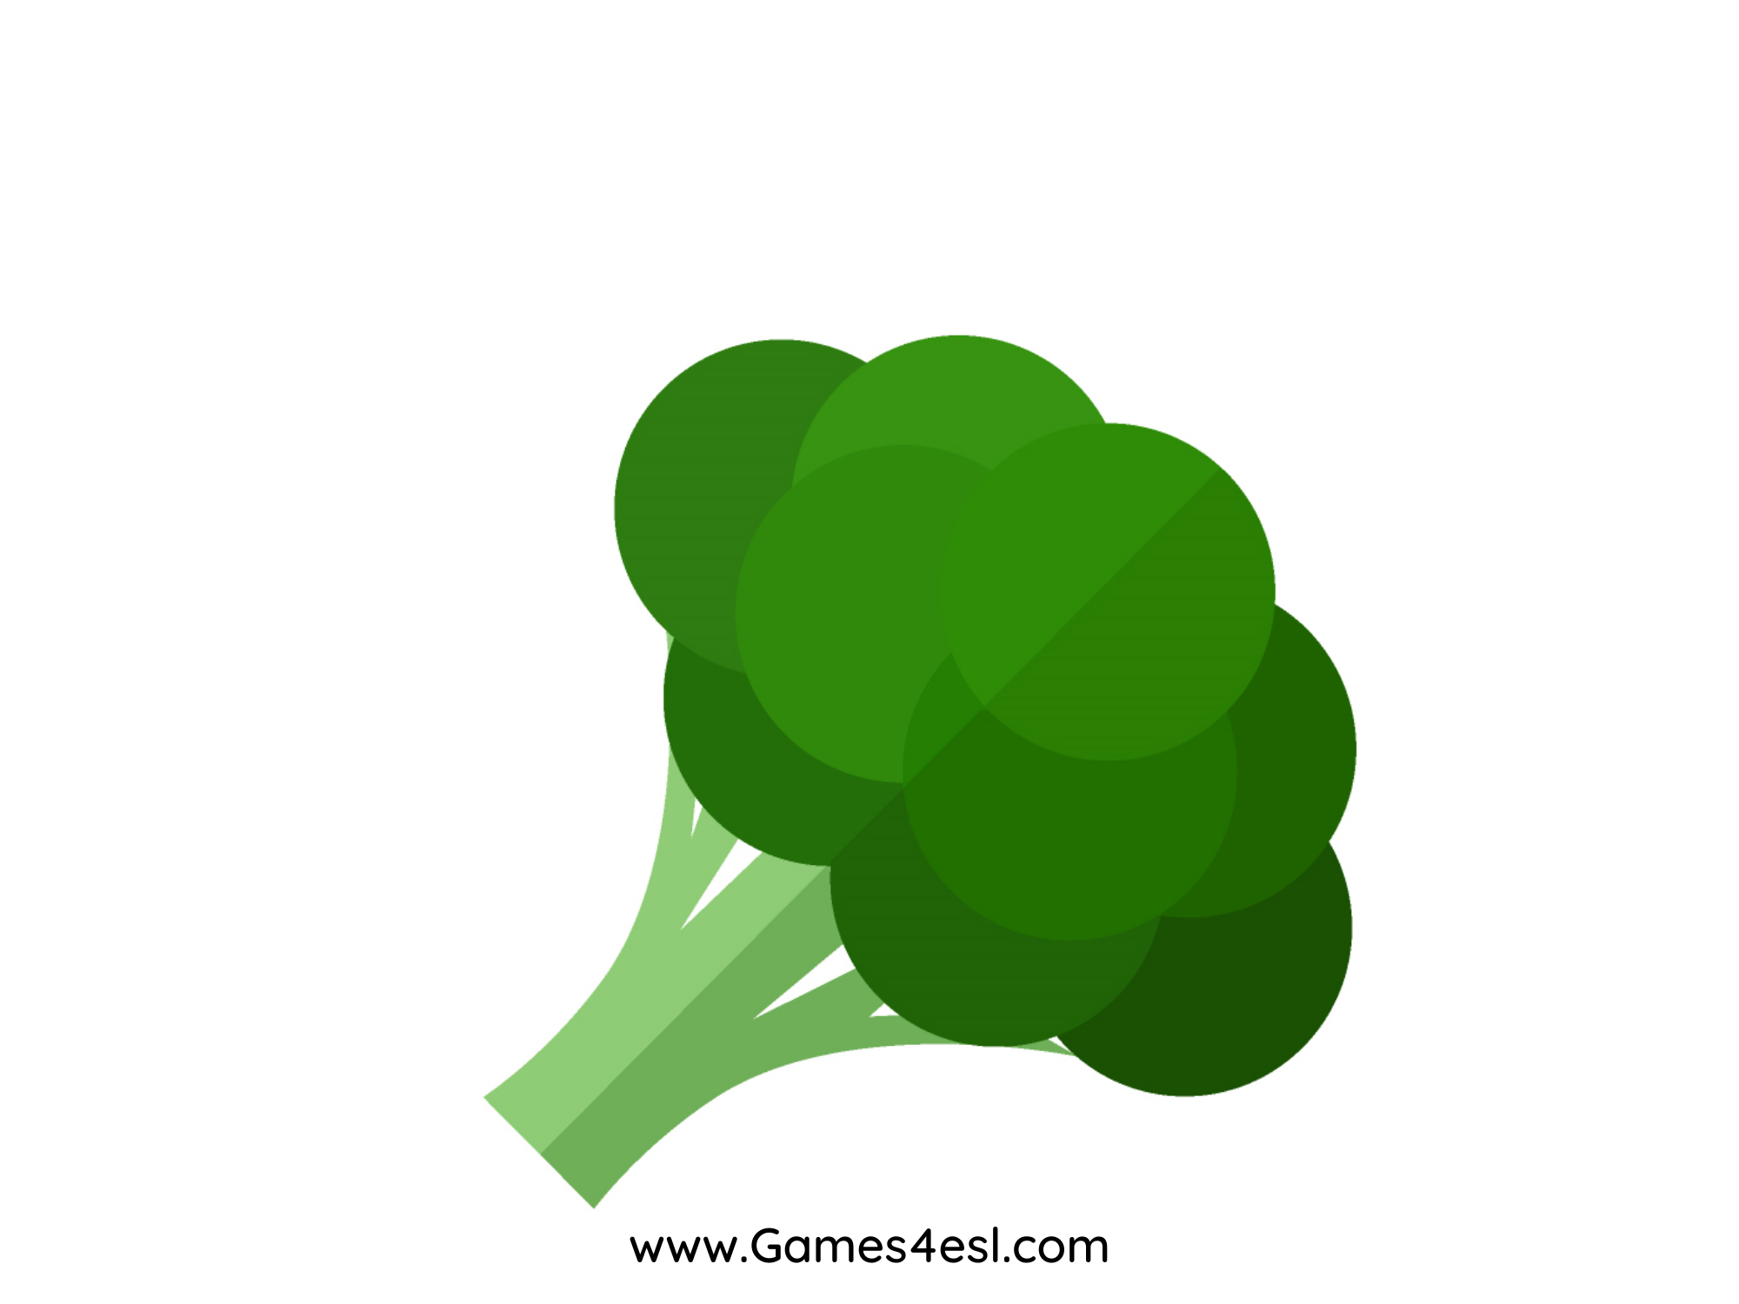
broccoli
SHOW

Slide 3
pumpkin
SHOW

Slide 4
onion
SHOW

Slide 5
corn
SHOW

Slide 6
cucumber
SHOW

Slide 7
carrot
SHOW

Slide 8
potato
SHOW

Slide 9
chilli
SHOW

