Slide 1
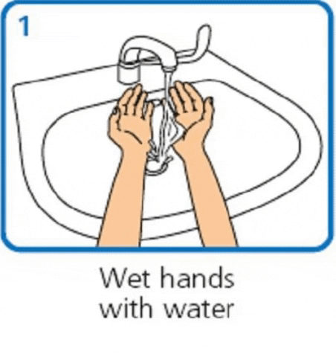
Washing your hands properly

Slide 3
Wet your hands!

Slide 4
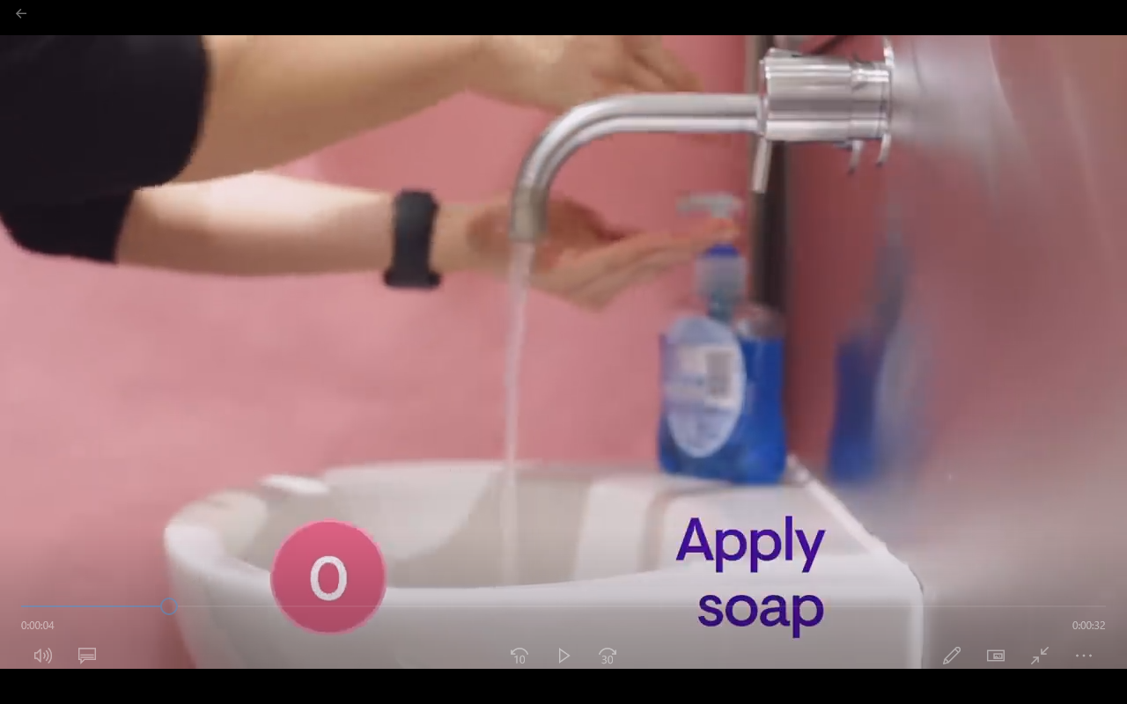
Apply soap!

Slide 5
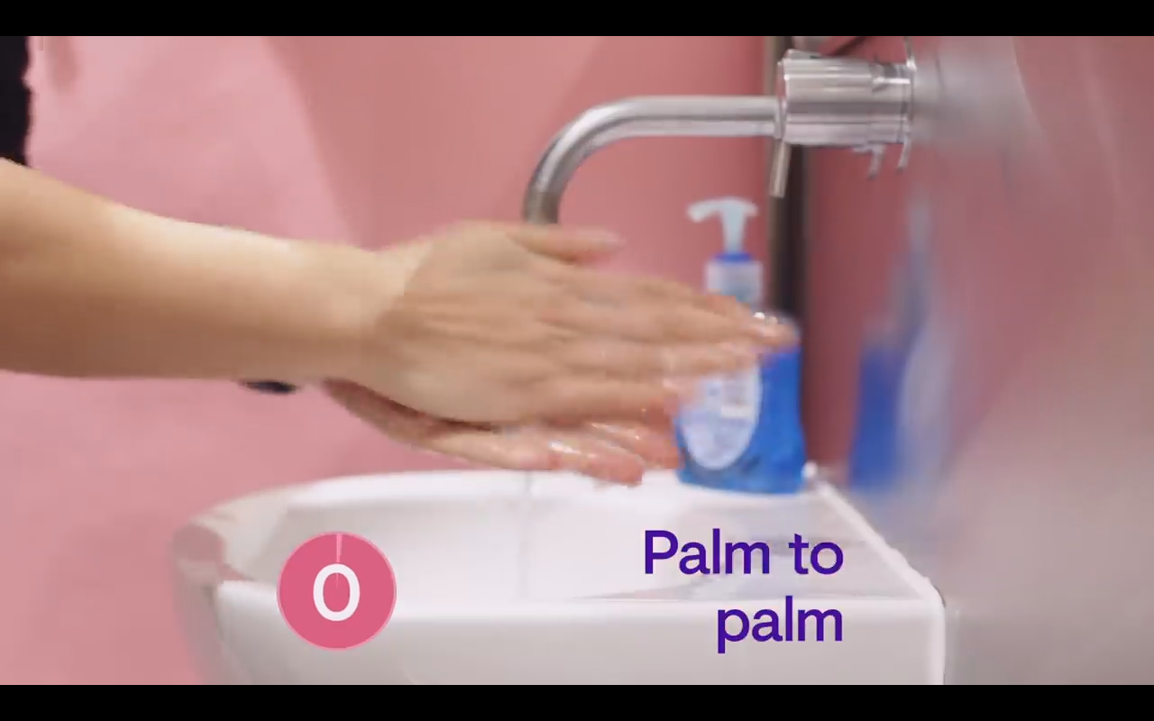
Wash your palms!

Slide 6
Front to back!

Slide 7
Palm to palm
and between the
fingers.

Slide 8
Rub on
both sides!

Slide 9
Clean your
thumbs!

Slide 10
Palm
circles!

Slide 11
Clean your
wrists!

Slide 12
Rinse well!

Slide 13
Dry with a
Paper towel!

Slide 14
Use the towel
to turn off the
tap.

Slide 15
Now watch the video one more time…

Slide 17
Well done!

