Slide 1
sunny
SHOW

Slide 2
rainy
SHOW

Slide 3
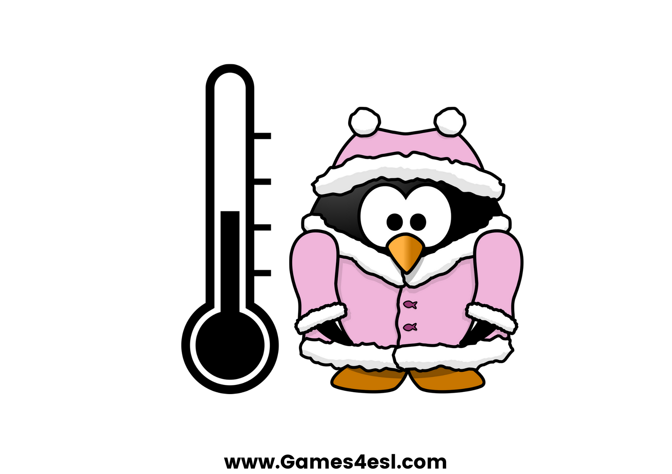
cold
SHOW

Slide 4
hot
SHOW

Slide 5
windy
SHOW

Slide 6
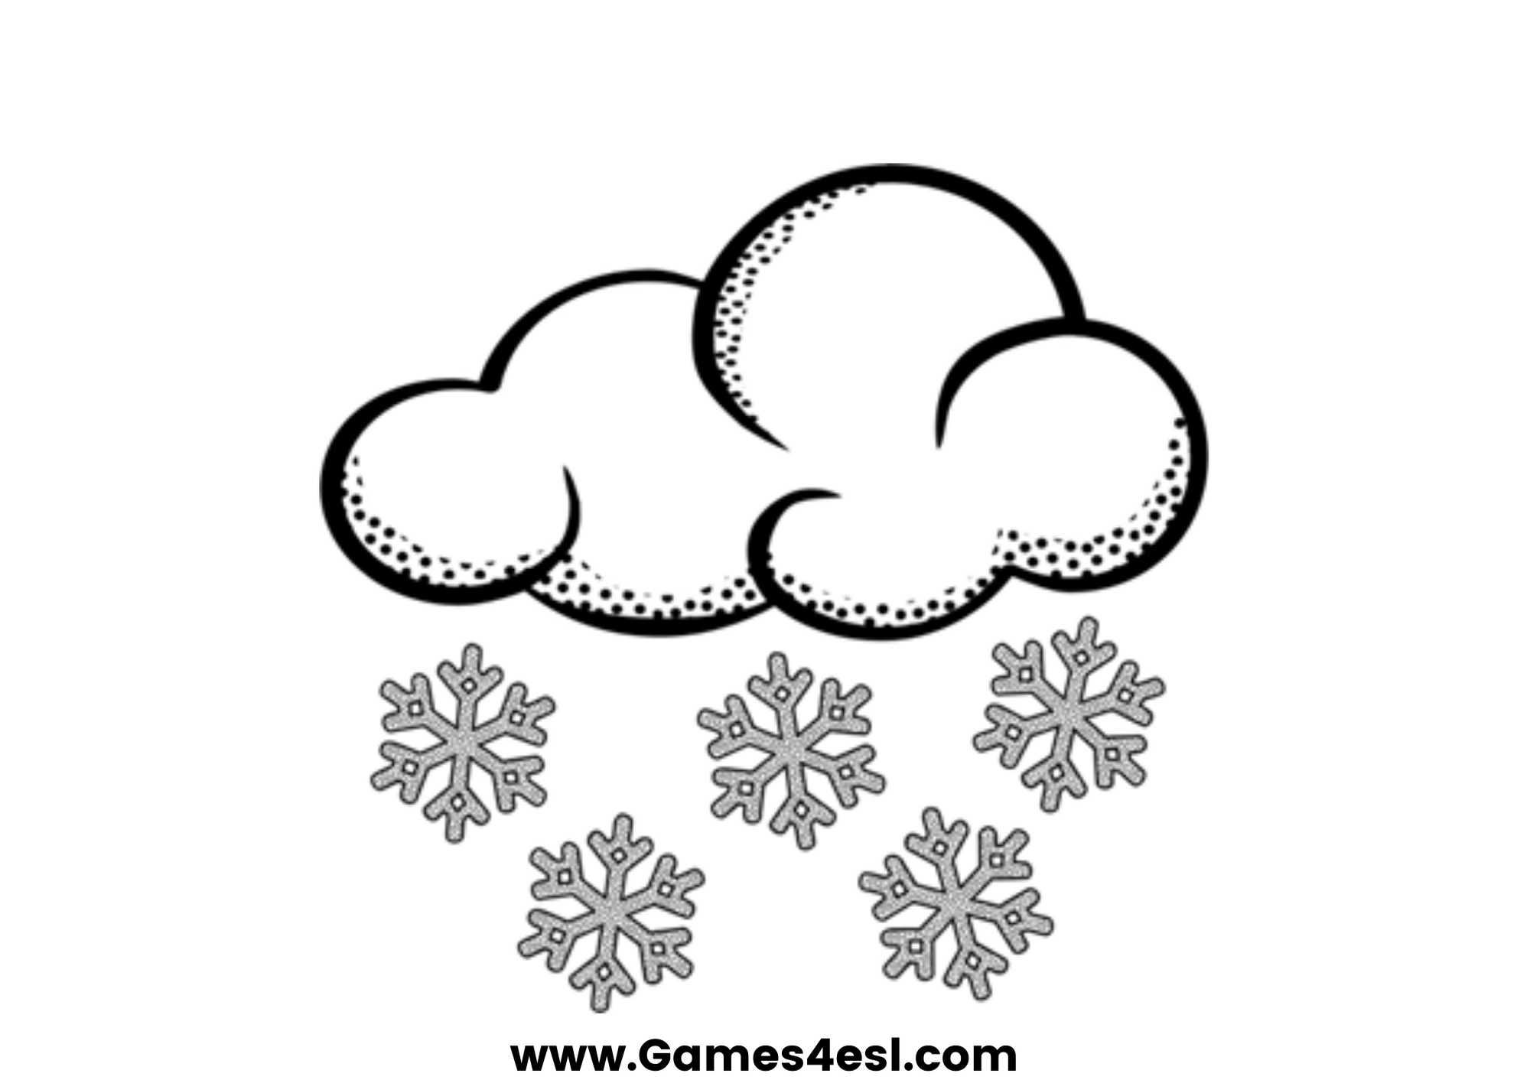
snowy
SHOW

Slide 7
cloudy
SHOW

Slide 8
foggy
SHOW

