Slide 1
Hidden Picture What are they doing?

Slide 2
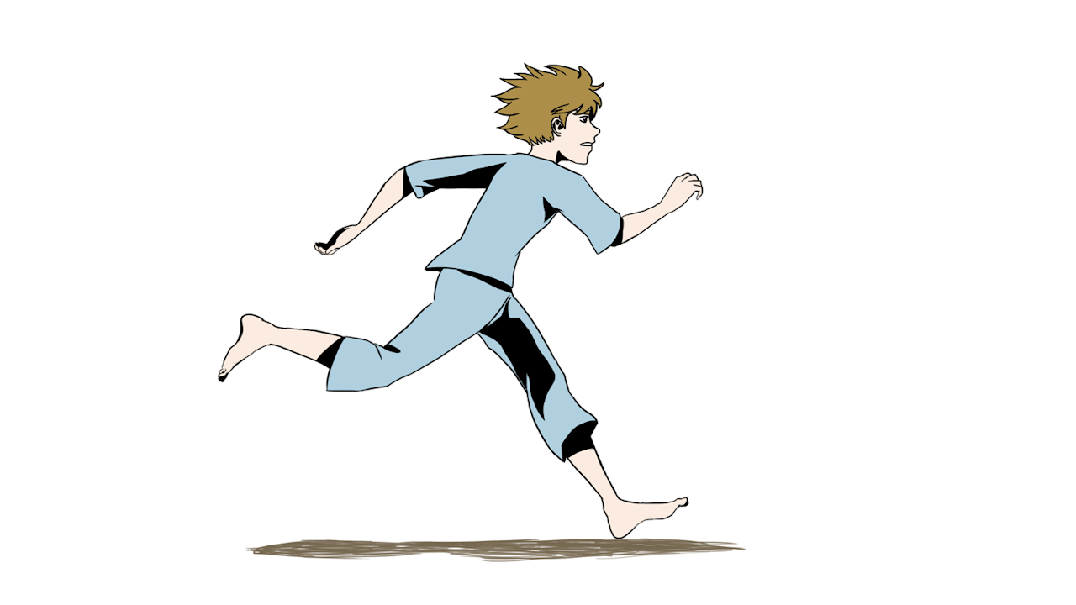
He is running
quickly.
Remove

Slide 3
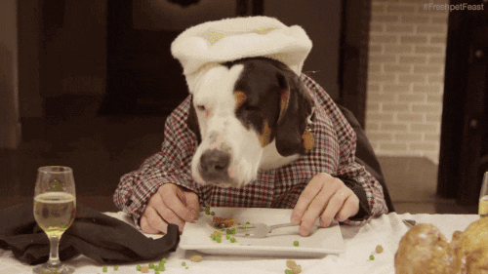
It is eating
hungrily.
Remove

Slide 4
They are
jumping
happily.
Remove

Slide 5
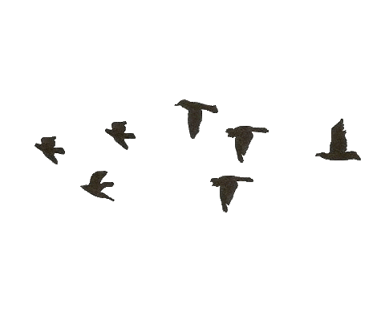
They are flying
swiftly.
Remove

Slide 6
She is sleeping
quietly.
Remove

Slide 7
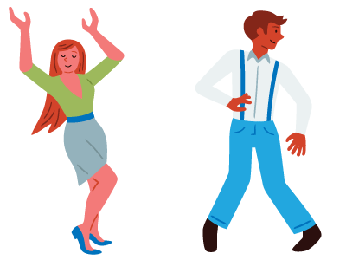
They are
dancing
happily.
Remove

Slide 8
It is eating
noisily.
Remove

Slide 9
She is sleeping
softly.
Remove

Slide 10
They are
jumping
excitedly.
Remove

Slide 11
They are
dancing
joyously.
Remove

Slide 12
He is running
fast.
Remove

Slide 13
They are flying
gently.
Remove

Slide 14
You win!
Well done!

