Slide 1
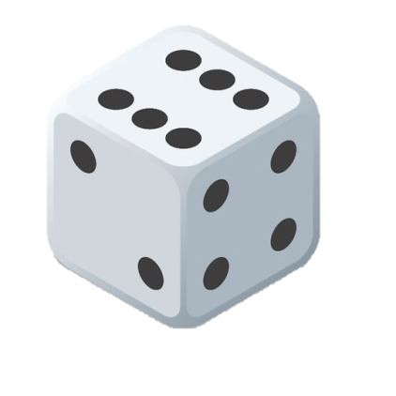
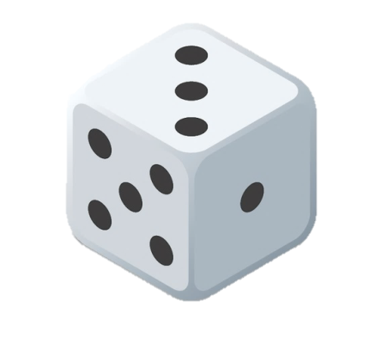
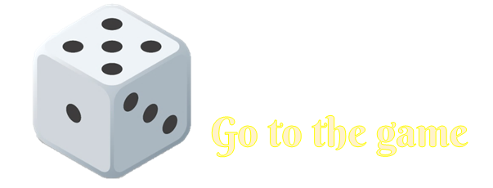
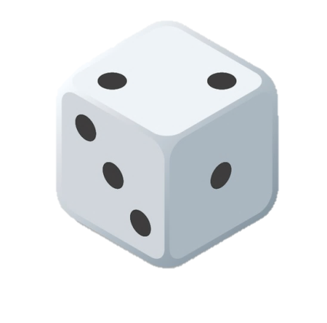
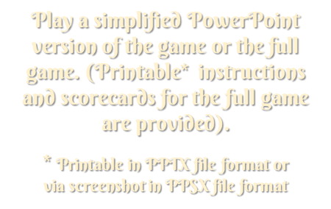

Slide 2
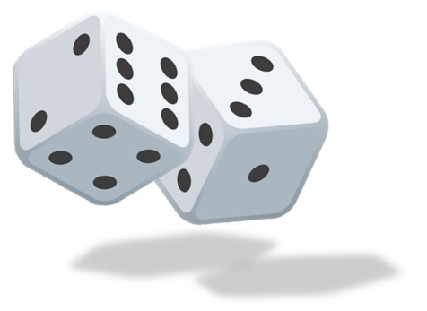
MAIN MENU
Object of the game
The object of the PowerPoint-only Yahtzee game is to score one of each category of throw shown on the two-player scorecards on each side of the screen.
The first player to score all categories is the winner. If playing solo, then only one scorecard will be needed.
Game Start and Play
To start with, click on all five yellow dice to roll the playing dice. After rolling you can either score the current roll or re-roll any or all of the dice.
To re-roll a dice, click on the ‘CLEAR’ button above it, then click on the corresponding yellow dice again.
You may only roll the dice a total of 3 times.
After rolling 3 times you must choose a category to score against. A check mark will appear when you click on the box adjacent to the category. (If you click in error, click on the check mark and it will disappear).
You may score the dice at any point in the round, i.e. it doesn't have to be after the 3rd roll.
If your final roll does not match any category, or you only score a category that you already have a check mark against, then that will be the end of the throw and no score will be achieved.
At the end of each round of throws, click in the yellow ‘CLEAR ALL’ button to remove all the playing dice. On completion of a full game, click the ‘CLEAR ALL’ buttons above any scorecards used. You will then be ready to play your next game
Yahtzee
All five dice of the same number e.g. 4 4 4 4 4
Large straight
Any five consecutive numbers
e.g. 6 4 2 5 3
Small straight
Any four consecutive numbers e.g. 5 4 2 5 3
Full house
Any three of a kind and two of a kind e.g. 1 3 1 3 3
4 of a kind
Any four dice of the same number e.g. 5 5 5 2 5
3 of a kind
Any three dice of the same number e.g. 6 2 4 2 2

Slide 3
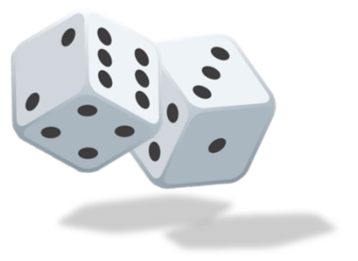
Yahtzee Rules
Object of the game
The object of Yahtzee is to obtain the highest score from throwing 5 dice.
The game consists of 13 rounds. In each round, you roll the dice and then score the roll in one of 13 categories. You must score once in each category. The score is determined by a different rule for each category.
The game ends once all 13 categories have been scored.
Game Start
To start with, roll all the dice. After rolling you can either score the current roll (see below), or re-roll any or all of the dice.
You may only roll the dice a total of 3 times. After rolling 3 times you must choose a category to score.
You may score the dice at any point in the round, i.e. it doesn't have to be after the 3rd roll.
Scoring
To score your combination of 5 dice, you click one of the 13 boxes, or write it on the scorecard (scoresheet). There are two sections to the score table - the Upper Section and the Lower Section.
Once a box has been scored, it cannot be scored again for the rest of the game (except the Yahtzee category), so choose wisely.
Upper Section Scoring
If you score in the upper section of the table, your score is the total of the specified die face. So if you roll:
5 - 2 - 5 - 6 - 5 and score in the Fives category, your total for the category would be 15, because there are three fives, which are added together.
If the One, Three or Four Categories were selected for scoring with this roll, you would score a zero.
If placed in the Two or Six category, you would score 2 and 6 respectively.
Bonus If the total of Upper scores is 63 or more, add a bonus of 35. Note that 63 is the total of three each of 1s, 2s, 3s, 4s, 5s and 6s.
Lower Section Scoring
In the lower scores, you score either a set amount, or zero if you don't satisfy the category requirements.
3 and 4 of a kind For 3 of a kind you must have at least 3 of the same die faces. You score the total of all the dice. For 4 of a kind you would need 4 die faces the same.
Small and Large Straight A Straight is a sequence of consecutive die faces, where a small straight is 4 consecutive faces, and a large straight 5 consecutive faces.
Small straights score 30 and a large 40 points. So if you rolled:
2 - 3 - 2 - 5 – 4 you could score 30 in small straight or 0 in large straight.
Full House A Full House is where you have 3 of a kind and 2 of a kind. Full houses score 25 points. i.e.:
3 - 3 - 2 - 3 – 2 would score 25 in the Full House category.
First Yahtzee A Yahtzee is 5 of a kind and scores 50 points, although you may elect NOT to score it as a yahtzee, instead choosing to take it as a top row score and safegaurd you bonus.
Additional Yahtzees. If you roll a second Yahtzee in a game, and you scored your first yahtzee in the Yahtzee box, you would score a further bonus 100 points in the yahtzee box. You must also put this roll into another category, as follows;
-If the corresponding Upper section category is not filled then you must score there. i.e. if you rolled:
4 - 4 - 4 - 4 - 4 and the Fours Category is not filled, you must put the score in the Fours category.
-If the corresponding Upper section category is filled you may then put the score anywhere on the Upper Section (scoring zero). In 3 of a Kind, 4 of a Kind, and Chance categories you
would score the total of the die faces. For the Small Straight, Large Straight, and Full House
categories, you would score 30, 40 and 25 points respectively.
Chance You can roll anything and be able to put it in the Chance category. You score the
total of the die faces.
Scratch or Dump scores.
You can score any roll in any category at any time, even if the resulting score is zero. Eg, you can take 2-3-3-4-6 in the 5's category. It will score 0. This could be used near the end of a game to lose a poor roll against a difficult-to-get category that you've failed to fill (eg, long straight or yahtzee).
MAIN MENU

Slide 4
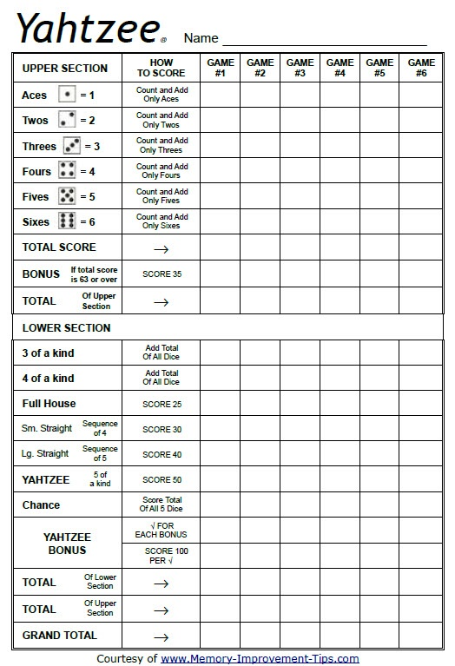
MAIN MENU

Slide 5
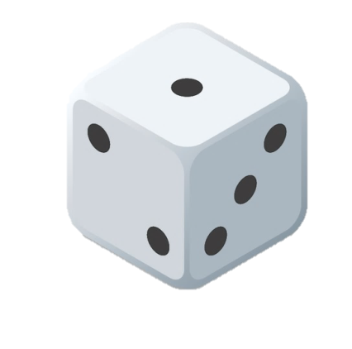
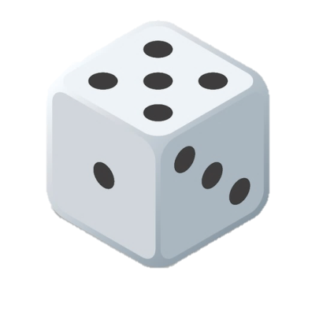
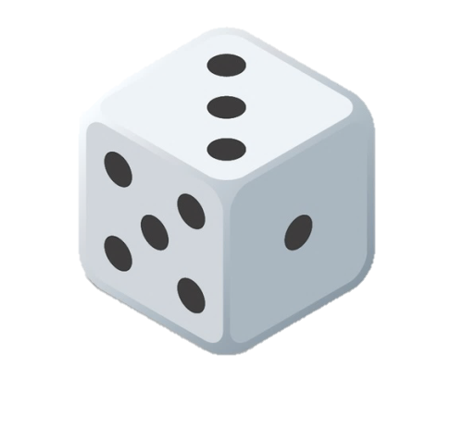
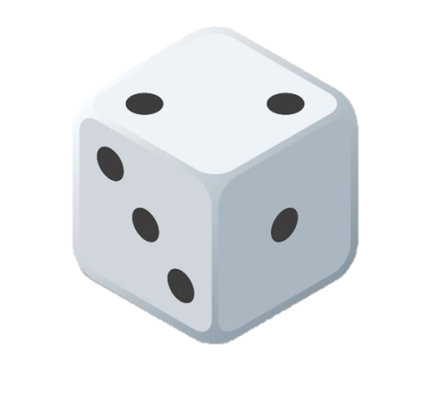
CLEAR
CLEAR
CLEAR
CLEAR
CLEAR
MAIN MENU
CLEAR
ALL
CLEAR ALL
CLEAR ALL
Yahtzee
Yahtzee
Large straight
Large straight
Small straight
Small straight
Full house
Full house
4 of a kind
4 of a kind
3 of a kind
3 of a kind

